Slide 1
St Peter’s C of E Primary School
Lockdown Poetry Competition
Arts Activity

Slide 2


Slide 3
Your Task:
To write a pandemic poem about your life during lockdown
Think about how times have changed.
What has happened to our lives since the pandemic. Why?
How has our behaviour changed?
Who are the heroes of our times?
Have you changed your habits? How?

Slide 4
What might your poem look like? Remember that…
Poems come in all sorts of shapes and sizes.
Some rhyme and some do not.
They can have short lines or long lines.
Poems can be about important aspects of our lives.
They can be solemn, serious, happy or funny. They can show any emotion!
Poetry is about the poet's own version of reality.

Slide 5

Let your heart speak to the world

Slide 6
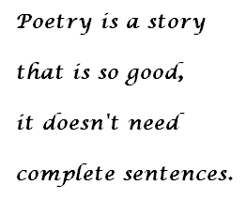
(Or punctuation)

Slide 7
What to do next…
Write your poem
Send it to your Year Group email address by Friday 26th February
Teachers in each Year Group will collect all poems to make an anthology (a collection of your poems)
A winning poem will be selected from each Year Group
The overall winner will receive a £10 book token

