Slide 1


Slide 3
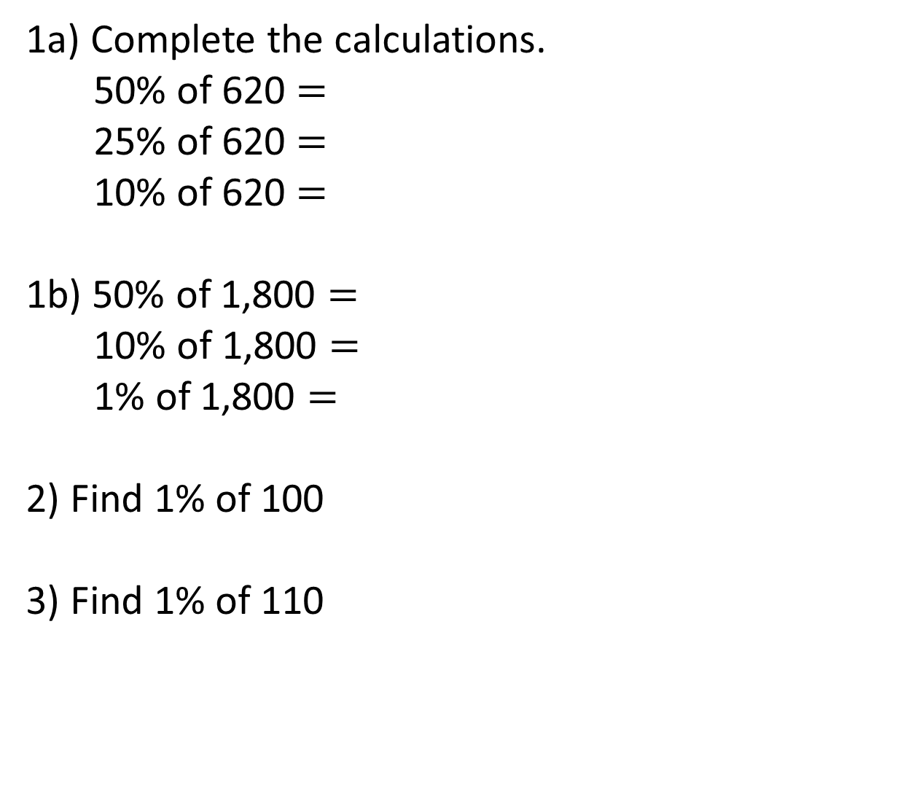
1a) Complete the calculations.
50% of 620 $=$
25% of 620 $=$
10% of 620 $=$
1b) 50% of 1,800 $=$
10% of 1,800 $=$
1% of 1,800 $=$
2) Find 1% of 100
3) Find 1% of 110

Slide 4
1a) Complete the calculations.
50% of 620 $=$
25% of 620 $=$
10% of 620 $=$
1b) 50% of 1,800 $=$
10% of 1,800 $=$
1% of 1,800 $=$
2) Find 1% of 100
3) Find 1% of 110
310
155
62
900
180
18
1
1.1

Slide 6

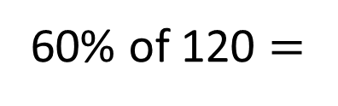
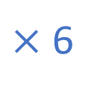
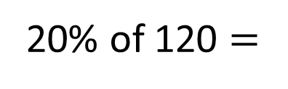
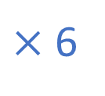
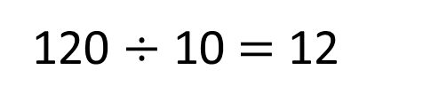
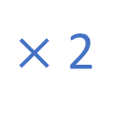
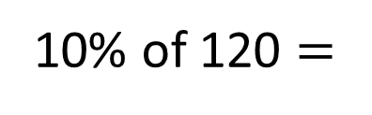

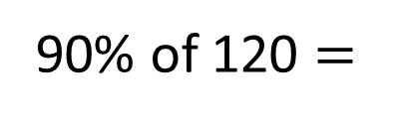
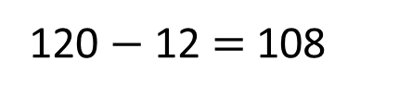
120
12
12 | 12 | 12 | 12 | 12 | 12 | 12 | 12 | 12 | 12
12 | 12 | 12 | 12 | 12 | 12 | 12 | 12 | 12 | 12
12 | 12 | 12 | 12 | 12 | 12 | 12 | 12 | 12 | 12
12 | 12 | 12 | 12 | 12 | 12 | 12 | 12 | 12 | 12
10$\text{\%}$ of 120 $=$
12
If I know this, how could I calculate these?
$×$ 2
120 $÷$ 10 $=$ 12
$×$ 2
$×$ 6
$×$ 6
20$\text{\%}$ of 120 $=$
24
60$\text{\%}$ of 120 $=$
72
120 $−$ 12 $=$ 108
90$\text{\%}$ of 120 $=$
108
Have a think

Slide 7
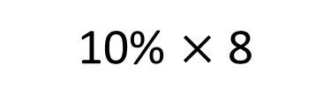
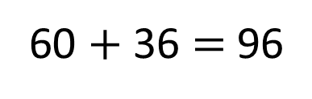
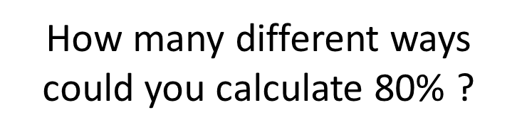
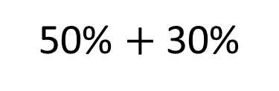
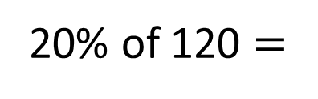
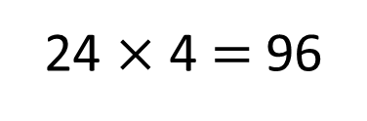
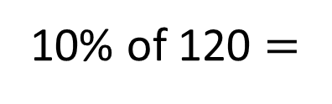
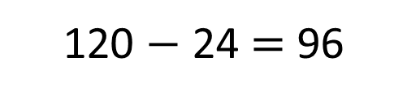
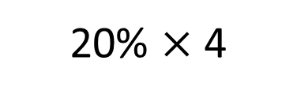
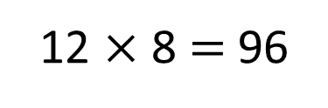
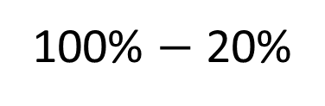
120
Have a think
12 | 12 | 12 | 12 | 12 | 12 | 12 | 12 | 12 | 12
10$\text{\%}$ of 120 $=$
12
How many different ways could you calculate 80$\text{\%}$ ?
20$\text{\%}$ of 120 $=$
24
10$\text{\%}$ $×$ 8
20$\text{\%}$ $×$ 4
12 $×$ 8 $=$ 96
24 $×$ 4 $=$ 96
50$\text{\%}$ $+$ 30$\text{\%}$
100$\text{\%}$ $−$ 20$\text{\%}$
60 $+$ 36 $=$ 96
120 $−$ 24 $=$ 96

Slide 8
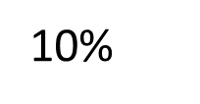
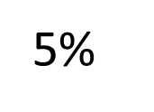
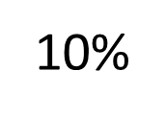
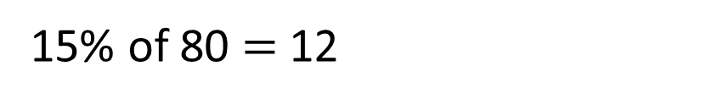

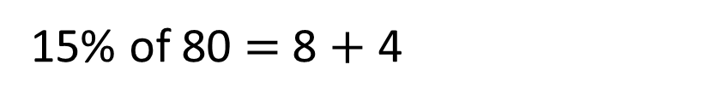

How could we calculate 15$\text{\%}$ of 80?
15$\text{\%}$ of 80 $=$ 8 $+$ 4
10$\text{\%}$
5$\text{\%}$
15$\text{\%}$ of 80 $=$ 12
80
8
8 | 8 | 8 | 8 | 8 | 8 | 8 | 8 | 8 | 8
8 | 4 | 4 | 8 | 8 | 8 | 8 | 8 | 8 | 8 | 8
10$\text{\%}$
5$\text{\%}$

Slide 9


Find 75% of 400
Have a think
I found 10% and multiplied by 7 to work out 70% and then found 5% and added them together.
I found 25% and then multiplied it by 3

Slide 10
Find 75% of 400
I found 10% and multiplied by 7 to work out 70% and then found 5% and added them together.
400
I found 25% and then multiplied it by 3
40
280
20
300

Slide 11
Find 75% of 400
400
I found 10% and multiplied by 7 to work out 70% and then found 5% and added them together.
100
300
I found 25% and then multiplied it by 3
300

Slide 12
Have a go at questions
1 - 3 on the worksheet

Slide 13

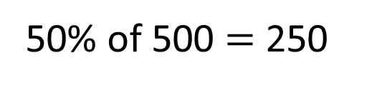
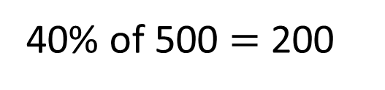
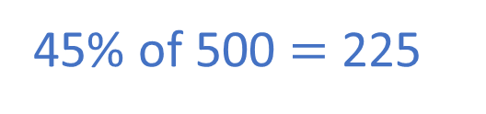
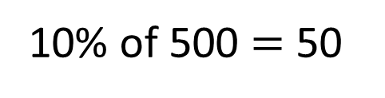
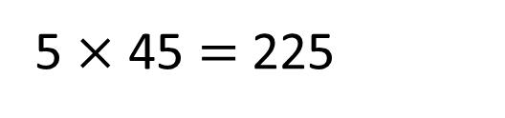

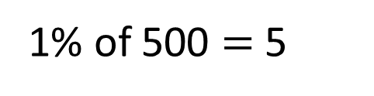
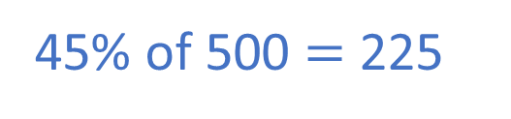
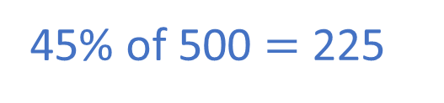
Have a think
Find 45% of 500
How many different methods can you think of?
10% of 500 $=$ 50
1% of 500 $=$ 5
40% of 500 $=$ 200
5 $×$ 45 $=$ 225
5% of 500 $=$ 25
45% of 500 $=$ 225
45% of 500 $=$ 225
50% of 500 $=$ 250
5% of 500 $=$ 25
45% of 500 $=$ 225

Slide 14
Have a think
Complete the calculations
60% of 80
80% of 60
What do you notice?

Slide 15
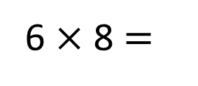
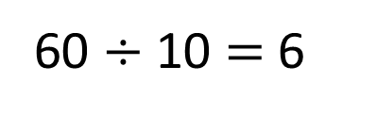
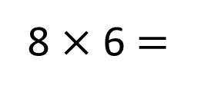
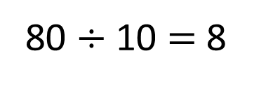
60% of 80
80
80 $÷$ 10 $=$ 8
8 $×$ 6 $=$
48
80% of 60
60
60 $÷$ 10 $=$ 6
6 $×$ 8 $=$
48

Slide 16
Have a go at the rest of the questions on the worksheet

