Slide 1


Slide 3


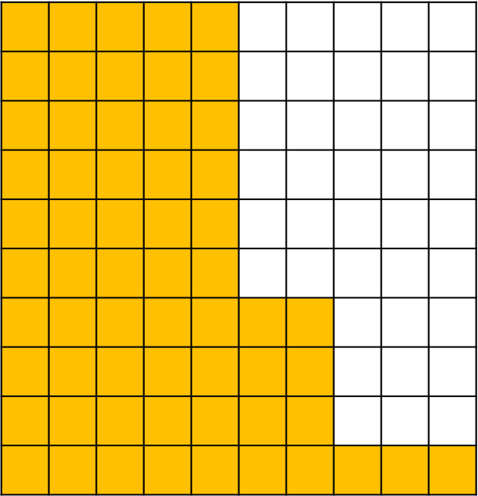
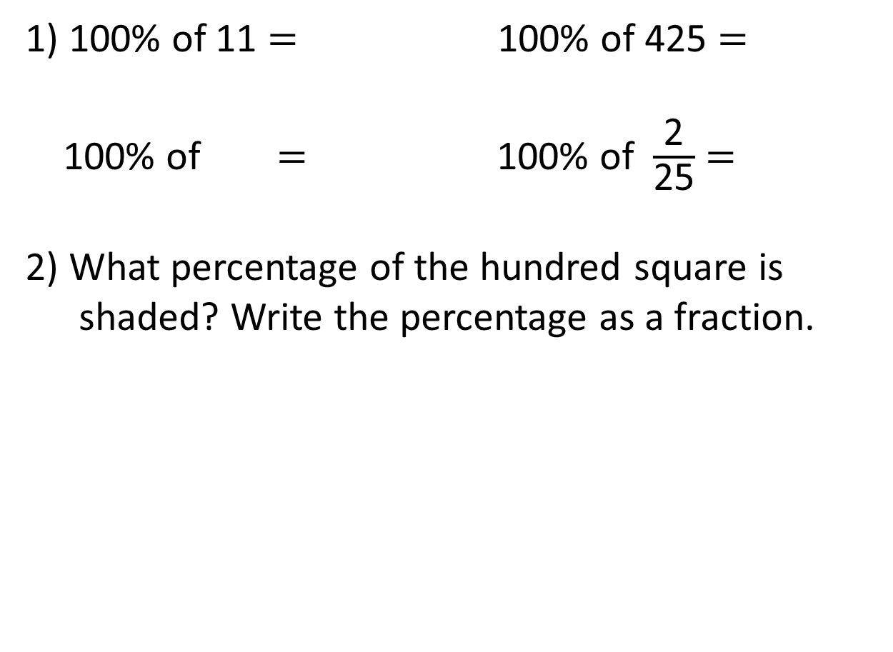
1) 100% of 11 $=$ 100% of 425 $=$
100% of $=$ 100% of $\frac{\text{2}}{\text{25}}$ $=$
2) What percentage of the hundred square is shaded? Write the percentage as a fraction.

Slide 4
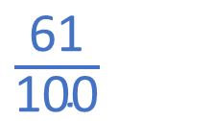
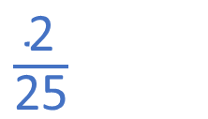
1) 100% of 11 $=$ 100% of 425 $=$
100% of $=$ 100% of $\frac{\text{2}}{\text{25}}$ $=$
2) What percentage of the hundred square is shaded? Write the percentage as a fraction.
11
425
$\frac{\text{2}}{\text{25}}$
61%
$\frac{\text{61}}{\text{100}}$

Slide 6
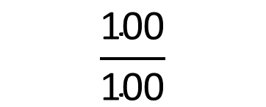
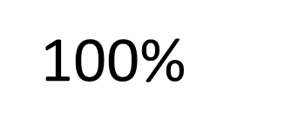
$$\frac{\text{100}}{\text{100}}$$
Everything
100$\text{\%}$
All
The whole

Slide 7
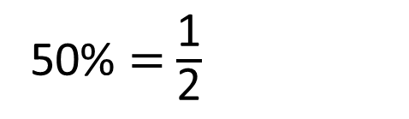
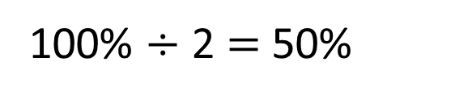
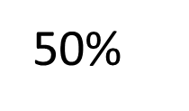
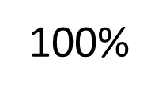
100$\text{\%}$
50$\text{\%}$
?
100$\text{\%}$ $÷$ 2 $=$ 50$\text{\%}$
50$\text{\%}$ $=$ $\frac{\text{1}}{\text{2}}$

Slide 8

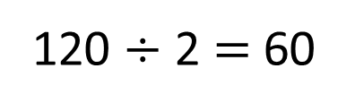
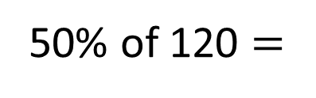
Have a think
120
60
60
?
60
50$\text{\%}$ of 120 $=$
60
120 $÷$ 2 $=$ 60

Slide 9
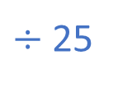


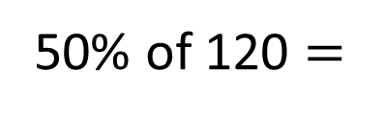
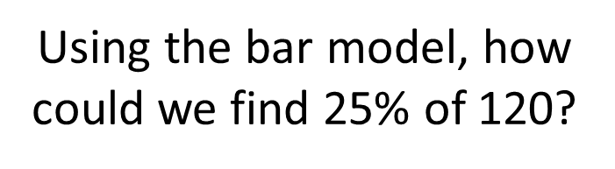

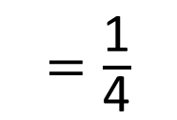
120
30 | 30 | 30 | 30
Using the bar model, how could we find 25$\text{\%}$ of 120?
$÷$ 25
$=\frac{\text{1}}{\text{4}}$
25$\text{\%}$ $=\frac{\text{25}}{\text{100}}$
120 $÷$ 4 $=$ 30
50$\text{\%}$ of 120 $=$
60
$÷$ 25

Slide 10
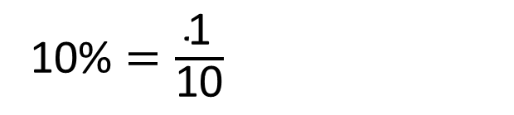
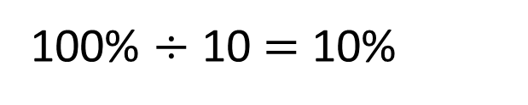
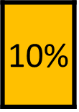
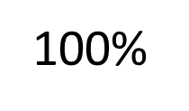
Have a think
What percentage would the shaded part represent?
100$\text{\%}$
10$\text{\%}$
100$\text{\%}$ $÷$ 10 $=$ 10$\text{\%}$
10$\text{\%}$ $=\frac{\text{1}}{\text{10}}$

Slide 11
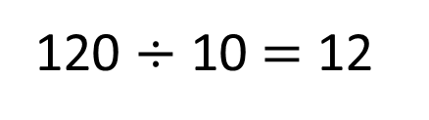
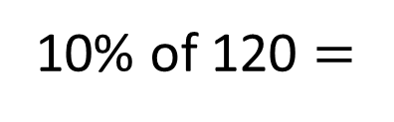
Have a think
120
12
12
10$\text{\%}$ of 120 $=$
12
120 $÷$ 10 $=$ 12

Slide 12
Have a go at questions
1 - 3 on the worksheet

Slide 13
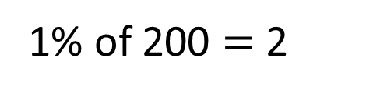
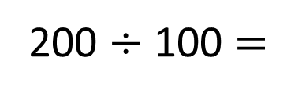
Find 1% of 200
The whole is worth 200
200 $÷$ 100 $=$
2
1% of 200 $=$ 2

Slide 14
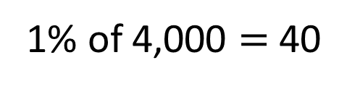
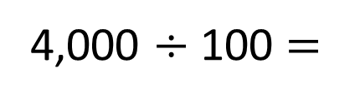
Find 1% of 4,000
Have a think
The whole is worth 4,000
4,000 $÷$ 100 $=$
40
1% of 4,000 $=$ 40

Slide 15
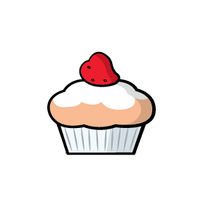

Annie needs to make 1,270 cupcakes for a party.
In the morning she makes 50% of the cupcakes.
In the afternoon Annie makes another 10% of her target amount of cupcakes.
How many more cupcakes does she need to make?
Have a think

Slide 16
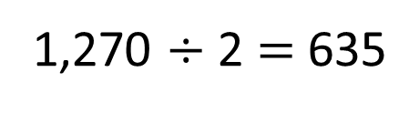
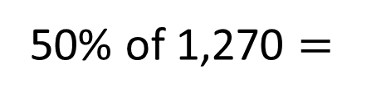
Annie needs to make 1,270 cupcakes for a party.
In the morning she makes 50% of the cupcakes.
1,270
635
635
635
?
50$\text{\%}$ of 1,270 $=$
635
1,270 $÷$ 2 $=$ 635

Slide 17
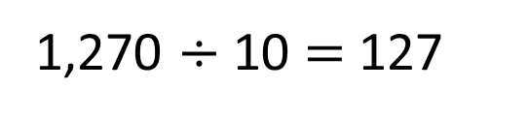
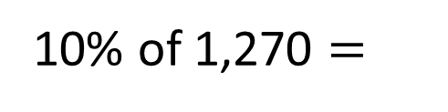
In the afternoon Annie makes another 10% of her target amount of cupcakes.
1,270
127
10$\text{\%}$ of 1,270 $=$
127
1,270 $÷$ 10 $=$ 127

Slide 18
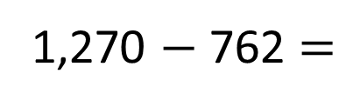
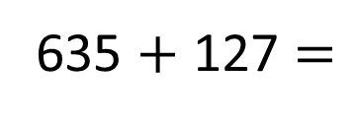
Annie needs to make 1,270 cupcakes for a party.
In the morning she makes 50% of the cupcakes.
635
In the afternoon Annie makes another 10% of her target amount of cupcakes.
127
How many more cupcakes does she need to make?
508
635 $+$ 127 $=$
762
1,270 $−$ 762 $=$
508

Slide 19
Have a go at the rest of the questions on the worksheet

