Slide 1


Slide 3
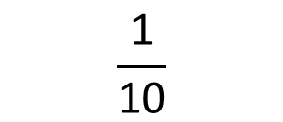
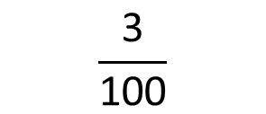

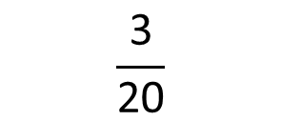
1) Match the equivalent fractions, decimals and percentages.
2) Write the decimal that is less than 100%
$$\frac{\text{3}}{\text{20}}$$
0.03
3%
$$\frac{\text{1}}{\text{2}}$$
50%
0.15
$$\frac{\text{3}}{\text{100}}$$
0.5
15%
$$\frac{\text{1}}{\text{10}}$$

Slide 4
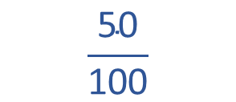
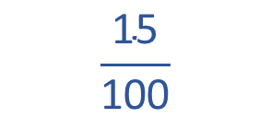
1) Match the equivalent fractions, decimals and percentages.
2) Write the decimal that is less than 100%
$$\frac{\text{15}}{\text{100}}$$
$$\frac{\text{3}}{\text{20}}$$
0.03
3%
$$\frac{\text{1}}{\text{2}}$$
$$\frac{\text{50}}{\text{100}}$$
50%
0.15
$$\frac{\text{3}}{\text{100}}$$
0.5
15%
$$\frac{\text{1}}{\text{10}}$$
0.9

Slide 6
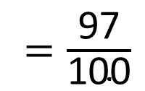
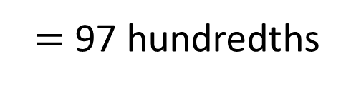


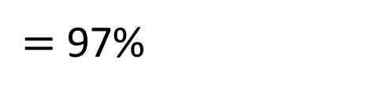
Order the following from smallest to greatest
$\frac{\text{3}}{\text{4}}$
0.97
95$\text{\%}$
0.97
$=$ 97 hundredths
0.97
$=\frac{\text{97}}{\text{100}}$
0.97
$=$ 97$\text{\%}$

Slide 7

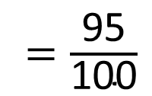
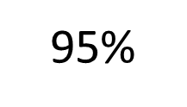
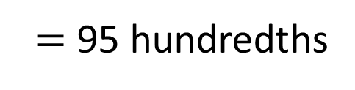
Order the following from smallest to greatest
$\frac{\text{3}}{\text{4}}$
0.97
95$\text{\%}$
95$\text{\%}$
$=$ 95 hundredths
95$\text{\%}$
$=\frac{\text{95}}{\text{100}}$

Slide 8
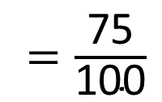
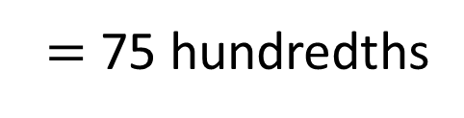


Order the following from smallest to greatest
$\frac{\text{3}}{\text{4}}$
0.97
95$\text{\%}$
$\frac{\text{3}}{\text{4}}$
$=$ 75 hundredths
$=\frac{\text{75}}{\text{100}}$
$\frac{\text{3}}{\text{4}}$

Slide 9

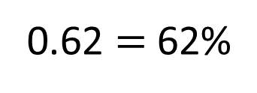

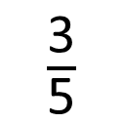
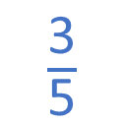
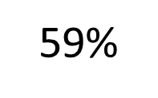
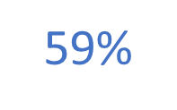
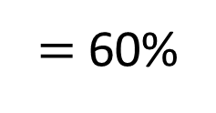
Order the following from smallest to greatest
0.62
$$>$$
$\frac{\text{3}}{\text{5}}$
$\frac{\text{3}}{\text{5}}$
59$\text{\%}$
$=$60$\text{\%}$
59$\text{\%}$
0.62
0.62 $=$ 62$\text{\%}$
Have a think

Slide 10
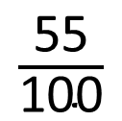
Have a think
Place these decimals, percentages and fractions on the number line.
$\frac{\text{55}}{\text{100}}$
90%
0.75
0
1

Slide 11
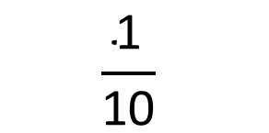
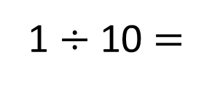
Place these decimals, percentages and fractions on the number line.
$\frac{\text{55}}{\text{100}}$
90%
0.75
0.9
0.55
0
0.1
0.2
0.3
0.4
0.5
0.6
0.7
0.8
0.9
1
1 $÷$ 10 $=$
0.1
$$\frac{\text{1}}{\text{10}}$$
0.1
10%

Slide 12
Have a go at questions
1 - 2 on the worksheet

Slide 13


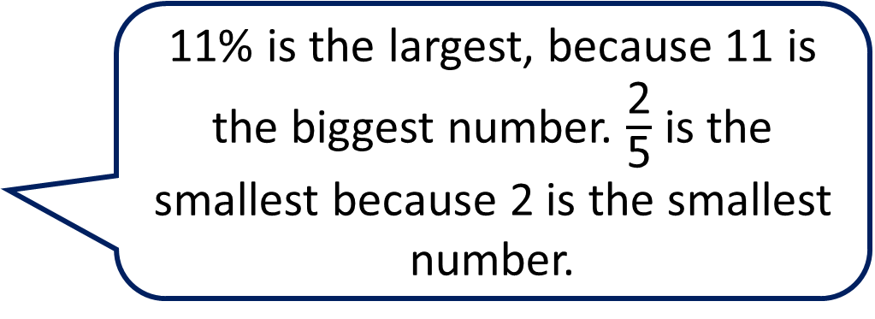
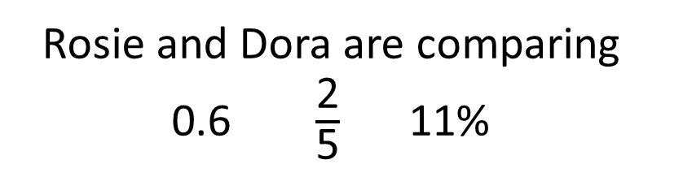
Rosie and Dora are comparing 0.6 $\frac{\text{2}}{\text{5}}$ 11$\text{\%}$
Have a think
11$\text{\%}$ is the largest, because 11 is the biggest number. $\frac{\text{2}}{\text{5}}$ is the smallest because 2 is the smallest number.
I don’t think that’s right, but I’m not sure how to explain it…

Slide 14
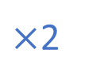
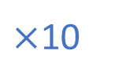
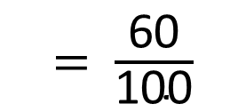
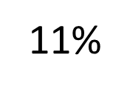
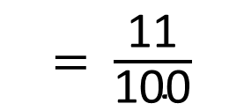
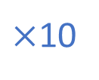
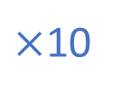
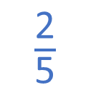
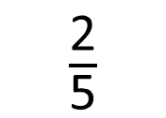
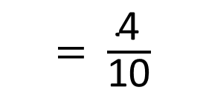
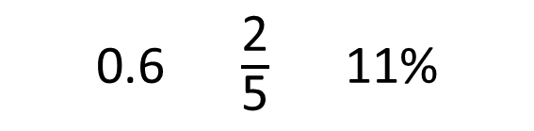
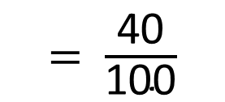
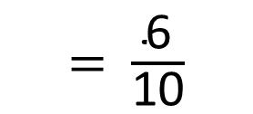
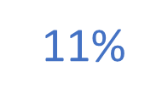
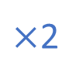
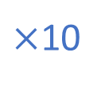
0.6 $\frac{\text{2}}{\text{5}}$ 11$\text{\%}$
$×$10
$=$ $\frac{\text{6}}{\text{10}}$
$=$ $\frac{\text{60}}{\text{100}}$
0.6
$×$10
$×$2
$×$10
$\frac{\text{2}}{\text{5}}$
0.6
11$\text{\%}$
$=$ $\frac{\text{4}}{\text{10}}$
$\frac{\text{2}}{\text{5}}$
$=$ $\frac{\text{40}}{\text{100}}$
$×$2
$×$10
$=$ $\frac{\text{11}}{\text{100}}$
11$\text{\%}$

Slide 15



Find a percentage to make the statement correct.
0.2
$$<$$
$\frac{\text{1}}{\text{4}}$
$$<$$
How many different percentages can you find?
Have a think

Slide 16
Find a percentage to make the statement correct.
0.2
$$<$$
21%
$\frac{\text{1}}{\text{4}}$
$$<$$
20%
25%
How many different percentages can you find?
22%
23%
24%

Slide 17
Have a go at the rest of the questions on the worksheet

