Slide 1

Monday 25 January 2021
LI: To convert fractions to percentages
10 questions
Video: https://vimeo.com/492449530
Stem Sentence: Percentage is of 100
Worksheet found under your home learning
Mark your work using the answers.

Slide 2
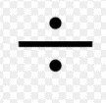
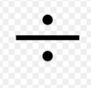
10 questions
97 + 10
168 8
251 x 3
9.6 – 0.4
7092 + 582
6. 812 – 80
7. 108 12
1 – 0.67
What is the name of a five-sided shape?
What is the perimeter of a rectangle with sides of 8 cm and 3 cm?

Slide 3
Answers
107
21
753
9.2
7674
732
9
0.33
Pentagon
22 cm

Slide 4
Fluency

Slide 6
Now try the sheet found in your home learning.
When you have finished mark your work.

