Slide 1


Slide 3
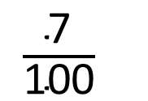
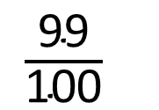
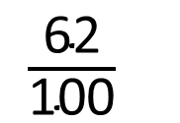
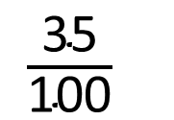
1) Convert the fractions to percentages.
2) Convert the percentages to fractions.
$\frac{\text{35}}{\text{100}}$
$\frac{\text{62}}{\text{100}}$
$\frac{\text{99}}{\text{100}}$
$\frac{\text{7}}{\text{100}}$
41 %
3 %
37 %
10 %

Slide 4
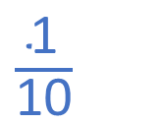
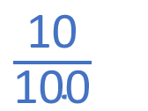
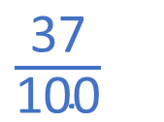
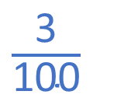
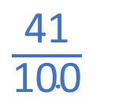
1) Convert the fractions to percentages.
2) Convert the percentages to fractions.
$\frac{\text{35}}{\text{100}}$
35 %
$\frac{\text{62}}{\text{100}}$
62 %
$\frac{\text{99}}{\text{100}}$
$\frac{\text{7}}{\text{100}}$
99 %
7 %
$\frac{\text{41}}{\text{100}}$
3 %
$\frac{\text{3}}{\text{100}}$
41 %
37 %
$\frac{\text{37}}{\text{100}}$
10 %
$\frac{\text{10}}{\text{100}}$
$\frac{\text{1}}{\text{10}}$

Slide 6

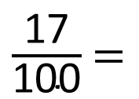
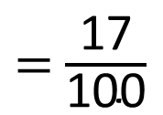
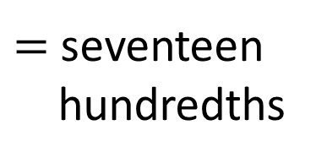
$=$ seventeen
hundredths
$=$ $\frac{\text{17}}{\text{100}}$
What percentage of the grid is shaded?
$\frac{\text{17}}{\text{100}}$ $=$
17
out of one hundred
‘out of’
‘one hundred’
$$\text{\%}$$

Slide 7

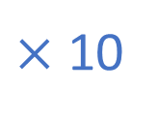
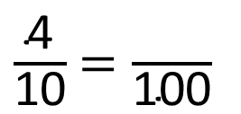
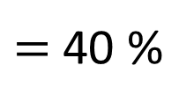
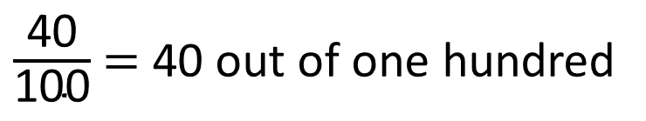
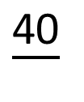

$×$ 10
$\frac{\text{4}}{\text{10}}$ $=\frac{\text{40}}{\text{1}\text{00}}$
$\frac{\text{40}}{}$
$×$ 10
$\frac{\text{40}}{\text{100}}$ $=$ 40 out of one hundred
$=$ 40 %
c
Have a think

Slide 8
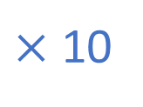

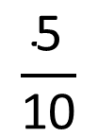

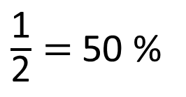
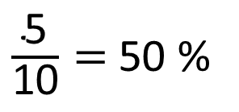



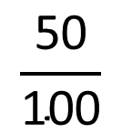


$×$ 5
$×$ 50
$×$ 10
$$\frac{\text{1}}{\text{2}}$$
$$\frac{\text{5}}{\text{10}}$$
$$\frac{\text{50}}{\text{100}}$$
$×$ 5
$×$ 50
$×$ 10
$\frac{\text{5}}{\text{10}}$ $=$ $\frac{\text{50}}{\text{100}}$ $=$ 50 out of one hundred
$\frac{\text{5}}{\text{10}}=$ 50 %
$\frac{\text{1}}{\text{2}}=$ 50 %

Slide 9
Have a go at questions
1 - 2 on the worksheet

Slide 10
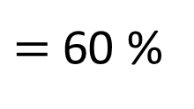
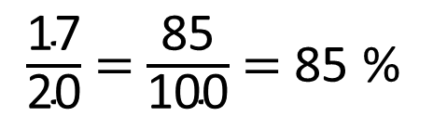
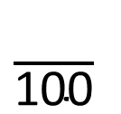
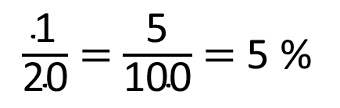
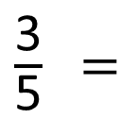
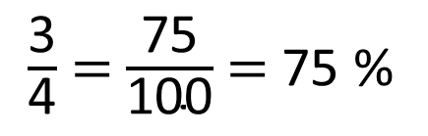
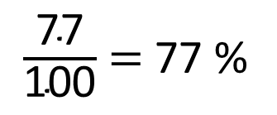

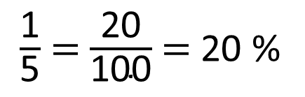
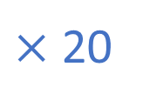
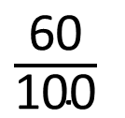
$×$ 20
$\frac{\text{3}}{\text{5}}$ $=$
$\frac{\text{60}}{\text{10}\text{0}}$
$\frac{\text{60}}{\text{10}\text{0}}$
Have a think
$=$ 60 %
$×$ 20
$\frac{\text{77}}{\text{100}}$ $=$ 77 %
$\frac{\text{1}}{\text{20}}$ $=$ $\frac{\text{5}}{\text{10}\text{0}}$ $=$ 5 %
$\frac{\text{1}}{\text{5}}$ $=$ $\frac{\text{20}}{\text{10}\text{0}}$ $=$ 20 %
$\frac{\text{17}}{\text{20}}$ $=$ $\frac{\text{85}}{\text{10}\text{0}}$ $=$ 85 %
$\frac{\text{3}}{\text{4}}$ $=$ $\frac{\text{7}\text{5}}{\text{10}\text{0}}$ $=$ 75 %

Slide 11


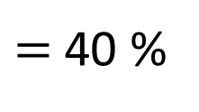
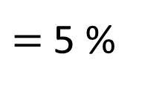
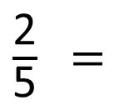
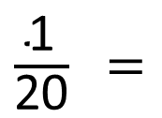
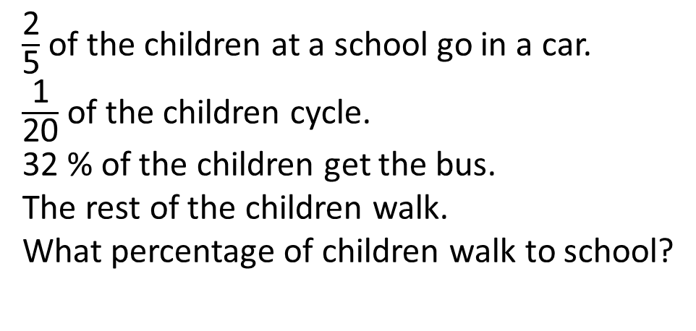
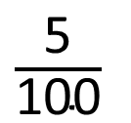
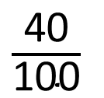


$\frac{\text{2}}{\text{5}}$ of the children at a school go in a car.
$\frac{\text{1}}{\text{20}}$ of the children cycle.
32 % of the children get the bus.
The rest of the children walk.
What percentage of children walk to school?
Have a think
$×$ 20
$×$ 5
$\frac{\text{2}}{\text{5}}$ $=$
$\frac{\text{5}}{\text{10}\text{0}}$
$\frac{\text{1}}{\text{20}}$ $=$
$\frac{\text{40}}{\text{10}\text{0}}$
$=$ 40 %
$=$ 5 %
$×$ 20
$×$ 5
23 % of children walk

Slide 12
Have a go at the rest of the questions on the worksheet

