Slide 1


Active Challenges
From active surrey
WEEK1.

Slide 2
Remember to take a break…..!
We also know that regular bursts of physical activity will make a huge difference to how we feel, how well we can concentrate, how well we sleep and our positive feelings of wellbeing.
Active Surrey have re-launching their weekly ‘Inside Active Schools @home’ e-news. This is a simple calendar of activities, including personal best competitions, movement breaks and activity challenges, suitable for all pupils in school and easily incorporated into any home schooling.

Slide 4
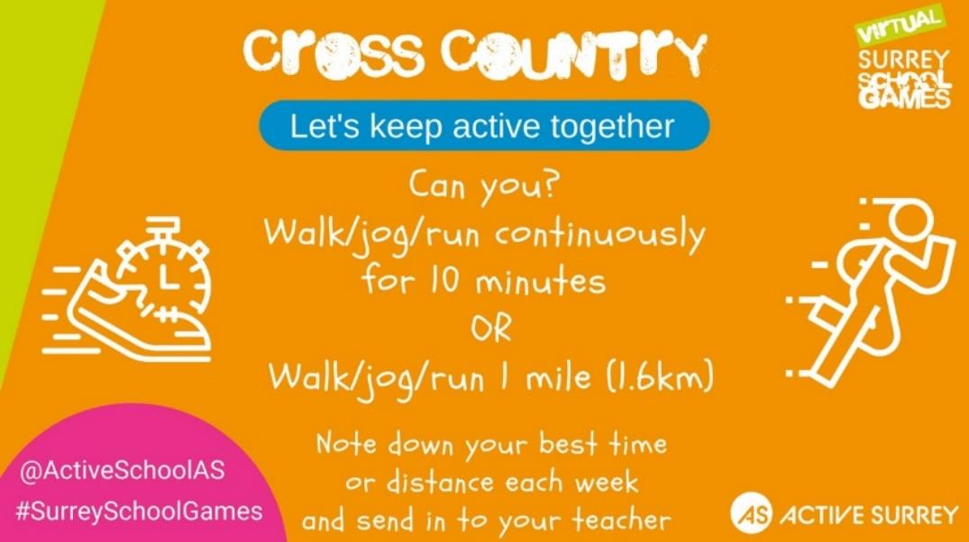
Can you record your best time for 1 mile and send it to edawson@stpeters-farnham.surrey.sch.uk before the 4th February.

