Slide 1

Friday 22nd January
LI To apply your knowledge of adverbs and conjunctions to write a school report

Slide 2
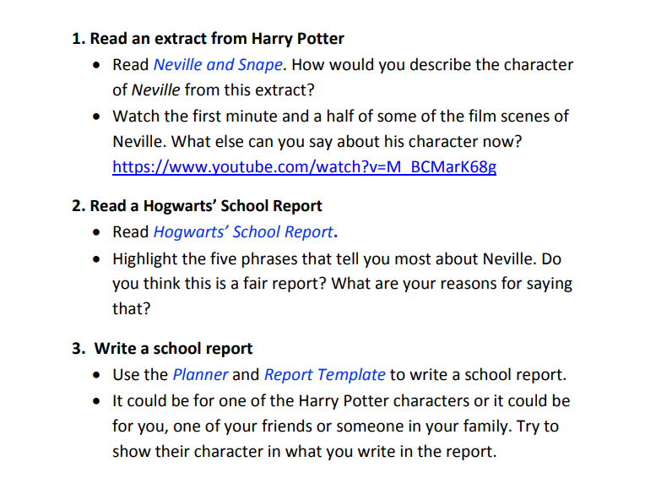

Slide 3
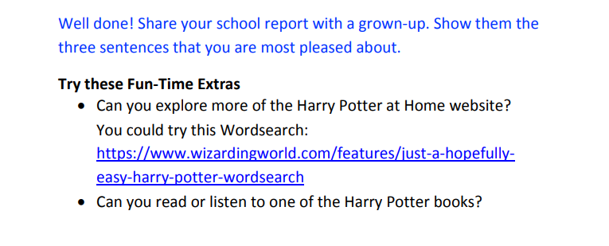

Slide 4
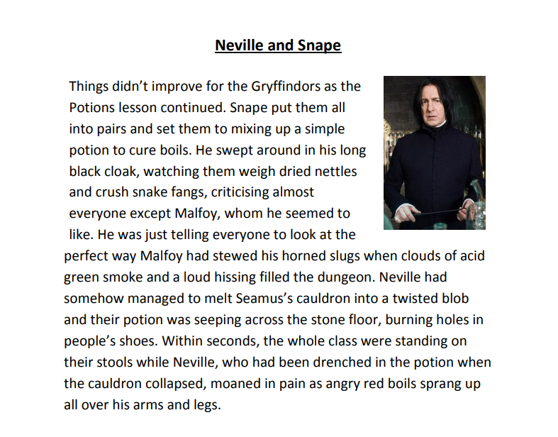
Continued on next page

Slide 5
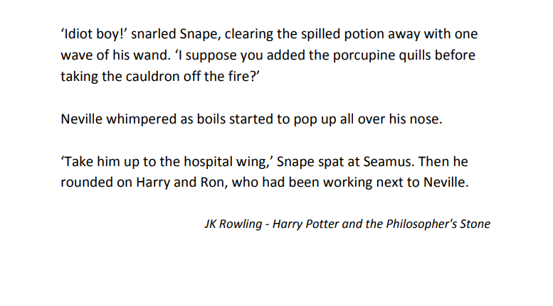

Slide 6
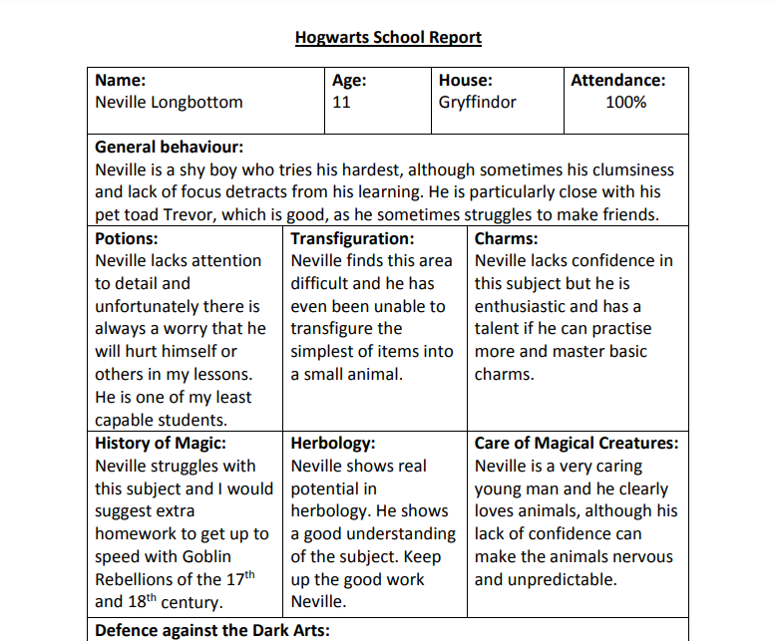
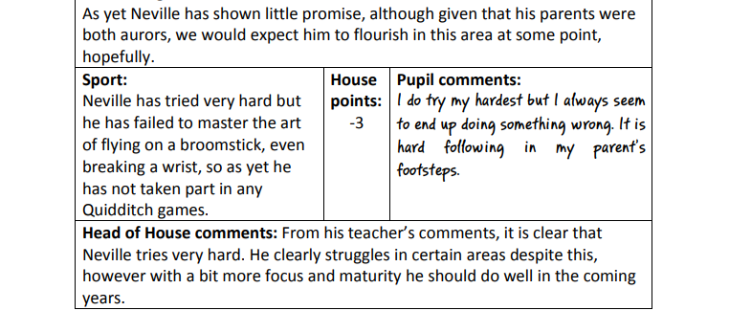

Slide 7
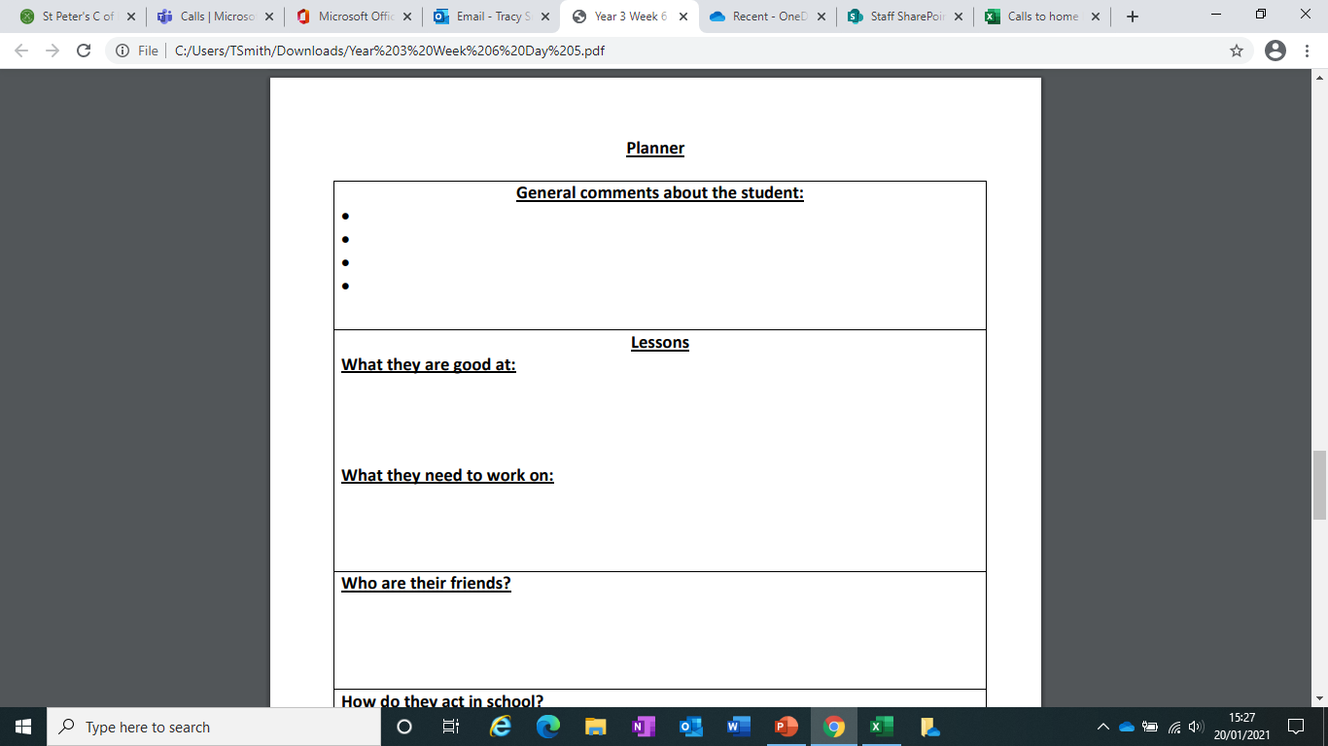
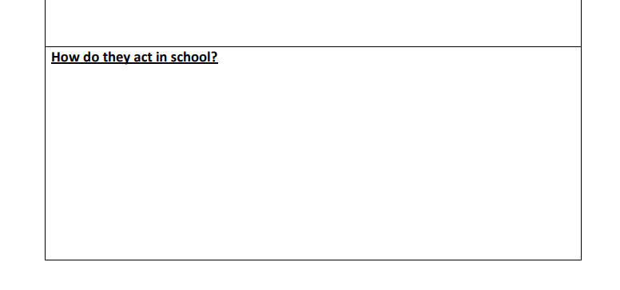
Draw up a chart like this to plan (briefly) a school report about yourself or a friend. You have to imagine yourself or your friend as a character in Harry Potter!

Slide 8
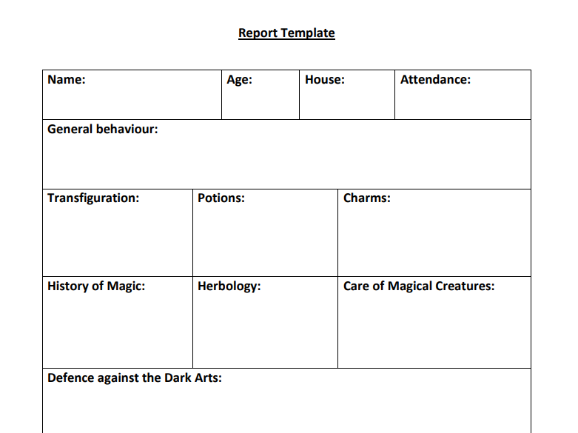
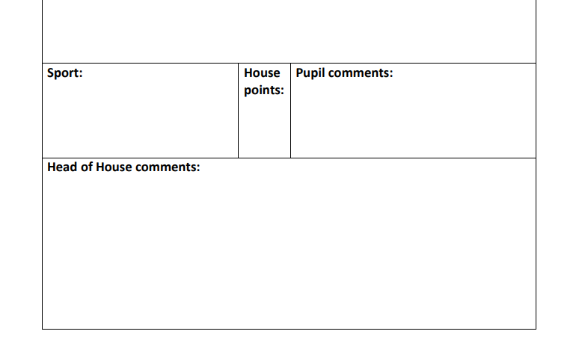
Remember to use adverbs and conjunctions (we worked on them this week) to write expressive, interesting sentences. Think about the information not asked for on school reports at St Peter’s.

