Slide 1
Thursday 28th February
LI To revise the use of adverbs and apply them to my writing

Slide 2
Prepare yourself for your learning
What do you need to do before you start?
Remember – you do not need to print all the pages (if any). Simply write your learning onto paper.
You can ask your grown-up to send photos of your work to the year 3 email address or upload them onto Purple Mash.

Slide 3
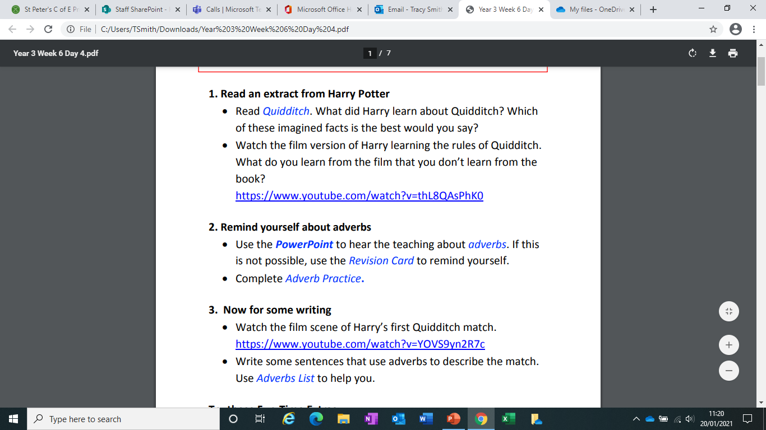

Slide 4
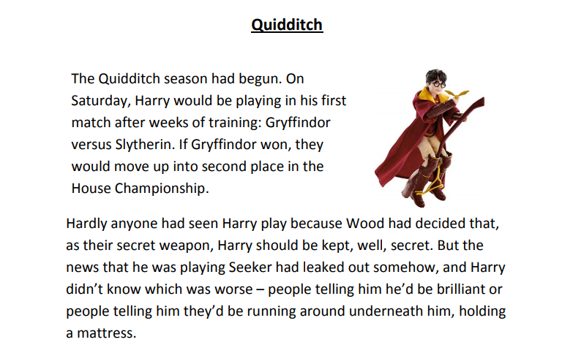

Slide 5
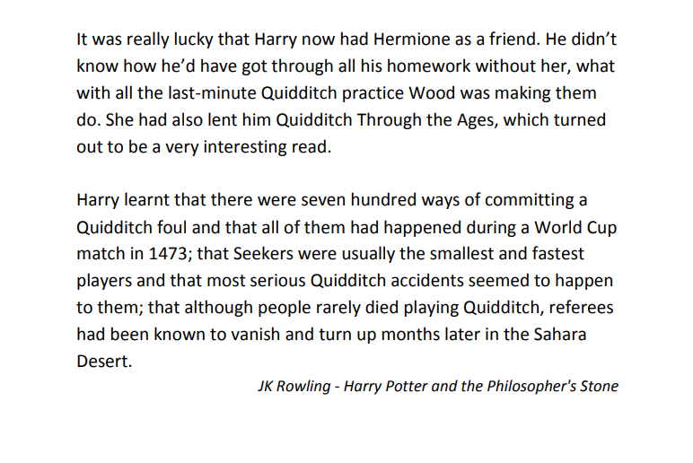

Slide 6
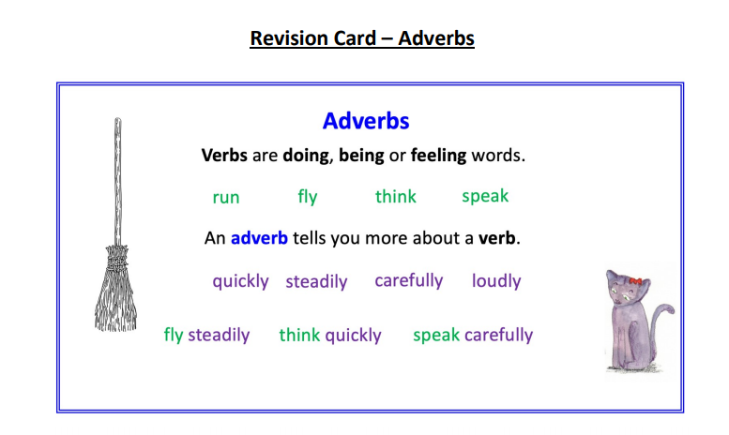

Slide 7
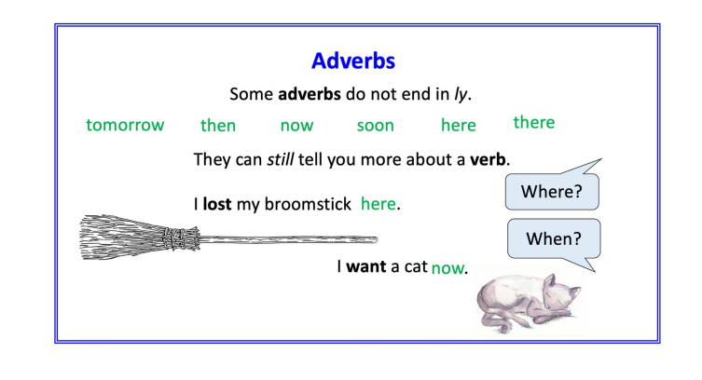

Slide 8
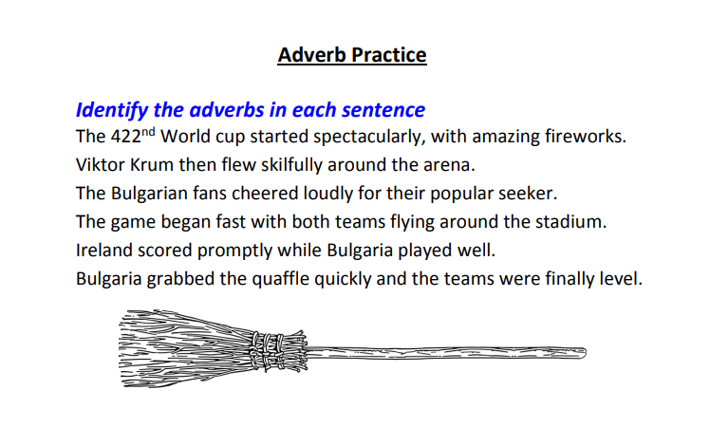

Slide 9
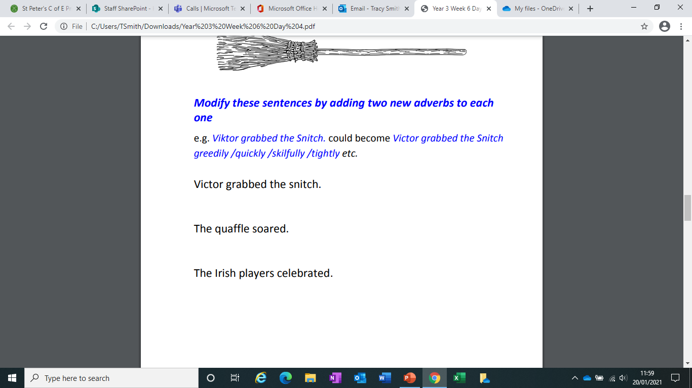
Modify means change

Slide 10
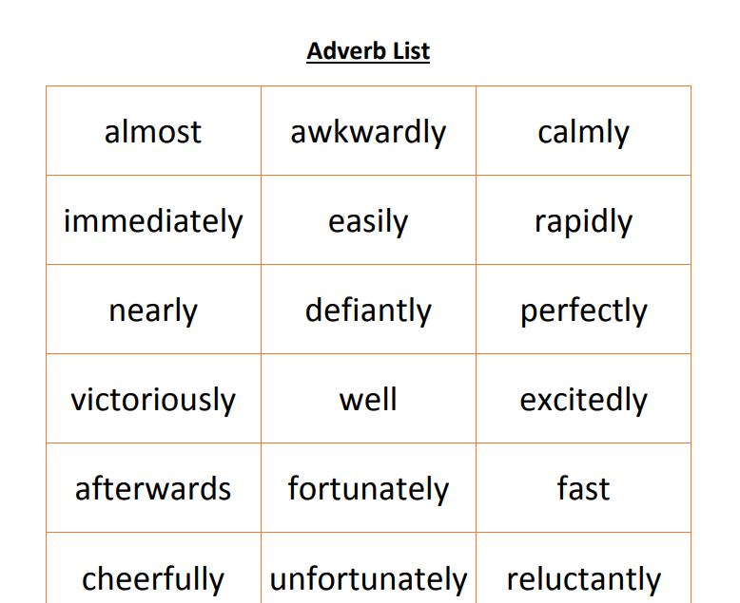
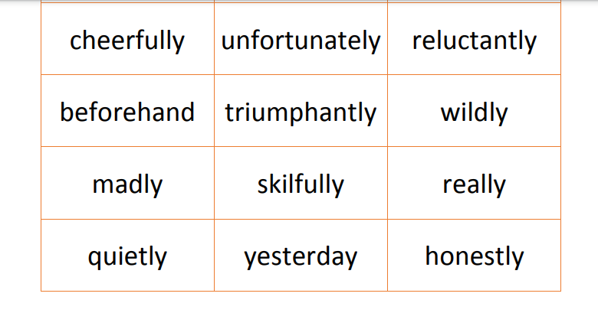
Watch the extract about Harry’s first quidditch match.
Write sentences with adverbs about the match. E.g. Harry’s broomstick raced around wildly as he tried desperately to control it.

Slide 11
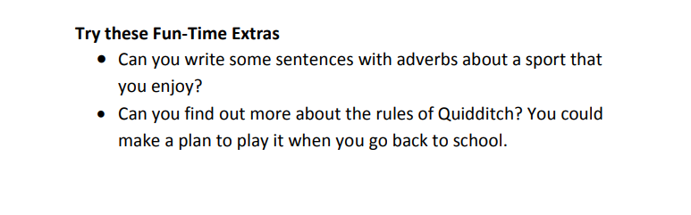
If you have time today, try these activities.

