Slide 1
Wednesday 27th January 2021
Day 3 Week 4
Check you have all you need before you begin!

Slide 2
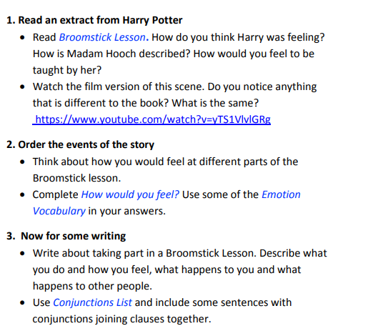
Remember how to cut and paste the web address into the browser bar to access the You Tube clip.

Slide 3
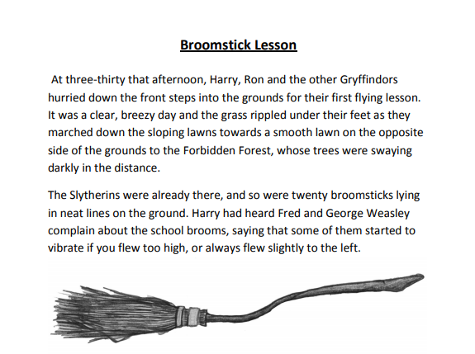

Slide 4
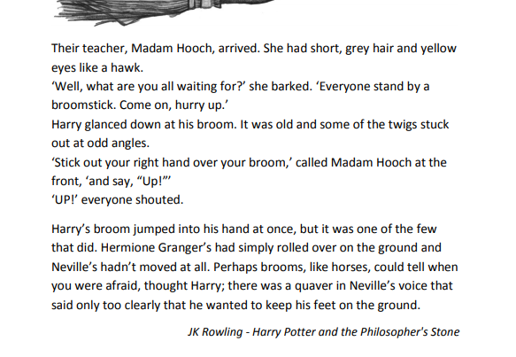

Slide 5
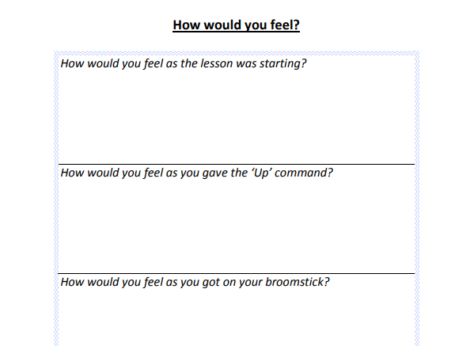
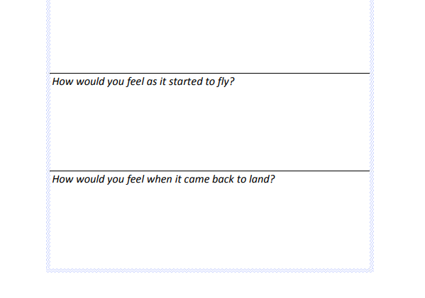
How would YOU feel? Why?

Slide 6
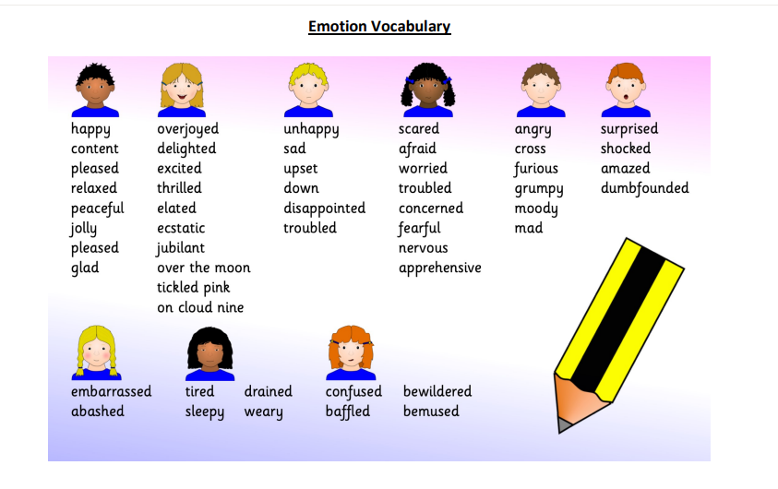

Slide 7
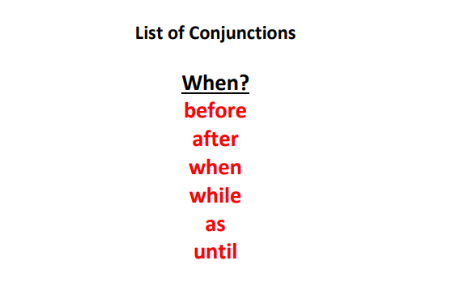
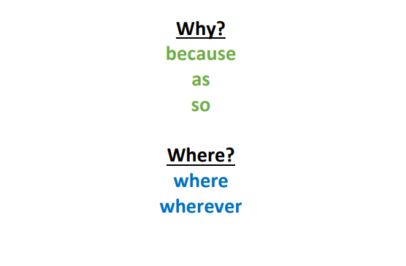
Describe how you would feel during a broomstick lesson. Write in first person (about yourself). Use conjunctions to make your sentences more complex.

