Slide 1
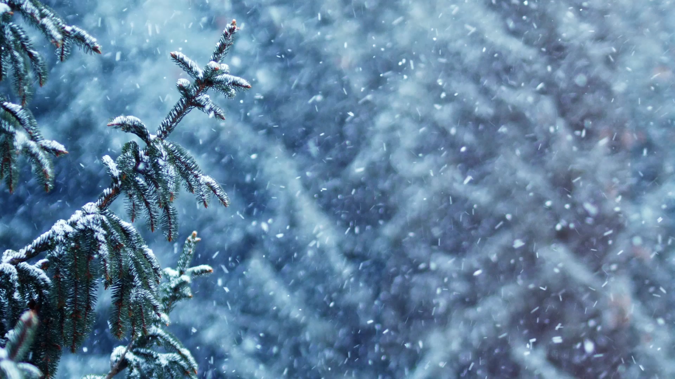
Tuesday 26th January 2021
Day 2 Week 4
Water, pencil, paper, rubber, sharpener

Slide 2
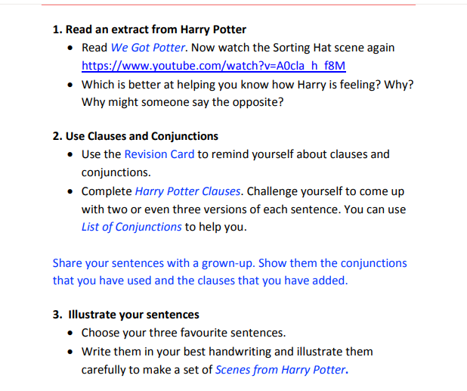
Today’s Work
To access websites you can copy and then paste them into your browser. You have to come out of SLIDE SHOW to do this.

Slide 3
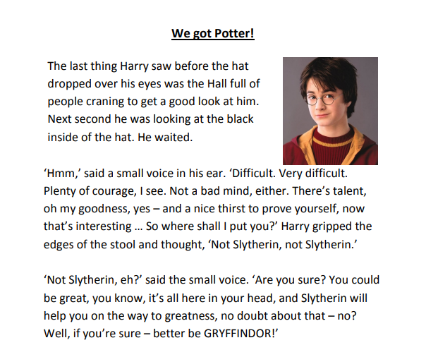

Slide 4
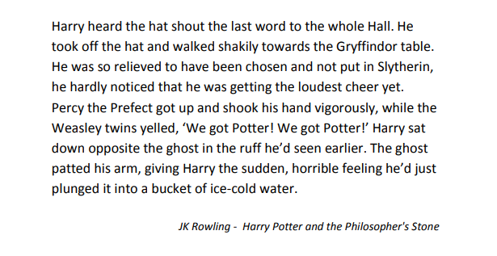

Slide 5
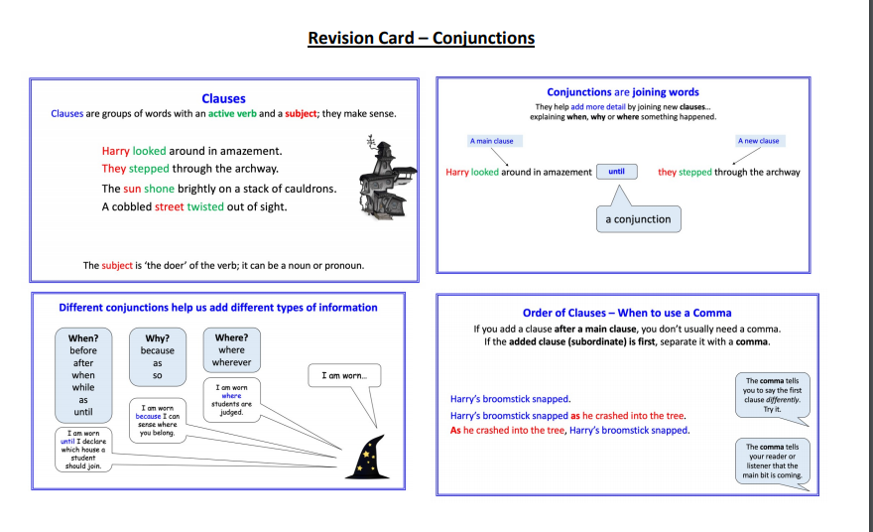

Slide 6
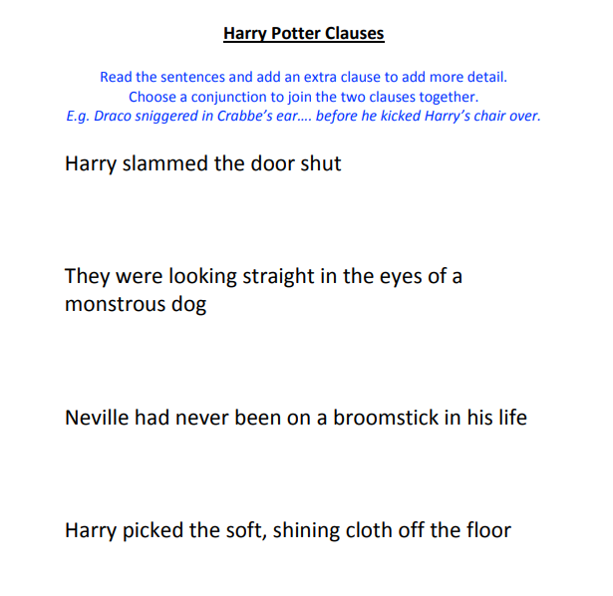
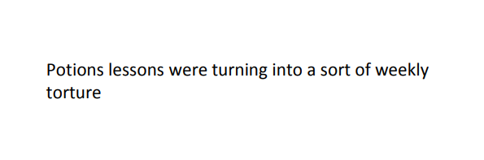

Slide 7
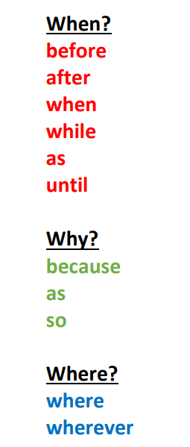

Slide 8
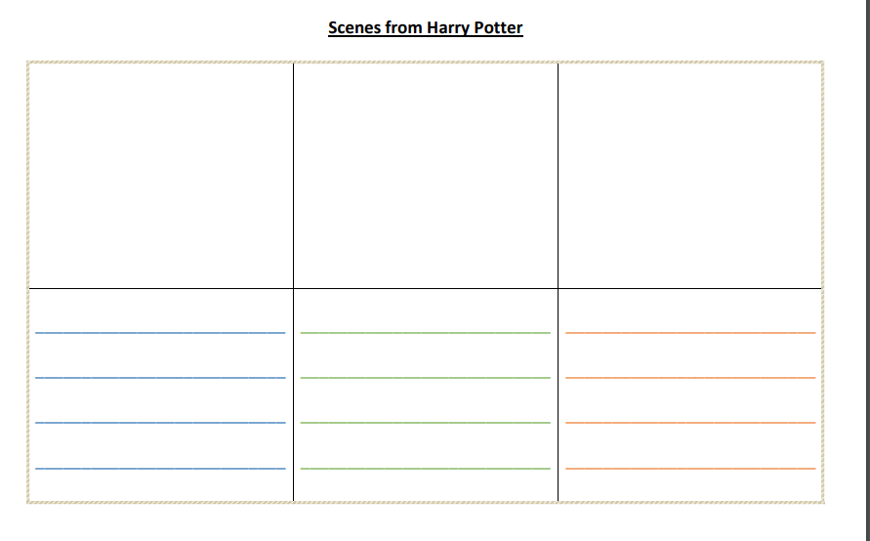

Slide 9


