Slide 1


Slide 3




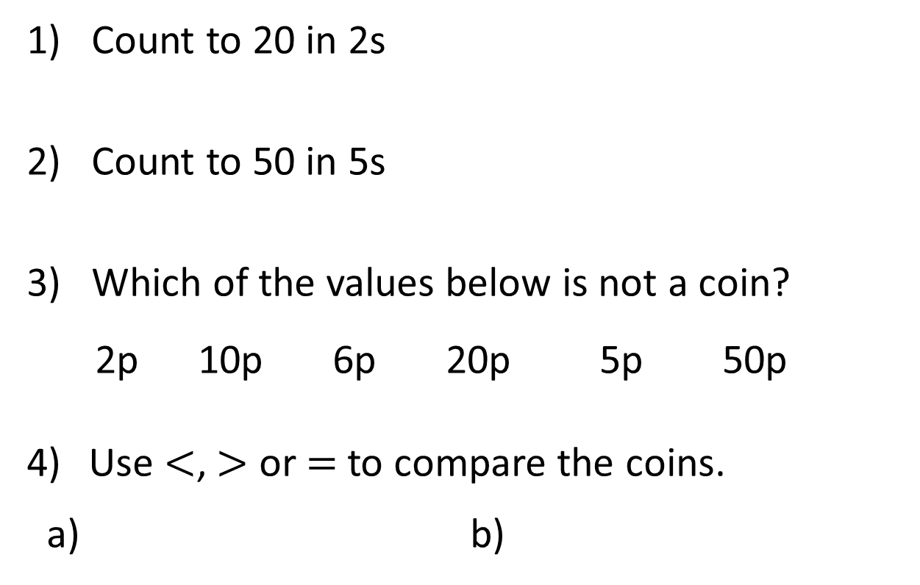
1) Count to 20 in 2s
2) Count to 50 in 5s
3) Which of the values below is not a coin?
2p 10p 6p 20p 5p 50p
Use $<$, $>$ or $=$ to compare the coins.
a) b)

Slide 4


1) Count to 20 in 2s
2) Count to 50 in 5s
3) Which of the values below is not a coin?
2p 10p 6p 20p 5p 50p
Use $<$, $>$ or $=$ to compare the coins.
a) b)
2, 4, 6, 8, 10, 12, 14, 16, 18, 20
5, 10, 15, 20, 25, 30, 35, 40, 45, 50
$$<$$
$$>$$

Slide 6








1p
2p
5p
10p
20p
50p
£1
£2
£5
£10
£20
£50

Slide 7


Dora has used pennies to represent the value of different coins.
Which coins has she represented?
Have a think

Slide 8

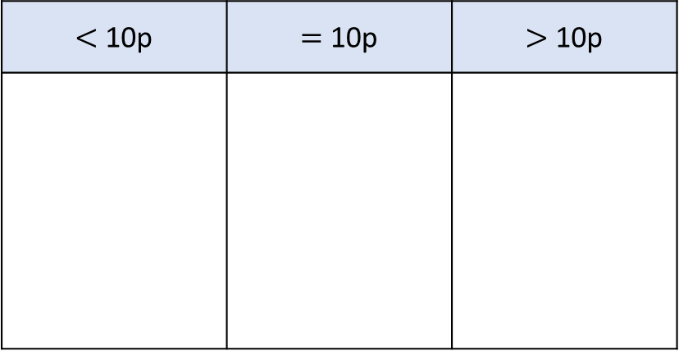
Jack is sorting the coins.
Can you explain how he has sorted them?
How else could you sort the coins?
Have a think
$<$ 10p | $=$ 10p | $>$ 10p

Slide 9


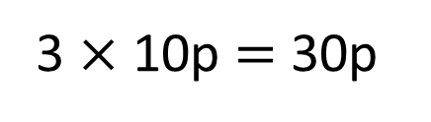
How much money is there?
30p
5
10
15
20
25
30
10p
10p
10p
3 $×$ 10p $=$ 30p
I will count in 5s
I will make 10s

Slide 10

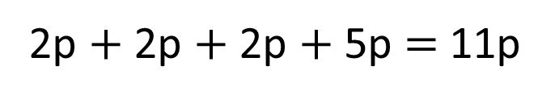
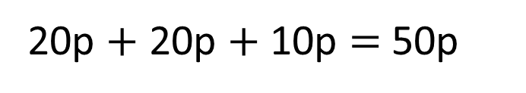
How much money is there?
61p
2p $+$ 2p $+$ 2p $+$ 5p $=$ 11p
20p $+$ 20p $+$ 10p $=$ 50p
50p $+$ 11p $=$ 61p
Have a think

Slide 11
Have a go at questions
1 - 4 on the worksheet

Slide 12
I have more money
I have more money
Have a think
Who is correct?

Slide 13
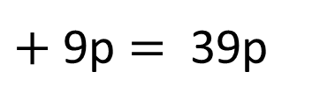
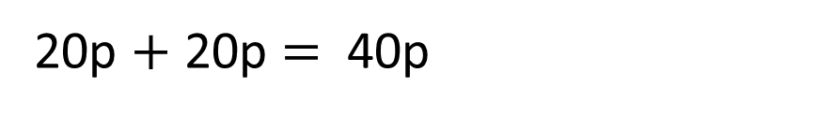
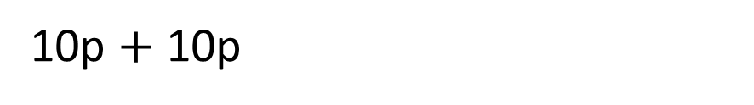
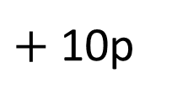
$+$ 10p
$+$ 9p $=$ 39p
10p $+$ 10p
20p $+$ 20p $=$ 40p
Annie has more coins
Eva’s coins have a greater value.
Eva has more money than Annie.

Slide 14


15p 12p 20p 60p
Have a think
I can make each amount using exactly 3 coins
I can make each amount using exactly 2 coins

Slide 15
Have a go at the rest of the questions on the worksheet

