Slide 1

Week 4 English
What do you need?
A sharp pencil
Paper
Water bottle
Worksheets and/or screen

Slide 2
Monday 25th January 2021
This week we are going to read a variety of texts from well-known authors
Study how they have joined clauses with conjunctions
Observe how the use of adverbs brings writing to life
LI To recognise
conjunctions and respond
to a text in sentences

Slide 3
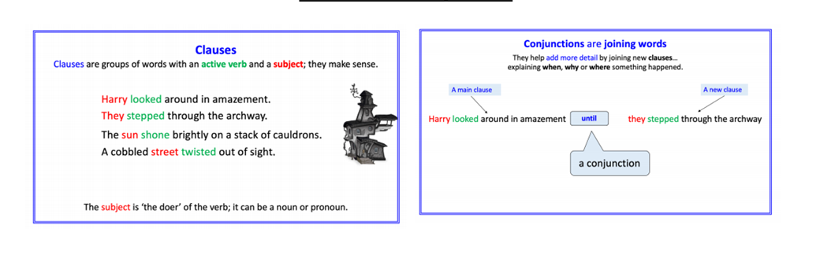
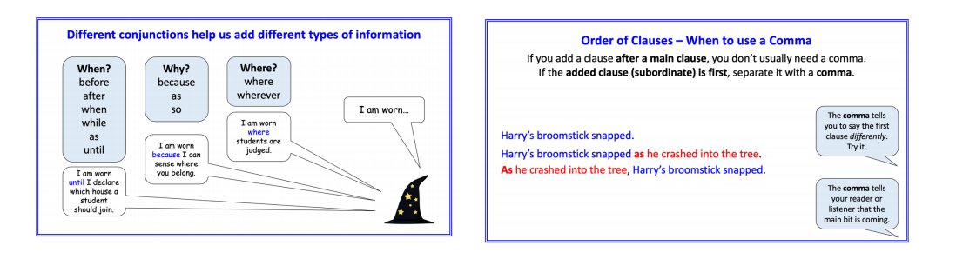

Slide 4
List of Conjunctions
When?
before
after
when
while
as
until
Why?
because
as
sock
to
Where?
where
wherever

Slide 5
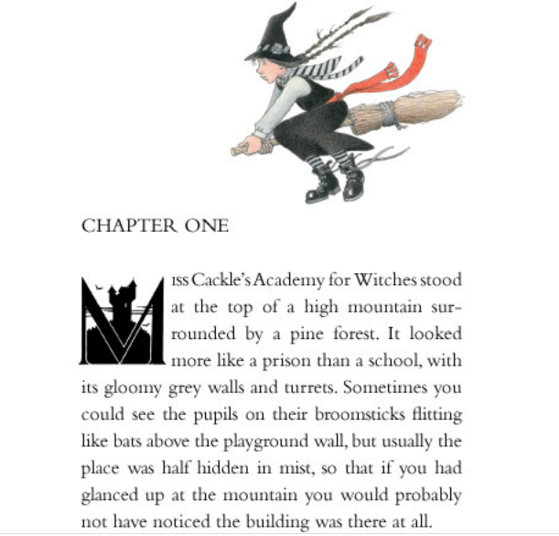
From
The Worst Witch
By Jill Murphy

Slide 6
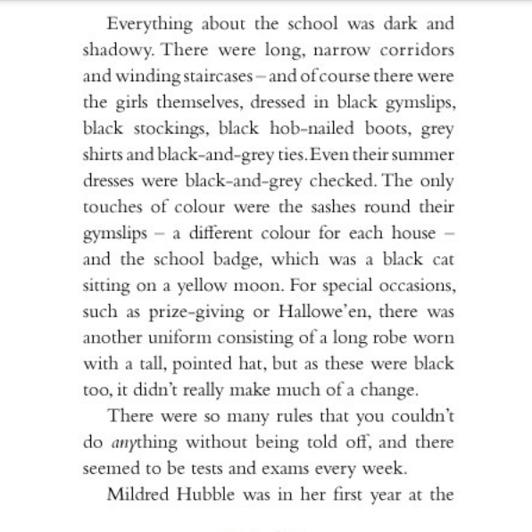
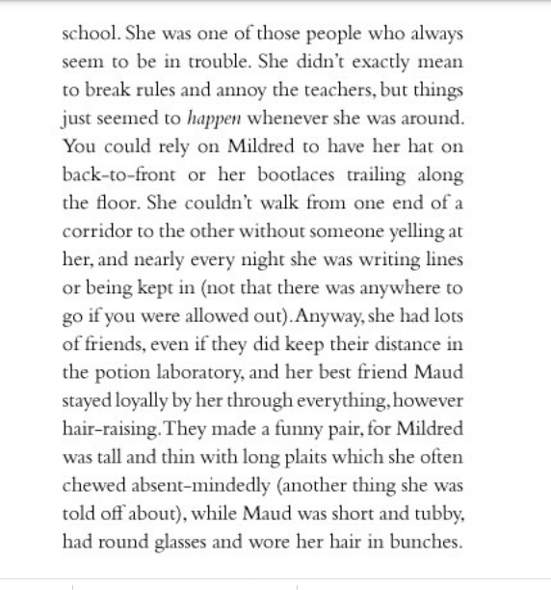

Slide 7
Once you have read the extract reread and identify the conjunctions. Note how they are used to extend sentences and make them more complex.
Did you find these?
with, but, so, and, which, that, whenever, or, however, for, while

Slide 8
LI To answer questions using full sentence responses, correct punctuation and spelling
1. Where is the witches, academy located?
2. Why is it sometimes difficult to see the school building?
3. Describe 3 things about the school.
4. Why were you likely to be told of frequently?
5. How do you think Mildred felt about getting into trouble so often? Explain why.
6. Why do you think Mildred's friends kept their distance in the potions laboratory?

Slide 9
Answers
1. The witches' academy is located at the top of a high mountain surrounded by a pine forest.
2. It is sometimes difficult to see the school as the mountain is often covered in mist.
3. The school had long winding staircases, was dark and shadowy and girls dressed in dull, drab uniforms.
4. You were likely to be told off frequently because there were an awful lot of rules.
5. Mildred may have felt frustratated and bewildered about getting into trouble so often. The story says that she didn't mean to break the rules but things just seemed to happen when she was around.
6. I think Mildred's friends kept their distance in the potions laboratory incase she had a dangerous disaster while mixing a potion.

