Slide 1


Friday 29th January
LI : To write a narrative based on the Lion, the Witch and the Wardrobe including dialogue and action.

Slide 2
To start writing you will need:
your planning sheet
a dictionary
a thesaurus ( if you have one)
some rough paper to draft sentences
writing tools
your imaginations!

Slide 3
Today
You will be writing about how your character returns to the “real” world.
Your character is going to tell the character they argued with at the beginning all about the adventure.
How does that person react?
Angry and upset and doesn’t want to talk or
excited and wants to go and explore and share the new world.

Slide 4
Direct speech
Vocab
Clear structure
Have you used direct speech correctly?
Have you used paragraphs and written in the third person?
Is your writing full of rich vocabulary and a range of sentences?

Slide 5
Evaluating your writing and thinking about your targets
Do you see an improvement in this piece of writing?
Have you tried to include a range of sentences?
Have you checked each sentence to see that it makes sense?

Slide 6
Glossary
Expanded noun phrases – a single tear (an adjective describing the noun.)
Use of adverbs – she walked hastily (they emphasize the way in which the action is done).
Simple sentence – a short sentence to give dramatic impact, has one verb.
Compound sentence – two simple sentences joined together by a coordinating conjunction. Has two verbs and two main clauses.
Direct speech – use of speech marks to show characters speaking.

Slide 7
Glossary
Complex sentences with verbs – in these the verb is at the beginning to produce action and impact. The sentence has a subordinate clause and a main clause. (Punching his arms in the air, his heart pounded. )
Complex sentence which starts with a subordinate clause – a sentence with two clauses (subordinate and main) where the subordinating clause goes at the beginning or at the end and a comma separates the two clauses. Uses a subordinating conjunction.
Question?afterthought – the writer can share the thoughts and feelings of the character without having to use speech marks.

Slide 8
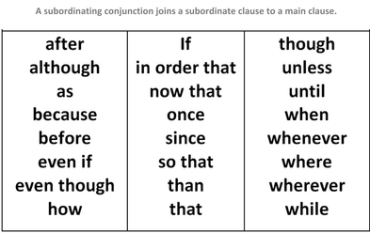
Subordinating conjunctions

