Slide 1
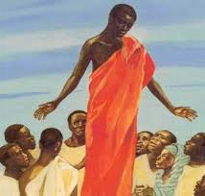

RE Week 4
LI: To explore the impact of Jesus’ teachings on Christians today

Slide 2

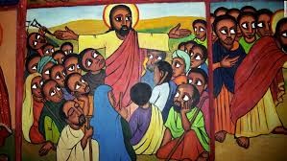
The Lord’s Prayer
The Miracles
The Parables
The Sermon on the Mount

Slide 3


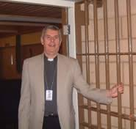

What do prison chaplains do?
How does Christian Aid help people?
What does Traidcraft Exchange do to help people?
Leprosy Mission – how does this link with Jesus’ teachings?

Slide 4


Task
Find out more about one of the organisations mentioned in the previous slide or here.
Can you write a short presentation that describes how the good work your chosen organisation does relates to Jesus’ teachings today?
You can either write out your presentation or you can use 2Write or 2 Publish in Purple Mash to present your work.
International Red Cross and Red Crescent Movement

Slide 5
How does your presentation link to Jesus’ teachings?
Can you think of something Jesus said which links to your case study?
Which story from the Bible relates to what you have found out?
Is it only Christians whose good work relates to Jesus’ teachings?
Let’s have a think...

