Slide 1


Thursday 28th January
LI : To write a narrative based on the Lion, the Witch and the Wardrobe including dialogue and action.

Slide 2
To start writing you will need:
your planning sheet
a dictionary
a thesaurus ( if you have one)
some rough paper to draft sentences
writing tools
your imaginations!

Slide 3
Today’s writing
You will continue to write your own story using some example sentences as a guide.
Introduce the new character as planned and write dialogue to include actions between the two. (Just as C.S. Lewis did with Lucy and Mr Tumnus)
Who do they meet?
What happens when they do?
*Remember the dialogue must not be too long. It’s purpose is to move the story along.*

Slide 4
Look at the next example to show how you might introduce the new character into the story.
Think about the variety of sentences and how the writer uses direct speech.
Can you remember the rules for direct speech?
In the example Cressida (main character) goes through a greenhouse and finds herself in a tropical jungle where she meets a talking tiger.

Slide 5
She had become accustomed now to the humidity and the intense heat, although she realized that she had become extremely thirsty and was desperate for a drink. Overcome with curiosity and excitement, she started weaving her way through the greenery. Strange birds flew over head and a cacophony of hoots and squawks made her feel uneasy. Where was she? she thought. Then she felt the ground vibrate.
Thunderous steps thudded nearby and came to an abrupt halt right in front of her. Cressida stood motionless.
“Oh goodness! A creature from the other side! Who are you?” asked a rather bemused tiger.
Even though she had seen pictures of a tiger before, she couldn’t help thinking that this one was different.
“I’m Crrresssida,” she stammered. “I don’t know exactly where I am, but I’m incredibly thirsty.” And with that, she fainted.

Slide 6
Complex sentence with verb
Complex sentence with subordinate clause
Question? afterthought
Even though she had seen pictures of a tiger before, she couldn’t help thinking that this one was different.
Overcome with curiosity and excitement, she started weaving her way through the greenery.
Where was she? she thought.

Slide 7
Glossary
Expanded noun phrases – a single tear (an adjective describing the noun.)
Use of adverbs – she walked hastily (they emphasize the way in which the action is done).
Simple sentence – a short sentence to give dramatic impact, has one verb.
Compound sentence – two simple sentences joined together by a coordinating conjunction. Has two verbs and two main clauses.
Direct speech – use of speech marks to show characters speaking.

Slide 8
Glossary
Complex sentences with verbs – in these the verb is at the beginning to produce action and impact. The sentence has a subordinate clause and a main clause. (Punching his arms in the air, his heart pounded. )
Complex sentence which starts with a subordinate clause – a sentence with two clauses (subordinate and main) where the subordinating clause goes at the beginning or at the end and a comma separates the two clauses. Uses a subordinating conjunction.
Question?afterthought – the writer can share the thoughts and feelings of the character without having to use speech marks.

Slide 9
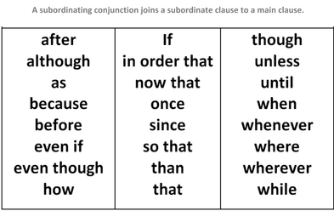
Subordinating conjunctions

