Slide 1


Wednesday 27th January
LI : To write a narrative based on the Lion, the Witch and the Wardrobe including dialogue and action.

Slide 2
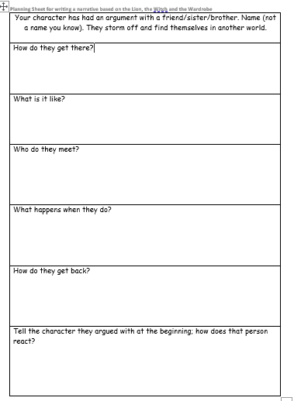
To start writing you will need:
your planning sheet
a dictionary
a thesaurus ( if you have one)
some rough paper to draft sentences
writing tools
your imaginations!

Slide 3
Today’s writing must include
Introduce your character in a situation like an argument or a game.
(verbs, adverbs, expanded noun phrases, direct speech)
Write about how they find themselves in another world - how do they get there?
(verbs, adverbs, description of how they got there)
Describe what it is like using a variety of vivid language.
(adjectives, expanded noun phrases, verbs and adverbs )

Slide 4
Start the story with speech
Use a simple sentence for effect
Use a compound sentence
“Leave me alone! I refuse to play anymore by your ever-changing rules - I’ve had enough!” Douglas shouted angrily at his older brother. With that he flew out of the sitting room and raced outside into the garden, almost knocking over his mother’s ornamental china dolls as he fled.
A single tear rolled down her cheek. It always ended up like this whenever they played hide and seek. It was tiresome. Cressida was forever the one seeking and never the lucky one hiding. As she wandered dreamily through the house, she found herself at the very top of the staircase.
“ I hope you capsize!” Lottie screamed. She turned her head haughtily away from her sister’s gaze and stomped off towards the house. Pent up with anger, she thought she might explore for a little while before she went back inside.

Slide 5
Discovering the new world
Look at how these sentences have been started. Do you recognise the sentence types?
As I pushed through the dense foliage at the back of the greenhouse, I could feel the air getting warmer.
Quite unexpectedly, the mirror started to move as if it were liquid. He stepped through the glass, closing his eyes as he did so. Darkness. Then, all of a sudden, a dazzling bright light.
He gently pushed open the barn door and went inside. It was just as he had expected. Musty, dank and dark. A peculiar smell hung in the air.

Slide 6
Glossary
Expanded noun phrases – a single tear (an adjective describing the noun.)
Use of adverbs – she walked hastily (they emphasize the way in which the action is done).
Simple sentence – a short sentence to give dramatic impact, has one verb.
Compound sentence – two simple sentences joined together by a coordinating conjunction. Has two verbs and two main clauses.
Direct speech – use of speech marks to show characters speaking.

