Slide 1

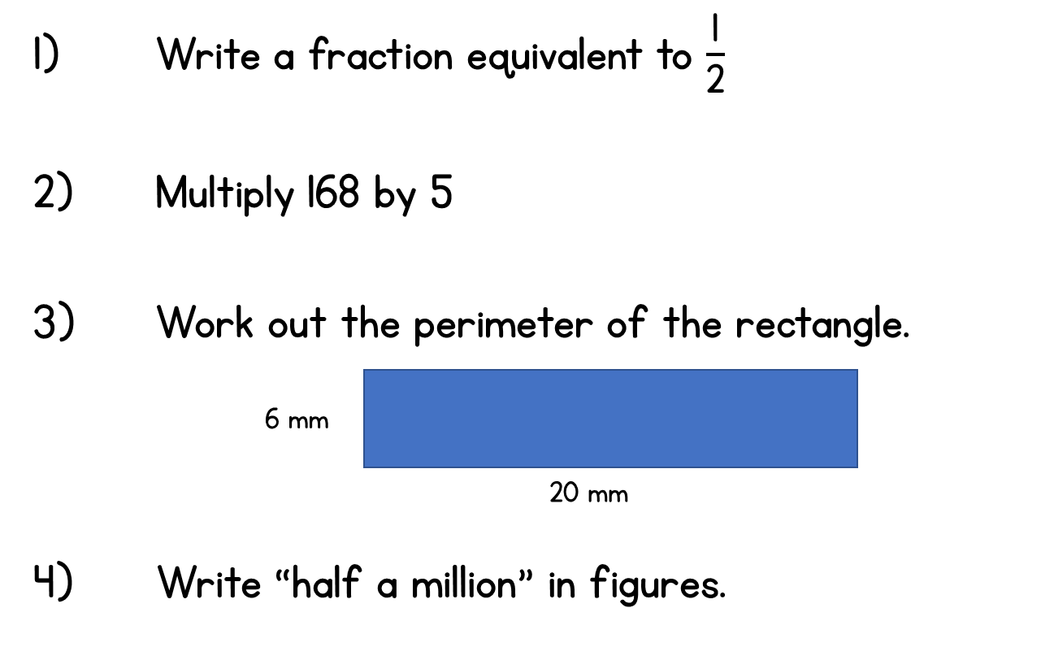
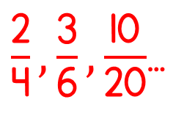
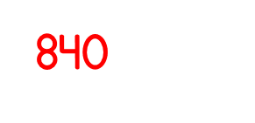
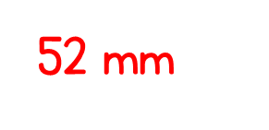


Year 5 | Week 3 | Day 2
Perimeter = 20 + 20 + 6 + 6 mm
=
5) 627 x 34 =
21,218
6) 6738 ÷ 3 =
2,246

Slide 2
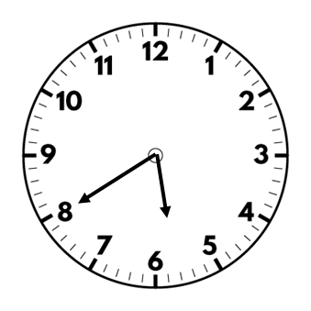
Twenty to six in the morning
5:40 am
5:40 pm
05:40
17:40
Twenty to six in the evening

Slide 3
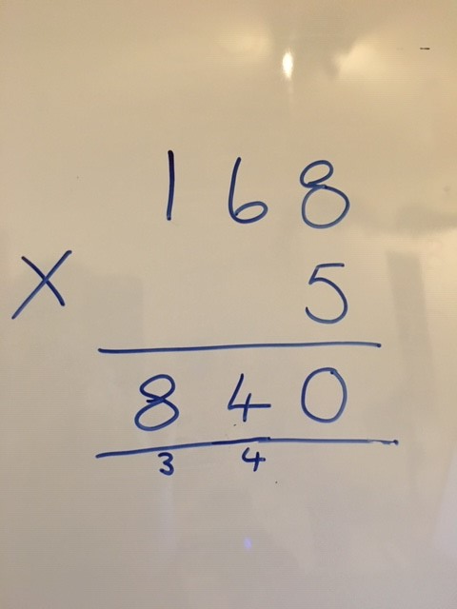
2)

Slide 4
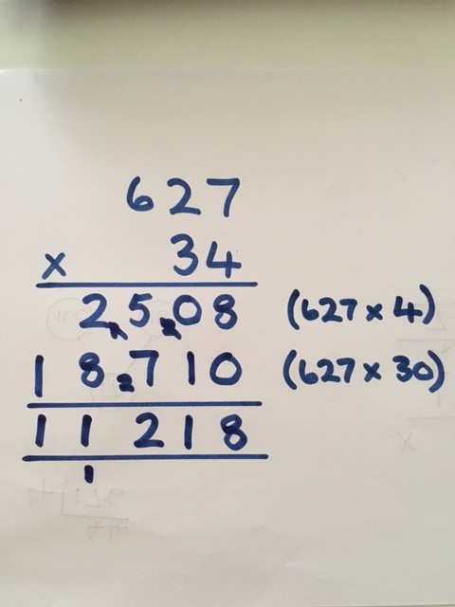
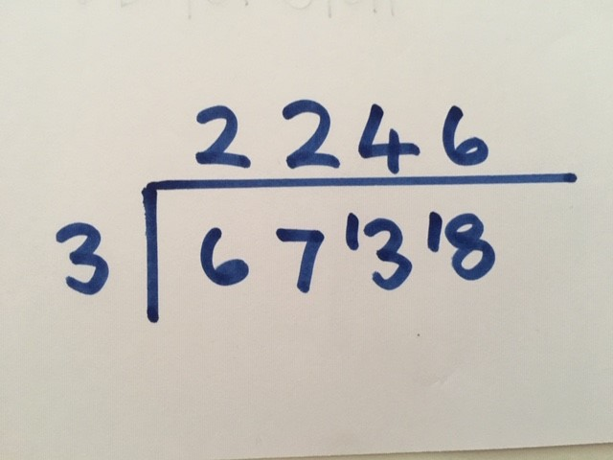
5)
6)

