Slide 1


Science
Monday 25th January
How can we get drinkable water from seawater?

Slide 2

Why is it not a good idea to
drink seawater?
How is this shipwrecked explorer going to make some fresh water from the seawater
around him?

Slide 3
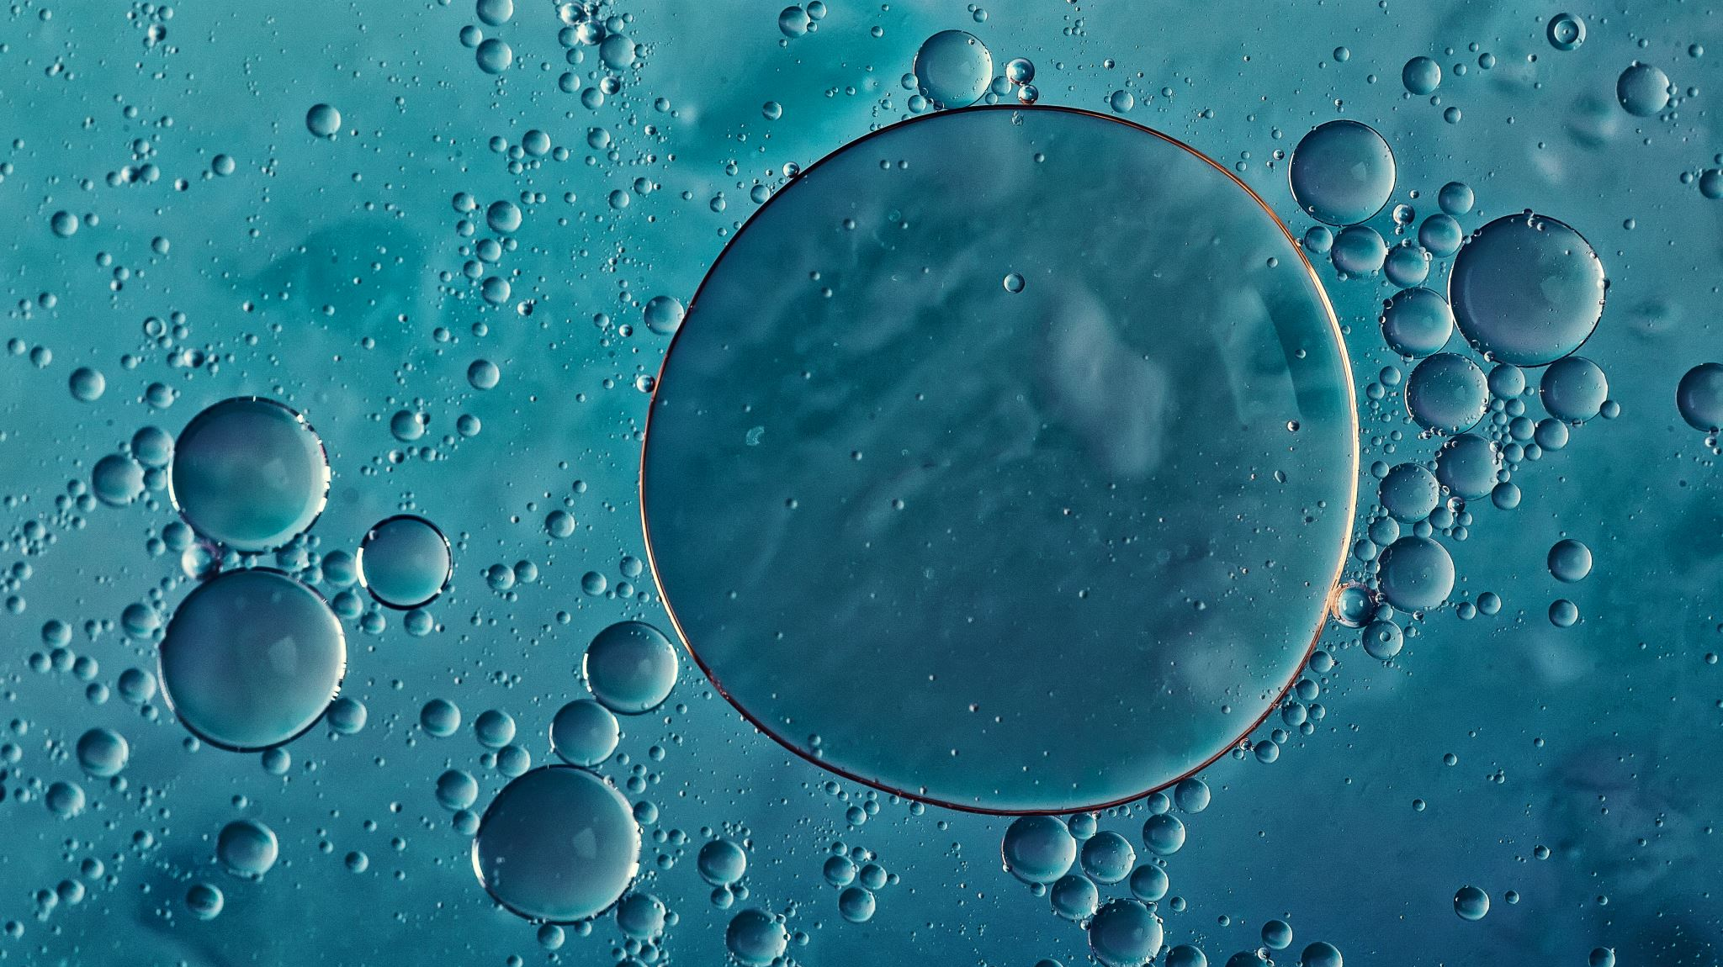
What is a solution?
What happens when salt dissolves in water?
The salt (called the solute) mixes with the water (the solvent) to make a homogeneous solution. That means that the salt has mixed so well with the water that you can no longer see the difference between the water and the salt.

Slide 4

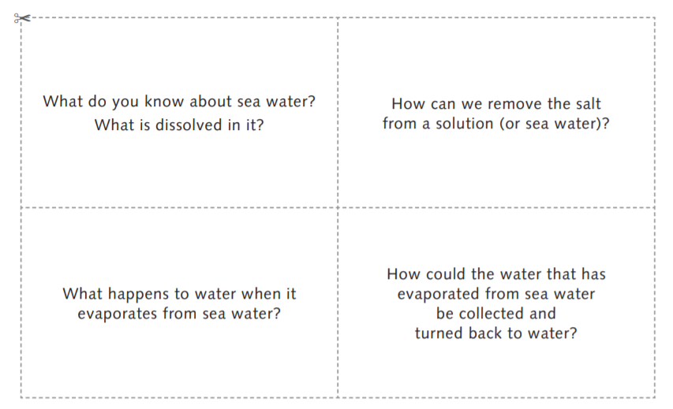
Take a few minutes to think about these questions …

Slide 5
This week you are going to carry out two different experiments involving a
salt water solution.
To recover fresh water from a salt water solution.
To recover the salt from a salt water solution.
LI: To describe and explain how dissolved material can be separated from a liquid.

Slide 6

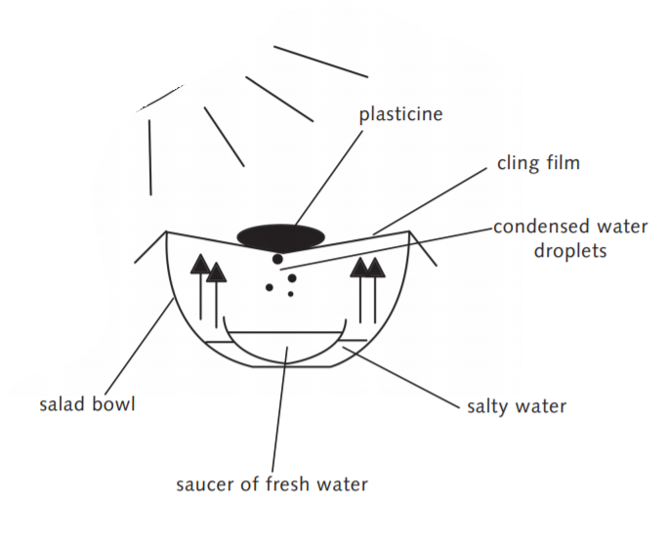
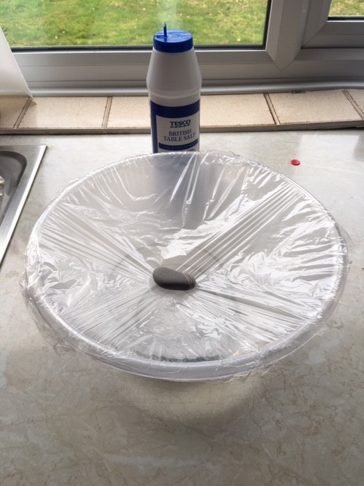
Experiment 1
Heat
(warm)

Slide 7
Experiment 2
Dissolve some salt into a little water. Keep adding salt until no more will dissolve.
Fill a petri dish, saucer or other shallow container (preferably transparent) with your solution.
Place your container on a sunny windowsill or in a warm place (perhaps near a radiator).
Observe the dish every day at the same time for a week. Write down what you can see, and perhaps take a photograph.

Slide 8
Write up your experiments ……
Method
Including a diagram …
Results/Observations
What do you think happened?
Some vocabulary
salt water
water droplets
vapour
lamp
evaporate
evaporation
condensation
plastic film
temperature
hotter
cooler

Slide 9
LI: To describe and explain how dissolved material can be separated from a liquid.
Can you describe the processes involved?
Could you develop your own methods and designs to produce drinkable water from seawater?
Were you able to explain why the amount of drinkable water produced might vary depending on, for example, position of equipment (full sun or shade, and so on), surface area of container, or whether the wind was blowing?
Do you understand that using evaporation and condensation enables the materials that make up solutions to be separated?

