Slide 1


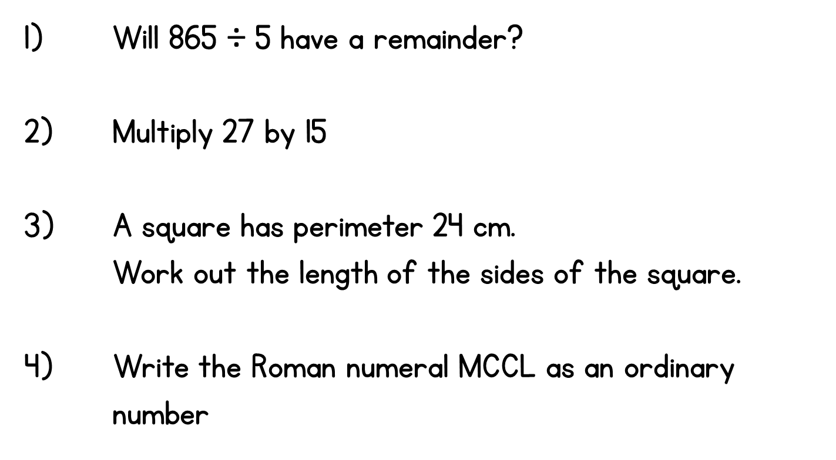


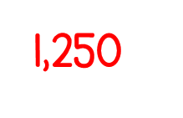

Year 5 | Week 3 | Day 1
5) 435 X 27 =
11,745
6) 435 ÷ 5 =
87

Slide 2
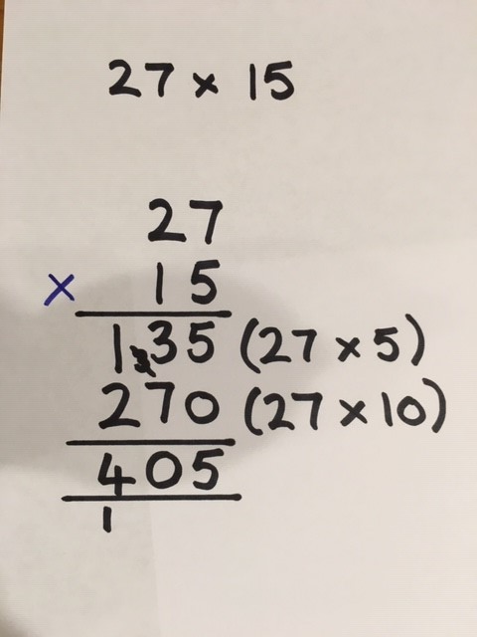
27 X 15 = (20 X 15) + (7 X 15)
= 300 + 105
= 405

Slide 3


