Slide 1
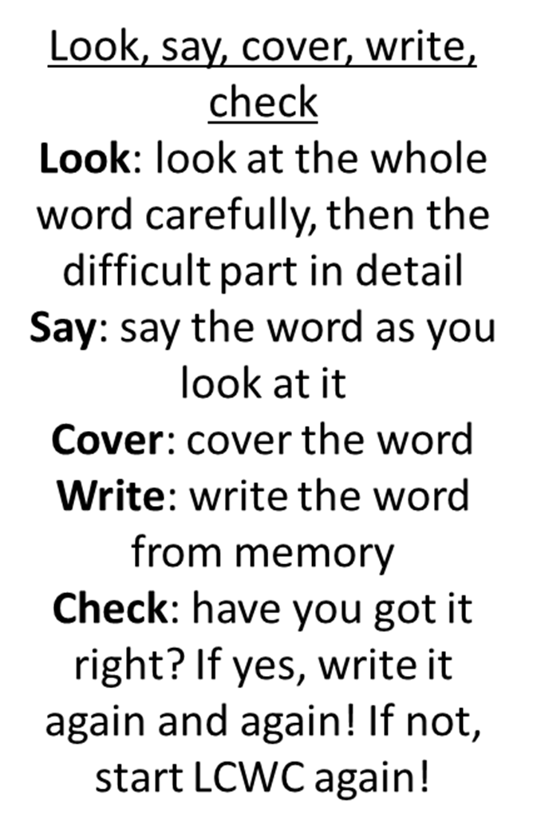

Spellings for Week 4
Statutory Words
Strategy
forty
accompany
committee
communicate
correspond
environment
foreign
government
occupy
opportunity
parliament
prejudice
sincere
suggest
system
vegetable

Slide 2
Memory hints – double consonant
accompany
committee
communicate
correspond
occupy
opportunity
suggest
Can you see the double consonants in these words?
Write them out and use a different colour to highlight the double consonant.

