Slide 1
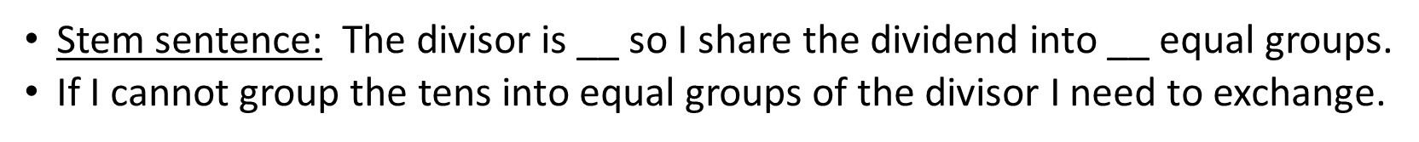
Wednesday 27 January 2021
LI: To work on correspondence problems
Times Tables
Video: https://vimeo.com/498265698
Worksheet found under your home learning
Mark your work using the answers.
.
nominator

Slide 2
Times Tables
6 times table
How quick are you at finding the answers.
Use Hit the Button if you needs some more support.
Now question yourself on the 6 times table.
Extension:
Multiples of 10 examples:
30 x 4
3 x 40

Slide 4
Listen to the video and complete the sheet and mark your work.

Slide 5
Reasoning

