Slide 1

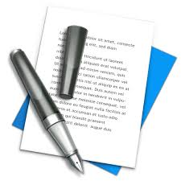

Friday 22nd January
LI: To edit and improve my writing

Slide 2
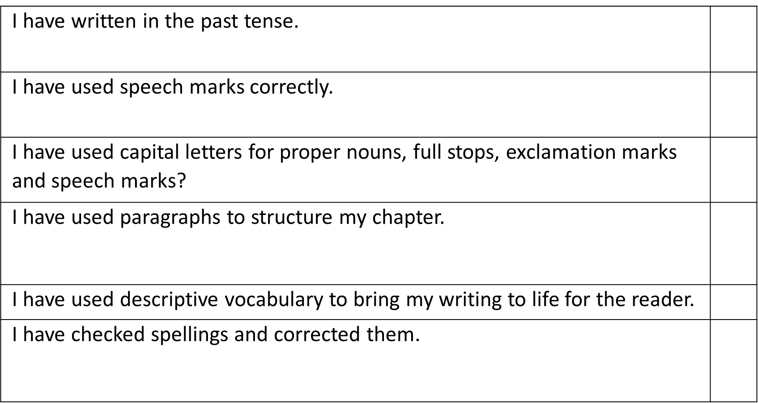

Slide 3
I have used a range of sentence starters.
I have used subordinate clauses to extend my writing and enhance the flow of my writing.
I have read each sentence to make sure it makes sense.
I have included details from the book.

Slide 4

My targets for improving my writing are…..

