Slide 1
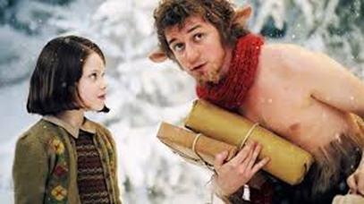

Thursday 21st January
LI: To write a chapter which describes Mr. Tumnus’ arrest using correctly punctuated speech
You will need:
your notes and a copy of the book
your comic strip of what happened when Mr Tumnus was arrested
a dictionary and a thesaurus (if you have them).

Slide 2
You must include:
correctly punctuated speech
think of other words synonyms for said - stuttered, muttered, cried, shouted, agreed
subordinate clauses (start these using as, after, while, when, because, before, if, although)
descriptive language noun phrases (e.g. warm fire/ gruff voice/ cold, bitter night/deafening bang/

Slide 3
How to start – some ideas
Mr Tumnus had just put another log on the fire and was about to settle in for the night, when he heard crunching footsteps outside his front door. Who could it be? he thought to himself. Maugrim. Panic surged through his strange body, although he instinctively knew that the Queen must have somehow learnt of his meeting.
Mr Tumnus was feeling relieved as he enjoyed his sardines on toast with a hot, steaming cup of tea. It had been a long, busy day. Thoughts of his new friend flashed through his mind. He had never before met a daughter of eve and he had been pleasantly surprised by her youthful honesty. All of a sudden, there was a sharp knock on the door. Mr Tumnus wondered it was Lucy until….
The night was perishingly cold and Mr Tumnus was pleased to finally get home. He lit the fire and decided on a nice, brown egg with buttered toast for supper. Quite unexpectedly, a sudden rapping at his wooden front door took him by surprise. As a rabble of dwarfs burst through the door, Mr Tumnus was knocked to the ground.

Slide 4
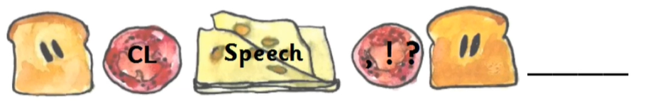
Remember how to punctate your speech
“Who’s there?” cried out Mr. Tumnus in fright.

Slide 5
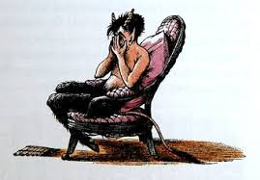
And finally..
You need to write at least an A4 page.
Write in paragraphs.
Your handwriting must be joined.
Check each sentence as you write it and read it to check it makes sense.
Use the text to help you.

