Slide 1


Wednesday 19th January
LI: To revise, use and punctuate direct speech

Slide 2
Grammar Refresher
1. Write out the sentence below underlining the subordinate clause (doesn’t make sense on its own).
As it was a beautiful morning, she decided to go out on her bike.
2. Rewrite this passage, putting in all the capital letters and full stops.
maisie ran a brilliant first race and everyone cheered enthusiastically they didn't win the race overall however next year she was sure they would win
3. Write the sentence underlining the noun phrase.
The lady wore an elegant fascinator instead of a hat.
4. Join each word to a suffix (goes at the end) to make a new word.
affection ful
point ate
achieve less
respect ment
5. Write the contracted form (shortened form) of the underlined words.
They could not see the rainbow clearly.

Slide 3
Now check your answers
1. As it was a beautiful morning, she decided to go out on her bike.
2. Maisie ran a brilliant first race and everyone cheered enthusiastically. They didn't win the race overall, however next year she was sure they would win.
3. The lady wore an elegant fascinator instead of a hat.
4. Words with added suffixes
    affectionate
    pointless
    achievement
    respectful
5. They couldn’t see the rainbow clearly.

Slide 4
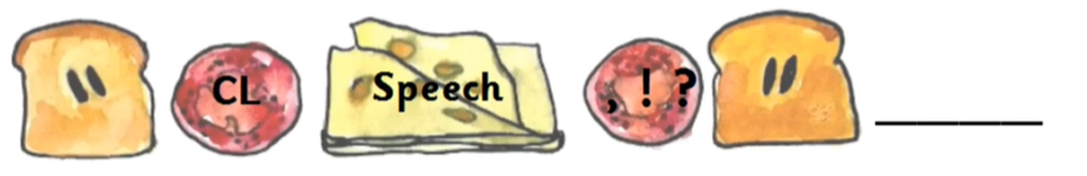
Direct speech
“But what are we to do?” said Susan.
“My dear young lady,” said the Professor, suddenly looking up with a very sharp expression at both of them, “there is one plan which no one has suggested and which is well worth trying.”
“What’s that?” said Susan.

Slide 5
Can you insert the speech marks and punctuation?
Who told you all that stuff about the White Witch he asked
Mr Tumnus, the Faun said Lucy
You can’t always believe what Fauns say said Edmund trying to sound as if he knew far more about them than Lucy
Who said so asked Lucy
Everyone knows it said Edmund you can ask anyone you like and they will tell you

Slide 6
Did you add them correctly?
“Who told you all that stuff about the White Witch?” he asked.
“Mr Tumnus, the Faun,” said Lucy.
“You can’t always believe what Fauns say,” said Edmund, trying to sound as if he knew far more about them than Lucy.
“Who said so?” asked Lucy.
“Everyone knows it,” said Edmund, “you can ask anyone you like and they will tell you.”

Slide 7
Quick checklist when using direct speech
Inverted commas “” or speech marks are the bread in the sandwich, they go around the filling which is the speech.
When you write speech marks in your books, use \\ to open the speech and //
to close the speech, just like the picture.
Punctuation, such as question marks, full stops and exclamation marks go inside the speech marks.
Always start on a new line, if a new character speaks.

