Slide 1


RE – Week 3
LI: To consider what it means to put learning into practice
Do you recognise the bible passage depicted in the picture on the following slide?

Slide 2
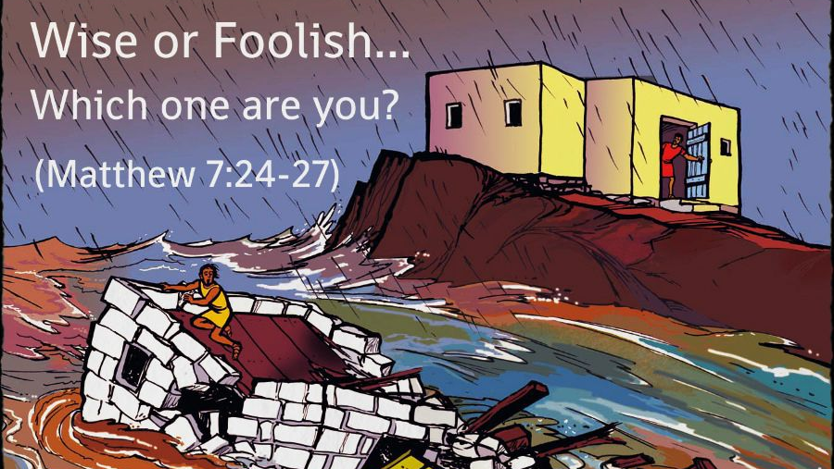

Slide 3
Matthew 7:24-27
The Wise and Foolish Builders
²⁴ “Therefore everyone who hears these words of mine and puts them into practice is like a wise man who built his house on the rock. ²⁵ The rain came down, the streams rose, and the winds blew and beat against that house; yet it did not fall, because it had its foundation on the rock. ²⁶ But everyone who hears these words of mine and does not put them into practice is like a foolish man who built his house on sand. ²⁷ The rain came down, the streams rose, and the winds blew and beat against that house, and it fell with a great crash.”
https://www.youtube.com/watch?v=kjoqMrFXx-k

Slide 4
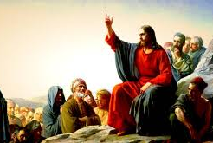
What was Jesus saying when he told this story?
How would Christians interpret this teaching today?

Slide 5
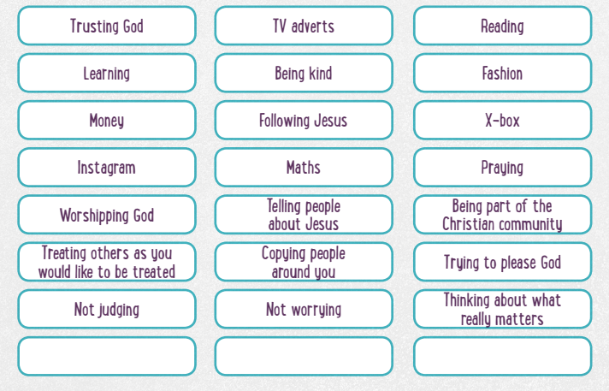

Slide 6
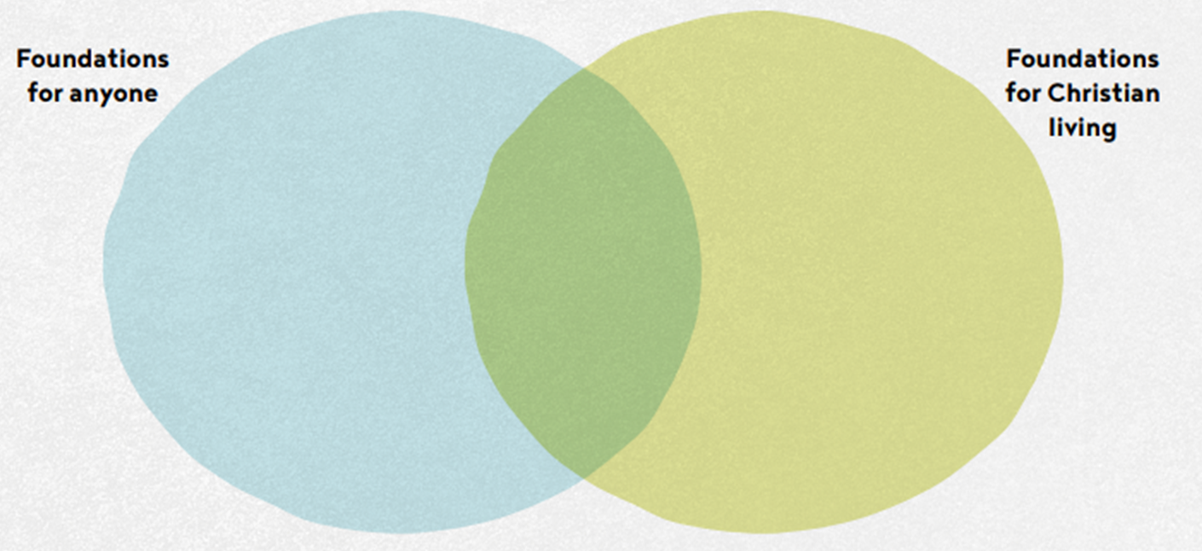
Draw a venn diagram like the one below to show the kinds of things that guide people how to live. Put them in the venn diagram as to whether you think they are helpful to build foundations for anyone, or foundations for Christians. You may think that some are not helpful and should go in the bin!

