Slide 1

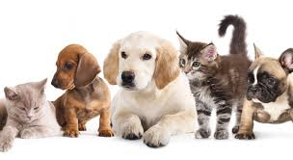
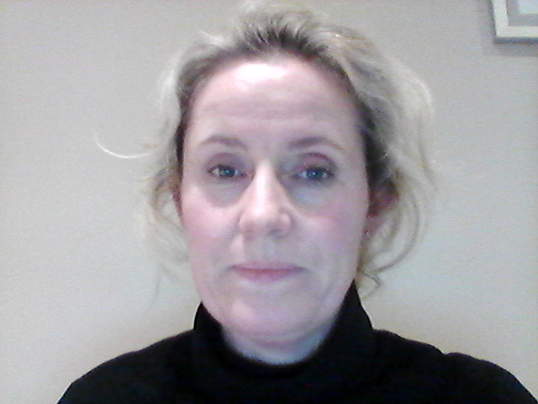
Our topic
As -tu un animal?
Do you have a pet?
French Year 5
Spring 1 2021
Notes:
Bonjour Year 5. This term in French we are going to be learning how to say if we have a pet by using the verb avoir to have. We will also be learning lots of names of animals and we are going to be using a new online resource called Language Angels Home School available for St Peter’s students.

Slide 2

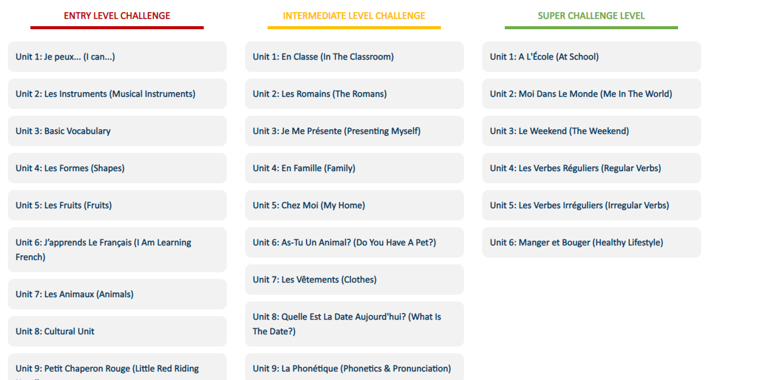
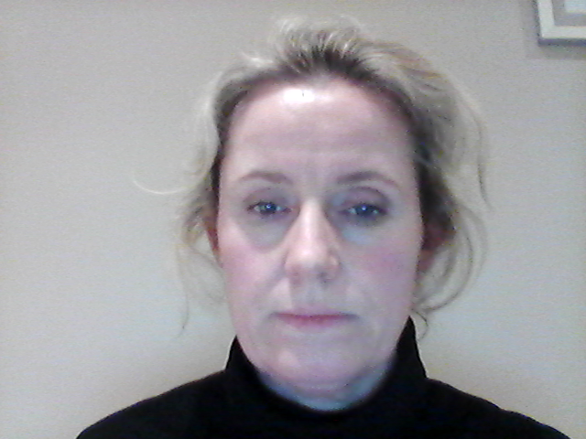
Using your login and password for St Peter’s you will see the list of topics that are available. We are studying Unit 6
Notes:
Remember this website is only for the use of students from St Peter’s.

Slide 3
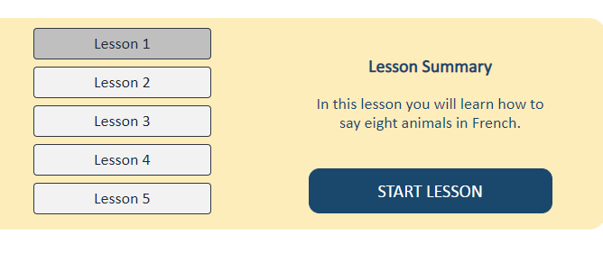
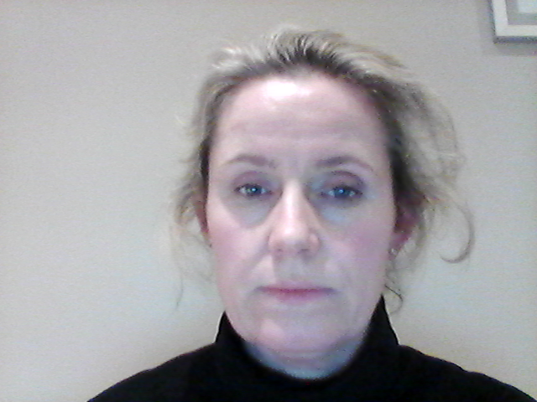
Lesson 1
As-Tu Un Animal? (Do You Have A Pet?)
Notes:
This is the page you will see when you select a lesson and you can easily find the worksheet that your teacher has instructed you to complete.

Slide 4
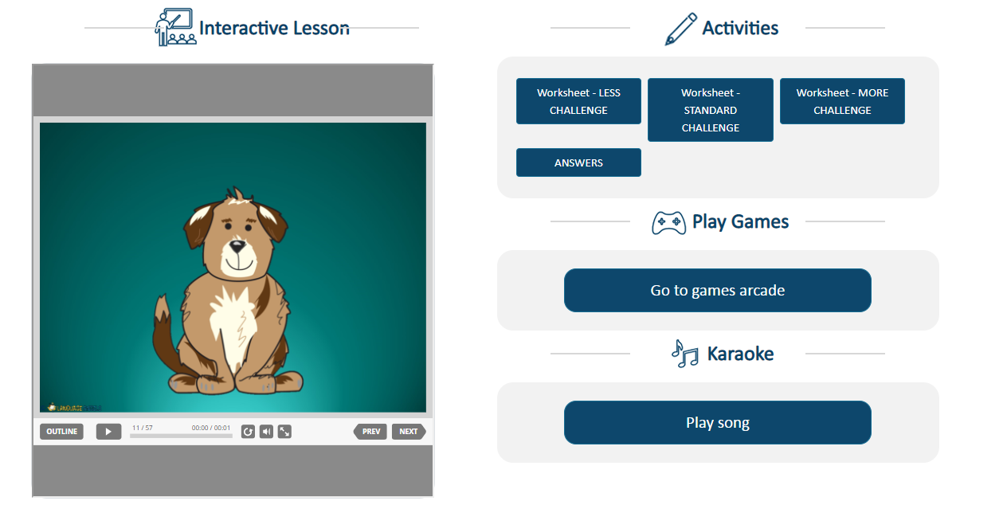
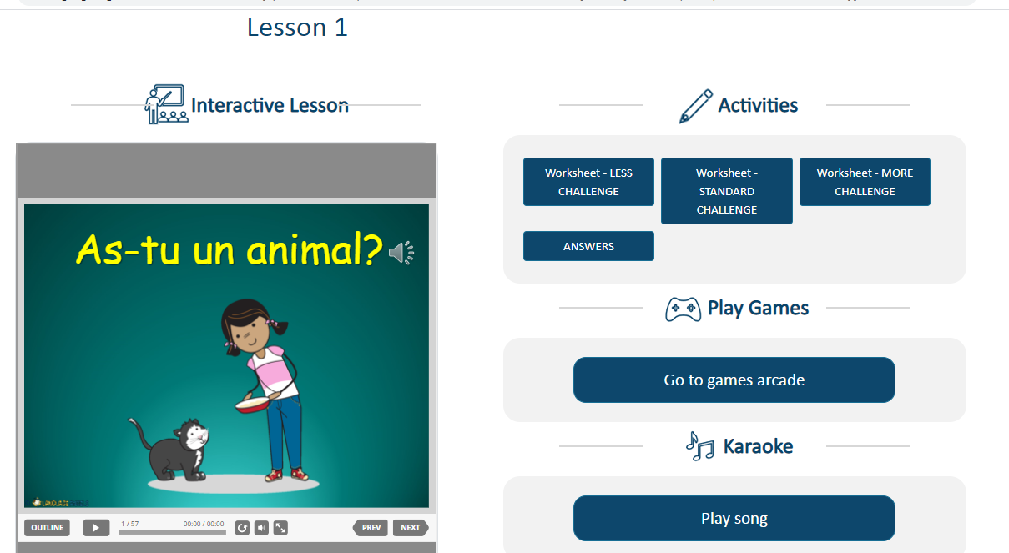
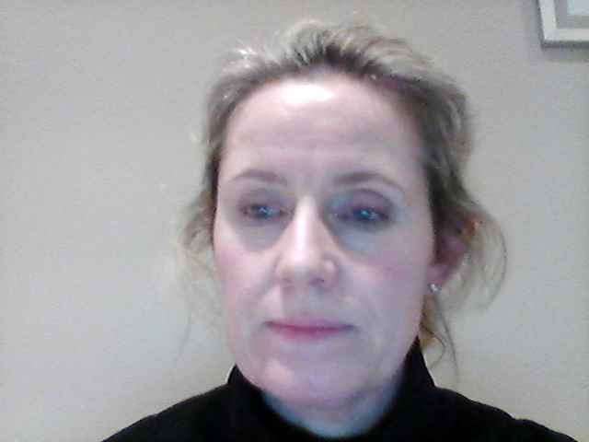

Slide 5
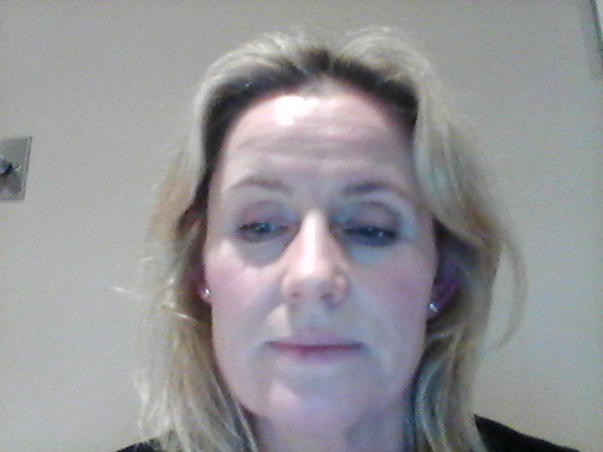
Lesson One – learning the names of animals
As-tu un animal?
J’ai un chat
J’ai un chien
J’ai un lapin
J’ai une tortue
Please download the STANDARD challenge or if you feel more confident the MORE challenge sheet.

