Slide 1
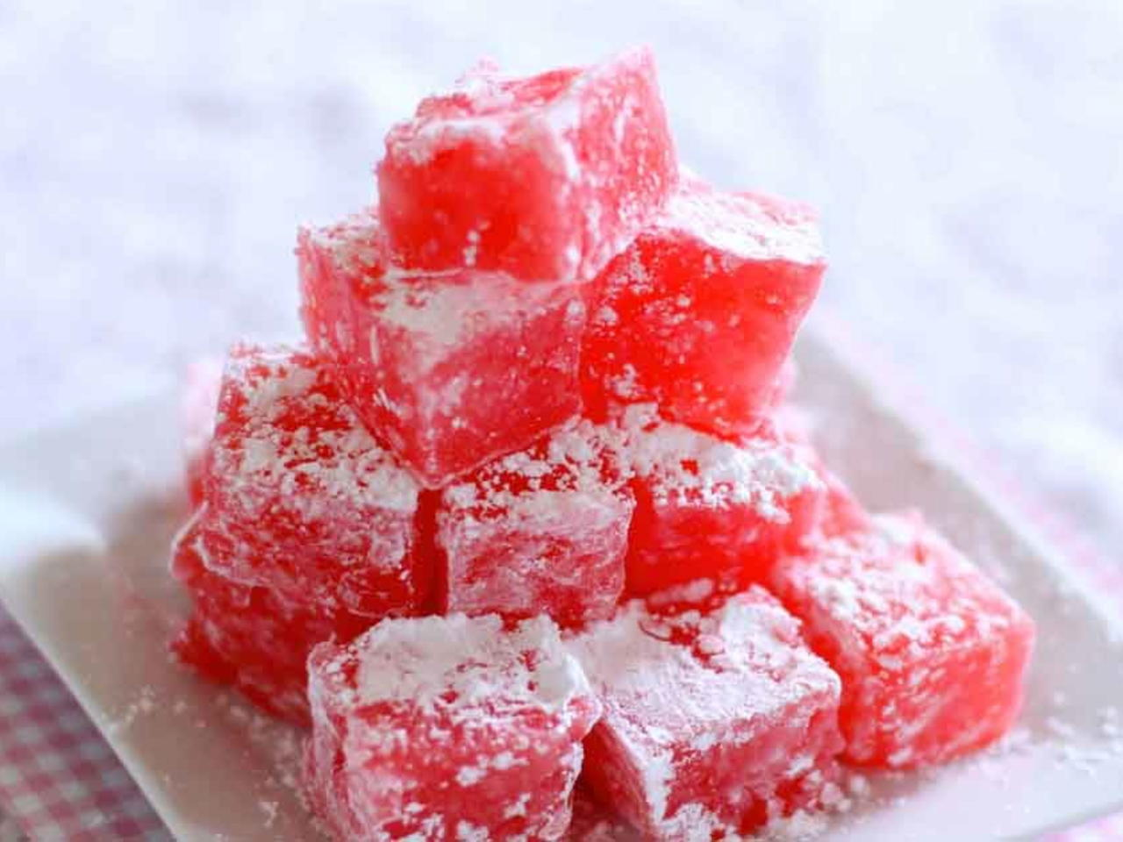

Monday
Read Chapter 4 of The Lion, the Witch and the Wardrobe.
Turkish Delight

Slide 2

Now answer the questions on Chapter 4 from the Educator’s Guide, pages 15-18, or in the separate document Y5 English Monday 18th Comp Questions.pdf.
Read the vocabulary pages and go onto the next slide.

Slide 4
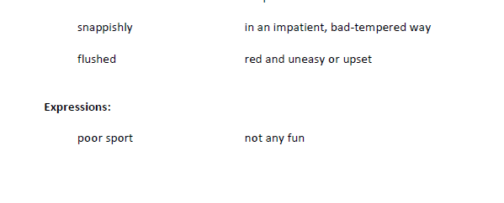
Then attempt the vocabulary enrichment activities.

Slide 6
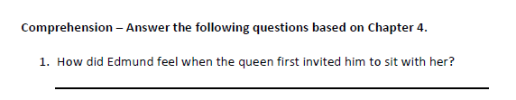
Find that part in the chapter, then answer:
Edmund felt a little bit scared when the queen first invited him to sit with her because it says in that text that he ‘did not like this arrangement at all but he dared not disobey’.

Slide 8


