Slide 1


Login:StPete1494
Password:lahome
https://www.languageangels.com/homeschool/
When you open up the site click on dashboard.
Go to the Intermediate Challenge Level
Click on Unit 1 (En Classe)
Go to lesson one and move through the slides making sure you repeat each word (press the speaker).
Then look at the words. Write them down using slide number 14.
Then practise the la questionne et la response on the next slide!
Bon courage!

Slide 2

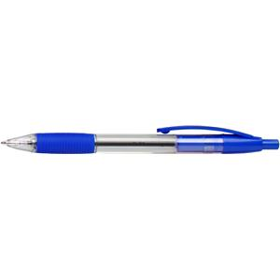
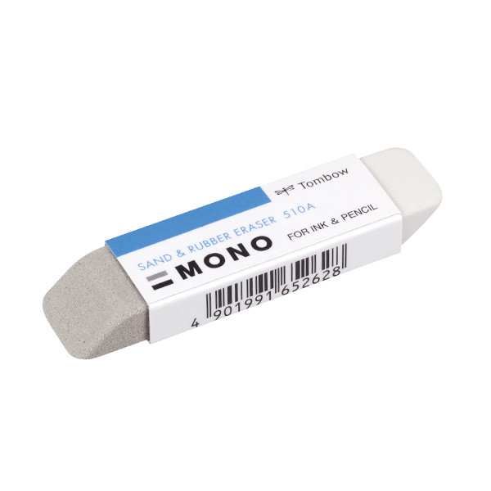
C’est un stylo.
C’est une gomme.
Qu’est-ce que c’est?
What is it?
Why do some words begin with ‘un’ and others with ‘une’?

