Slide 1


Slide 3
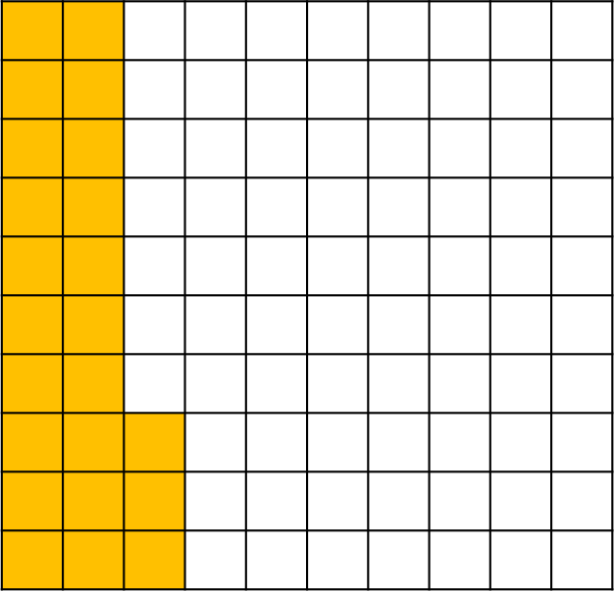
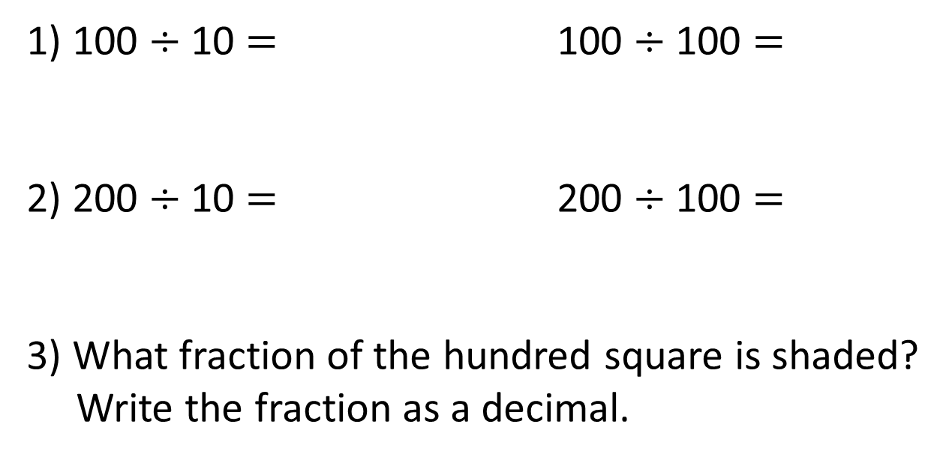
1) 100 $÷$ 10 $=$ 100 $÷$ 100 $=$
2) 200 $÷$ 10 $=$ 200 $÷$ 100 $=$
3) What fraction of the hundred square is shaded?
Write the fraction as a decimal.

Slide 4
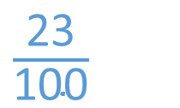
1) 100 $÷$ 10 $=$ 100 $÷$ 100 $=$
2) 200 $÷$ 10 $=$ 200 $÷$ 100 $=$
3) What fraction of the hundred square is shaded?
Write the fraction as a decimal.
10
1
20
2
$\frac{\text{23}}{\text{100}}$
0.23

Slide 6
Percent means parts out of 100
37
There are _______ parts out of a hundred shaded.
This is _______ %
37

Slide 7
There are ______ parts out of a hundred shaded.
This is ______ %
49
49
49% is shaded, so 51% is not shaded.

Slide 8


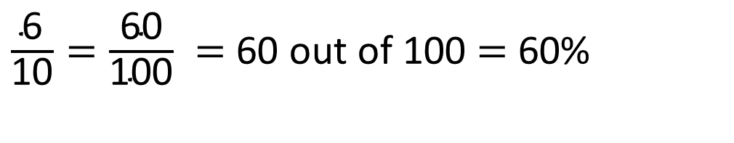
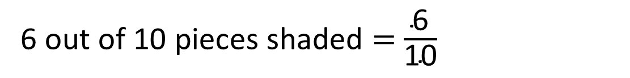
Has 6% of the bar model been shaded?
6 out of 10 pieces shaded $=$ $\frac{\text{6}}{\text{10}}$
$\frac{\text{6}}{\text{10}}=\frac{\text{60}}{\text{100}} =$ 60 out of 100 $=$ 60%
Have a think

Slide 9
What is 100%
100%
10%
25%
10%
10%
50%
10%
25%
10%
10%
25%
10%
10%
10%
25%
50%
10%

Slide 10
100%
5%
10%
30%
55%
60%

Slide 11
Have a go at questions
1 - 4 on the worksheet

Slide 12

There are 100 crayons in a box.
10% are broken.
How many are broken?
100 crayons
10% broken
10
______ crayons are broken.

Slide 13
There are 200 crayons in a box.
10% are broken.
How many are broken?
200 crayons
10% broken
20
______ crayons are broken.

Slide 14




Tommy has £1 to spend.
He spends 40 p on sweets.
He spends 35% of the £1 on a pencil.
What percentage of money does he have left?
Have a think

Slide 15
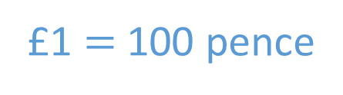
Tommy has £1 to spend.
He spends 40 p on sweets.
He spends 35% of the £1 on a pencil.
What percentage of money does he have left?
£1 $=$ 100 pence
25 % left

Slide 16
Have a go at the rest of the questions on the worksheet

