Slide 1


Slide 3
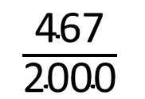
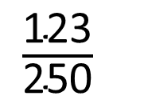
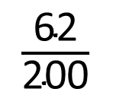
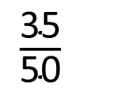
1) Find the equivalent decimals for these fractions.
2) Find the equivalent fractions for these decimals.
$\frac{\text{35}}{\text{50}}$
$\frac{\text{62}}{\text{200}}$
$\frac{\text{123}}{\text{250}}$
$\frac{\text{467}}{\text{2000}}$
0.41
0.057
0.36
0.75

Slide 4
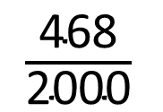
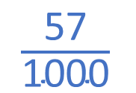
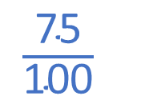
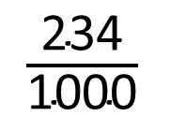
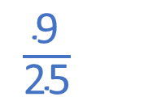
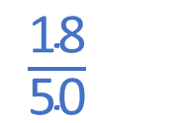
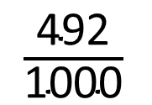
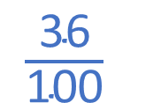
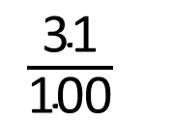
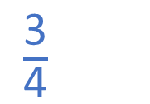
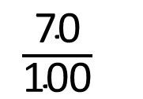
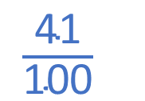
1) Find the equivalent decimals for these fractions.
2) Find the equivalent fractions for these decimals.
$\frac{\text{35}}{\text{50}}$
$\frac{\text{70}}{\text{100}}$
$\frac{\text{62}}{\text{200}}$
$\frac{\text{31}}{\text{100}}$
0.7
0.31
$\frac{\text{123}}{\text{250}}$
$\frac{\text{492}}{\text{1000}}$
$\frac{\text{468}}{\text{2000}}$
$\frac{\text{234}}{\text{1000}}$
0.492
0.234
0.41
$\frac{\text{41}}{\text{100}}$
0.057
$\frac{\text{57}}{\text{1000}}$
0.36
$\frac{\text{36}}{\text{100}}$
$\frac{\text{18}}{\text{50}}$
$\frac{\text{9}}{\text{25}}$
0.75
$\frac{\text{75}}{\text{100}}$
$\frac{\text{3}}{\text{4}}$

Slide 6




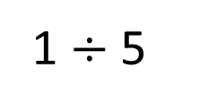
1
$\frac{\text{1}}{\text{5}}$
$$÷$$
5
0
1
$\frac{\text{1}}{\text{5}}$
$$=$$
1 $÷$ 5
Fractions can be expressed as divisions

Slide 7


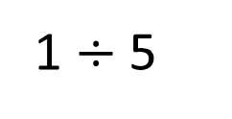

Find the decimal equivalent of $\frac{\text{1}}{\text{5}}$
1 $÷$ 5
Ones | tenths
5 | 1
0
.
2
.
1
0
0.2

Slide 8

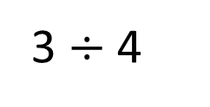
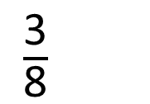
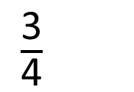
Find the equivalent decimals for these fractions.
4 | 3
0
.
7
5
$\frac{\text{3}}{\text{4}}$
3 $÷$ 4
0.75
.
3
0
2
0
$\frac{\text{3}}{\text{8}}$
Have a think

Slide 9
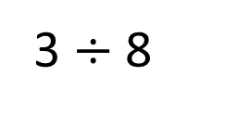
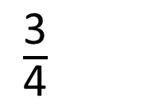
Find the equivalent decimals for these fractions.
4 | 3
0
.
7
5
$\frac{\text{3}}{\text{4}}$
3 $÷$ 4
0.75
.
3
0
2
0
8 | 3
0
.
3
7
5
$\frac{\text{3}}{\text{8}}$
3 $÷$ 8
3
6
4
0.375
.
0
0
0

Slide 10
Have a go at questions
1 - 3 on the worksheet

Slide 11
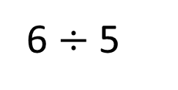
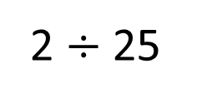
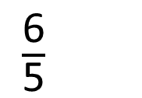
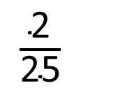
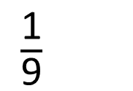
Find the equivalent decimals for these fractions.
25 | 2
0
.
0
8
$\frac{\text{2}}{\text{25}}$
2 $÷$ 25
2
20
0.08
.
0
0
5 | 6
1
.
2
$\frac{\text{6}}{\text{5}}$
6 $÷$ 5
1.2
1
.
0
$\frac{\text{1}}{\text{9}}$
Have a think

Slide 12
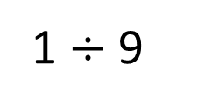
Find the equivalent decimals for these fractions.
25 | 2
0
.
0
8
$\frac{\text{2}}{\text{25}}$
2 $÷$ 25
2
20
0.08
.
0
0
5 | 6
1
.
2
$\frac{\text{6}}{\text{5}}$
6 $÷$ 5
1.2
1
.
0
9 | 1
0
.
1
1
1
$\frac{\text{1}}{\text{9}}$
●
1 $÷$ 9
0.1
1
0.111111…
.
1
1
0
0
0

Slide 13

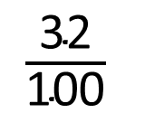
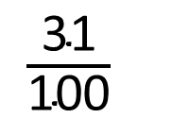
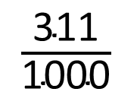
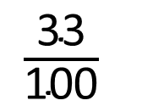
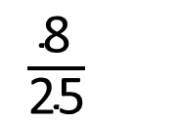
Rosie is thinking of a fraction.
When I convert it to a decimal it’s between 0.3 and 0.34
What fraction could Rosie be thinking of?
0.31
0.311
0.32
0.33
$\frac{\text{31}}{\text{100}}$
$\frac{\text{311}}{\text{1000}}$
$\frac{\text{32}}{\text{100}}$
$\frac{\text{8}}{\text{25}}$
$\frac{\text{33}}{\text{100}}$
Have a think

Slide 14
Have a go at the rest of the questions on the worksheet

