Slide 1


Slide 3


T | O | tth | hth
1) What number is represented in the place value chart? Write it in words and numerals.
2)
What fraction is represented on the bar model? Can you write it as a decimal?
3) What is the value of the digit 5? 46.95

Slide 4
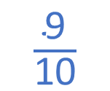
T | O | tth | hth
1) What number is represented in the place value chart? Write it in words and numerals.
2)
What fraction is represented on the bar model? Can you write it as a decimal?
3) What is the value of the digit 5? 46.95
0.32
thirty-two hundredths
$\frac{\text{9}}{\text{10}}$
0.9
5 hundredths

Slide 6

zero point one
one tenth
0.1
$$\frac{\text{1}}{\text{10}}$$
one out of 10

Slide 7

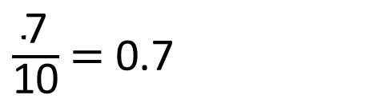
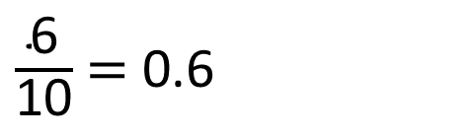
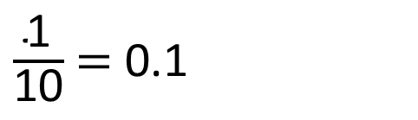

Have a think
$$\frac{\text{1}}{\text{10}}$$
0.1 | 0.1 | 0.1 | 0.1 | 0.1 | 0.1 | 0.1 | 0.1 | 0.1 | 0.1
$\frac{\text{1}}{\text{10}}$ $=$ 0.1
$\frac{\text{6}}{\text{10}}$ $=$ 0.6
$\frac{\text{7}}{\text{10}}$ $=$ 0.7

Slide 8

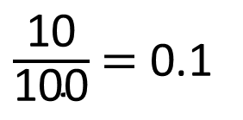
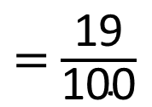
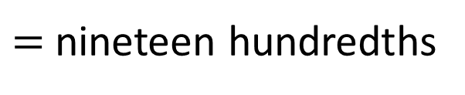
$=$ nineteen hundredths
$=$ $\frac{\text{19}}{\text{100}}$
$=$ $\text{0.19}$
$\frac{\text{10}}{\text{100}}$ $=$ 0.1
0

Slide 9
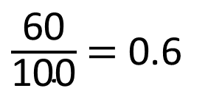
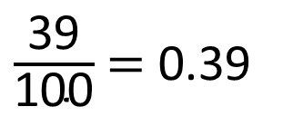
Have a think
$\frac{\text{39}}{\text{100}}$ $=$ 0.39
$\frac{\text{60}}{\text{100}}$ $=$ 0.6
0

Slide 10
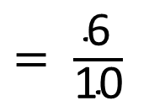
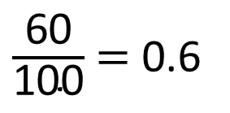
$\frac{\text{60}}{\text{100}}$ $=$ 0.6
$= \frac{\text{6}}{\text{10}}$

Slide 11
Have a go at questions
1 - 2 on the worksheet

Slide 12
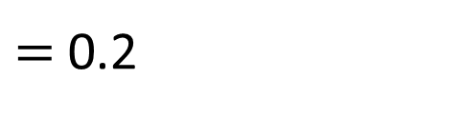


$$\frac{\text{1}}{\text{10}}$$
0.1 | 0.1 | 0.1 | 0.1 | 0.1 | 0.1 | 0.1 | 0.1 | 0.1 | 0.1
0.2 | 0.2 | 0.2 | 0.2 | 0.2
0.2
$$\frac{\text{1}}{\text{5}}$$
$=$ 0.2

Slide 13
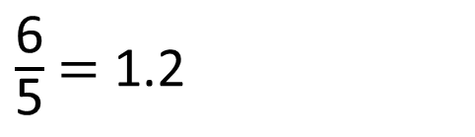
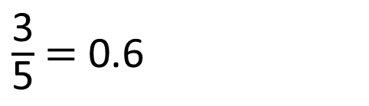
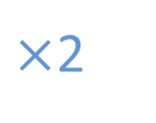
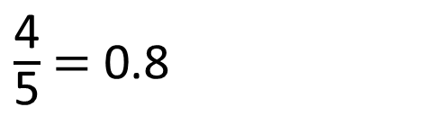

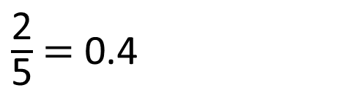


Have a think
0.2 | 0.2 | 0.2 | 0.2 | 0.2
0.2 | 0.2 | 0.2 | 0.2 | 0.2
0.2 | 0.2 | 0.2 | 0.2 | 0.2
$\frac{\text{2}}{\text{5}}$ $=$ 0.4
$\frac{\text{3}}{\text{5}}$ $=$ 0.6
$×$2
$×$2
$×$2
$×$2
$\frac{\text{4}}{\text{5}}$ $=$ 0.8
$\frac{\text{6}}{\text{5}}$ $=$ 1.2

Slide 14
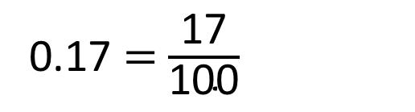
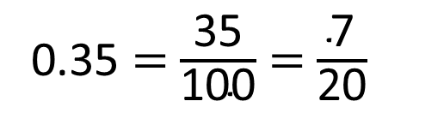
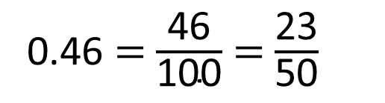
Fill in the missing numbers.
0.46 $=$ $\frac{\text{46}}{\text{100}}$ $=$ $\frac{\text{23}}{\text{50}}$
0.35 $=$ $\frac{\text{35}}{\text{100}}$ $=$ $\frac{\text{7}}{\text{20}}$
0.17 $=$ $\frac{\text{17}}{\text{100}}$
Have a think

Slide 15

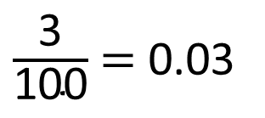
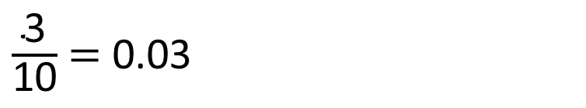
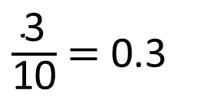
Have a think
$\frac{\text{3}}{\text{10}}$ $=$ 0.03
Draw a diagram to show that Tiny is incorrect.
$\frac{\text{3}}{\text{100}}$ $=$ 0.03
$\frac{\text{3}}{\text{10}}$ $=$ 0.3
0

Slide 16
Have a go at the rest of the questions on the worksheet

