Slide 1


Slide 3
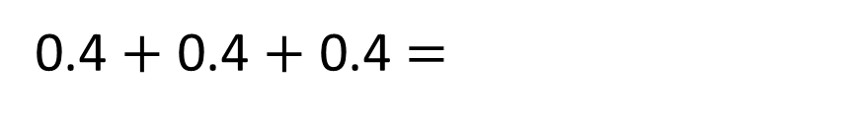
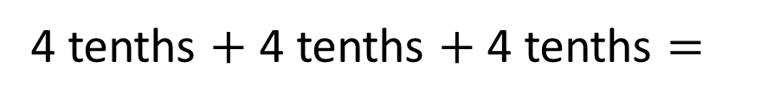
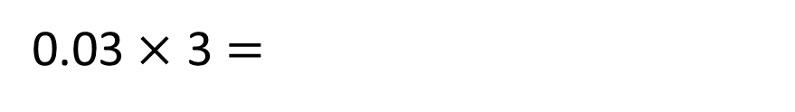
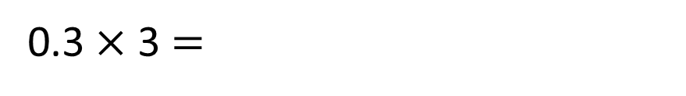
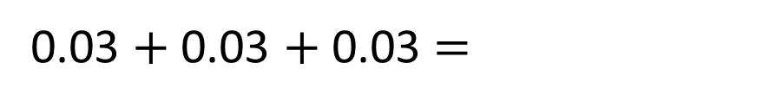
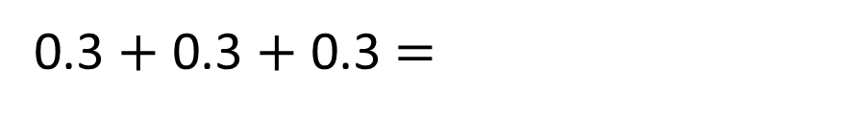
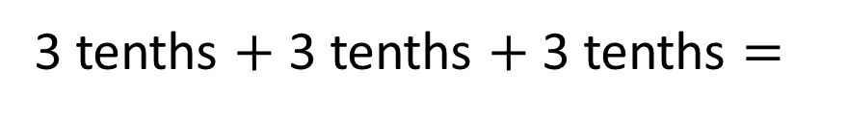
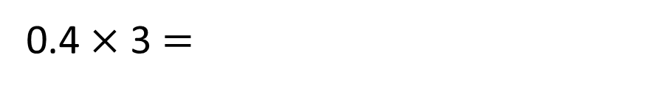
1)
2)
3)
3 tenths $+$ 3 tenths $+$ 3 tenths $=$
0.3 $+$ 0.3 $+$ 0.3 $=$
0.3$×$ 3 $=$
3 hundredths $+$ 3 hundredths $+$ 3 hundredths $=$
0.03 $+$ 0.03 $+$ 0.03 $=$
0.03$×$ 3 $=$
4 tenths $+$ 4 tenths $+$ 4 tenths $=$
0.4 $+$ 0.4 $+$ 0.4 $=$
0.4$×$ 3 $=$

Slide 4

1)
2)
3)
3 tenths $+$ 3 tenths $+$ 3 tenths $=$
9 tenths
0.3 $+$ 0.3 $+$ 0.3 $=$
0.9
0.3$×$ 3 $=$
0.9
3 hundredths $+$ 3 hundredths $+$ 3 hundredths $=$
9 hundredths
0.09
0.03 $+$ 0.03 $+$ 0.03 $=$
0.09
0.03$×$ 3 $=$
4 tenths $+$ 4 tenths $+$ 4 tenths $=$
12 tenths
1.2
0.4 $+$ 0.4 $+$ 0.4 $=$
1.2
10 tenths $=$ 1 whole
0.4$×$ 3 $=$

Slide 6

Teddy spends £1.50 on his lunch every day during the week.
How much money does Teddy need each week?

Slide 7





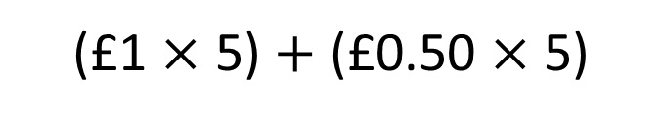

Teddy spends £1.50 on his lunch every day during the week.
£1.50 $×$ 5
$=$ £7.50
(£1 $×$ 5) $+$ (£0.50 $×$ 5)
£0.50 $×$ 5
$=$ £2.50

Slide 8


Have a think
Alex runs 3.3 km a day.
She does this for 3 days.
How far does she run in 3 days?

Slide 9


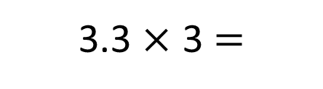
Alex runs 3.3 km a day.
She does this for 3 days.
How far does she run in 3 days?
3.3 $×$ 3 $=$
9.9 km
Tens | Ones | tenths

Slide 10

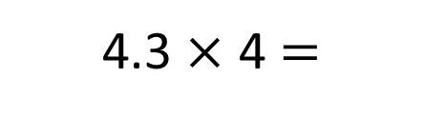

4.3 $×$ 4 $=$
17.2
Have a think
Tens | Ones | tenths
T | O | . | ths
 | 4 | . | 3
 |  |  | 4
$$×$$
1
7
.
2
1

Slide 11


T | O | . | ths
 | 6 | . | 5
 |  |  | 3
$$×$$
1
.
5
1
8
.
0
$$+$$
1
9
.
5

Slide 12


Have a think
T | O | . | ths
 | 5 | . | 3
 |  |  | 4
$$×$$
1
.
2
2
0
.
0
$$+$$
2
1
.
2

Slide 13
Have a go at questions
1 - 4 on the worksheet

Slide 14


Have a think
T | O | . | Ths
2 | 1 | . | 3
 |  |  | 4
 | H | T | O
 | 2 | 1 | 3
 |  |  | 4
$$×$$
$$×$$
8
5
.
2
8
5
2
1
1
What’s the same? What’s different?

Slide 15
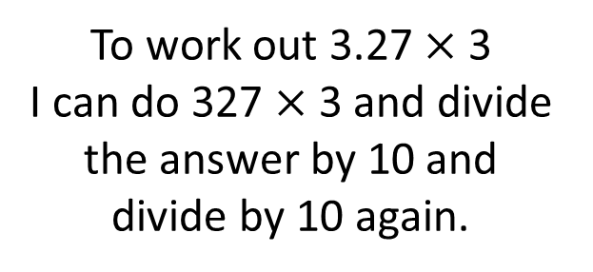
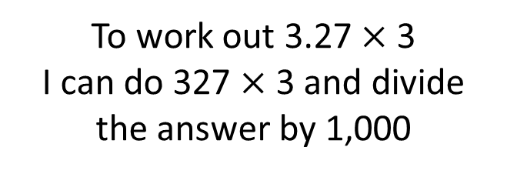
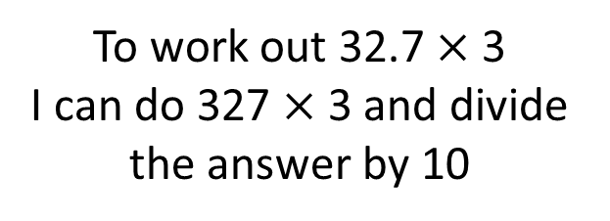
Have a think
True
False
To work out 32.7 $×$ 3
I can do 327 $×$ 3 and divide the answer by 10
To work out 3.27 $×$ 3
I can do 327 $×$ 3 and divide the answer by 1,000
To work out 3.27 $×$ 3
I can do 327 $×$ 3 and divide the answer by 10 and divide by 10 again.

Slide 16
Have a go at the rest of the questions on the worksheet

