Slide 1


Slide 3


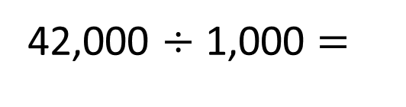
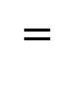
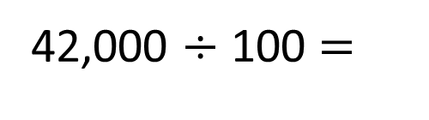
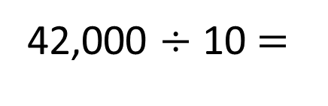
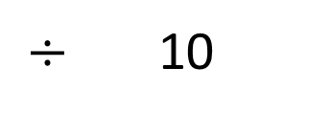
1)
2)
3)
42,000 $÷$ 10 $=$
42,000 $÷$ 100 $=$
42,000 $÷$ 1,000 $=$
$÷$ 10
$=$
80
?

Slide 4

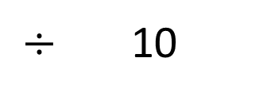
1)
2)
3)
42,000 $÷$ 10 $=$
4,200
42,000 $÷$ 100 $=$
420
42,000 $÷$ 1,000 $=$
42
$÷$ 10
$=$
24
240
$$÷$$
10
80
8
?

Slide 6
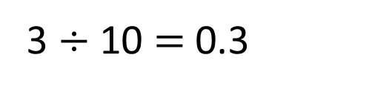
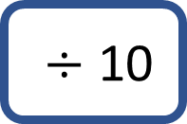
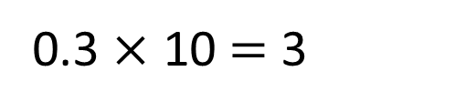
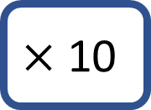
100 | 200 | 300 | 400 | 500 | 600 | 700 | 800 | 900
10 | 20 | 30 | 40 | 50 | 60 | 70 | 80 | 90
1 | 2 | 3 | 4 | 5 | 6 | 7 | 8 | 9
0.1 | 0.2 | 0.3 | 0.4 | 0.5 | 0.6 | 0.7 | 0.8 | 0.9
0.01 | 0.02 | 0.03 | 0.04 | 0.05 | 0.06 | 0.07 | 0.08 | 0.09
$$×\text{10}$$
$÷\text{10}$
0.3 $×$ 10 $=$ 3
3 $÷$ 10 $=$ 0.3

Slide 7
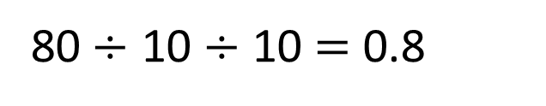
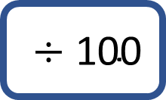
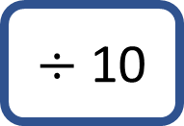
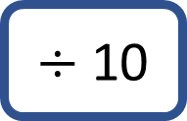
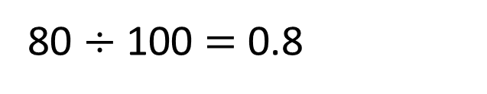
100 | 200 | 300 | 400 | 500 | 600 | 700 | 800 | 900
10 | 20 | 30 | 40 | 50 | 60 | 70 | 80 | 90
1 | 2 | 3 | 4 | 5 | 6 | 7 | 8 | 9
0.1 | 0.2 | 0.3 | 0.4 | 0.5 | 0.6 | 0.7 | 0.8 | 0.9
0.01 | 0.02 | 0.03 | 0.04 | 0.05 | 0.06 | 0.07 | 0.08 | 0.09
$÷$ $\text{10}$
$÷$ $\text{100}$
$÷$ $\text{10}$
80$÷$ 10 $÷$ 10 $=$ 0.8
80 $÷$ 100 $=$ 0.8

Slide 8
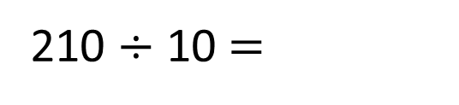
210 $÷$ 10 $=$
21
Th | H | T | O | tth | hth
2
1
0
When the number is divided by 10 the counters move _____ place to the _____.
1
right

Slide 9
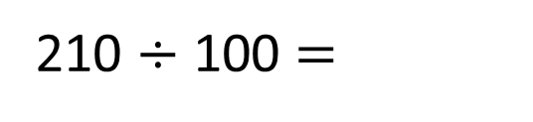
210 $÷$ 100 $=$
2.1
Th | H | T | O | tth | hth
2
1
0
When the number is divided by 100 the counters move _____ places to the _____.
2
right

Slide 10

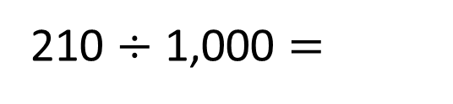
210 $÷$ 1,000 $=$
0.21
Have a think
Th | H | T | O | tth | hth
2
1
0
When the number is divided by 1,000 the counters move _____ places to the _____.
3
right

Slide 11
Have a go at questions
1 - 3 on the worksheet

Slide 12
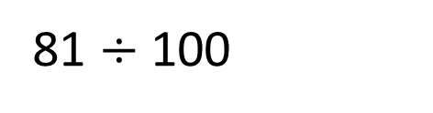
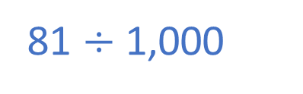
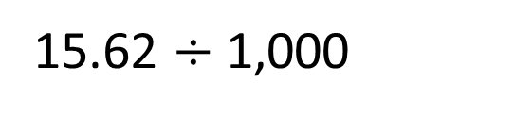
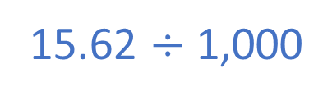

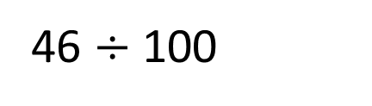
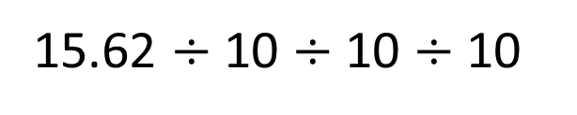


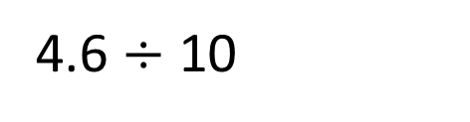

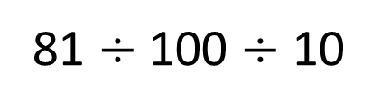
Use $> , <$or $=$ to complete the sentences
15.62 $÷$ 10 $÷$ 10 $÷$ 10
$$=$$
15.62 $÷$ 1,000
15.62 $÷$ 1,000
81 $÷$ 100
$$>$$
81 $÷$ 100 $÷$ 10
81 $÷$ 1,000
4.6 $÷$ 10
$$=$$
46 $÷$ 100
0.46
0.46
Have a think

Slide 13





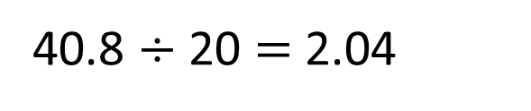
40.8 $÷$ 20 $=$ 2.04
Have a think
We could use the inverse and do
2.04 $×$ 20
Rosie
That’s a great idea Rosie! We could do 2.04 $×$ 2 $×$ 10
Amir
Let’s use a Gattegno chart to help us!
Dora

Slide 14
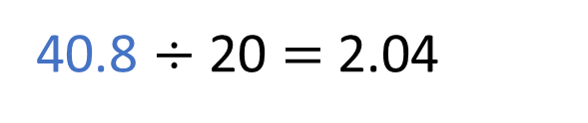
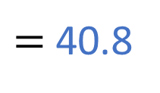
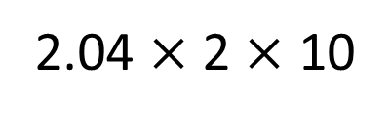
40.8 $÷$ 20 $=$ 2.04
100 | 200 | 300 | 400 | 500 | 600 | 700 | 800 | 900
10 | 20 | 30 | 40 | 50 | 60 | 70 | 80 | 90
1 | 2 | 3 | 4 | 5 | 6 | 7 | 8 | 9
0.1 | 0.2 | 0.3 | 0.4 | 0.5 | 0.6 | 0.7 | 0.8 | 0.9
0.01 | 0.02 | 0.03 | 0.04 | 0.05 | 0.06 | 0.07 | 0.08 | 0.09
2.04 $×$ 2 $×$ 10
$=$ 40.8

Slide 15
Have a go the rest of the questions on the worksheet

