Slide 1


Slide 3



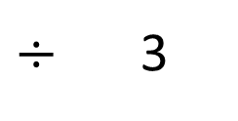
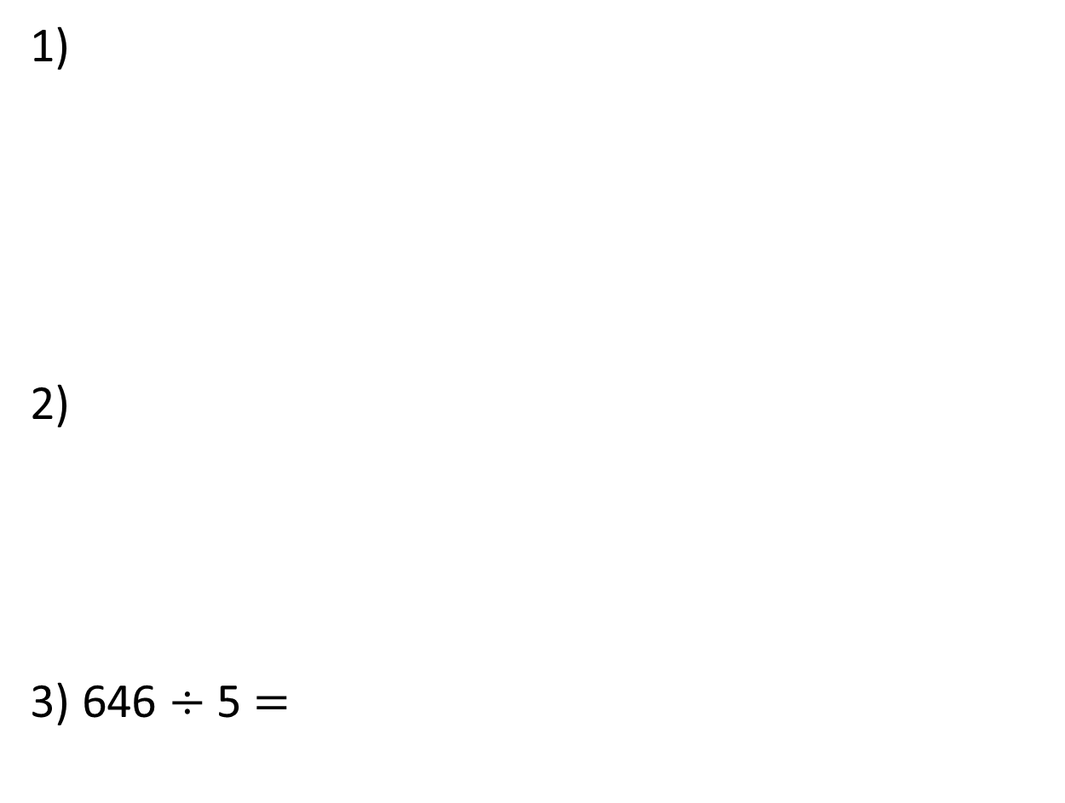
1)
2)
3) 646 $÷$ 5 $=$
$÷$ 3
645
?

Slide 4

1)
2)
3) 646 $÷$ 5 $=$
$÷$ 3
$$=$$
108
3 | 3 | 2 | 4
1
0
8
2
645
129
?
5 | 6 | 4 | 5
1
2
9
1
4
129 r1

Slide 6
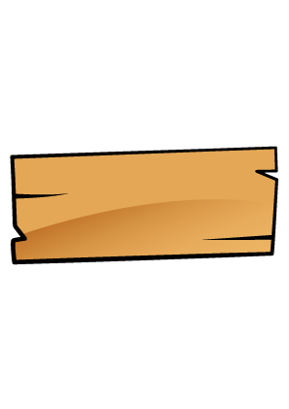
Mr Rose is building some garden furniture.
His plank of wood is 3.96 m long.
He needs to cut it into 3 equal pieces.
How long is each piece?

Slide 7


Ones | tenths | hundredths
 | 1
3 | 3 | . | 9 | 6
 | 1 | .
3 | 3 | . | 9 | 6
 | 1 | . | 3
3 | 3 | . | 9 | 6
 | 1 | . | 3 | 2
3 | 3 | . | 9 | 6
3 | 3 | . | 9 | 6
Each piece of wood will be 1.32 m long.

Slide 8

Have a think
Mr Rose has another plank of wood that
is 4.08 m long.
He needs to cut it into four equal pieces.
How long is each piece?

Slide 9
Ones | tenths | hundredths
1.2 m or 1.02 m?
4 | 4 | . | 0 | 8
 | 1
4 | 4 | . | 0 | 8
 | 1 | .
4 | 4 | . | 0 | 8
 | 1 | . | 0
4 | 4 | . | 0 | 8
 | 1 | . | 0 | 2
4 | 4 | . | 0 | 8
Each piece of wood will be 1.02 m long.

Slide 10
Ones | tenths | hundredths
4 | 5 | . | 2 | 8
 | 1
4 | 5 | . | 2 | 8
 | 1 | .
4 | 5 | . | 2 | 8
 | 1 | . | 3
4 | 5 | . | 2 | 8
 | 1 | . | 3 | 2
4 | 5 | . | 2 | 8
1
5.2
5.2
0.2
4
1.2
5

Slide 11
Ones | Tenths
Ones | tenths | hundredths
Have a think
4 | 4 | . | 2
 | 1
4 | 4 | . | 2 | 0
 | 1
4 | 4 | . | 2
 | 1 | .
4 | 4 | . | 2 | 0
 | 1 | . | 0
4 | 4 | . | 2 | 0
 | 1 | . | 0 | 5
4 | 4 | . | 2 | 0
2

Slide 12
Have a go at questions
1 - 4 on the worksheet

Slide 13
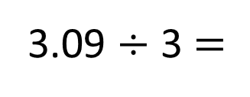
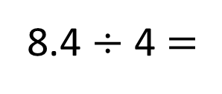
8.4 ÷ 4 $=$
2.1
3.09 ÷ 3 $=$
1.03
8.4
3.09
8
0.4
3
0.09
0.0
÷ 4
÷ 4
÷ 3
÷ 3
÷ 3
2
0.1
1
0.03
0.0

Slide 14
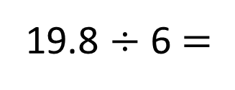
19.8 ÷ 6 $=$
3.3
19.8
19.8
19.8
19.8
6.6
9
19
10
6.6
18
0.8
0.8
1.8
6.6
÷ 6
÷ 6
÷ 6
÷ 6
÷ 6
19.8
3
0.3
1.1
1.1
1.1
10
9.8

Slide 15
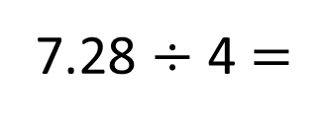
Have a think
7.28 ÷ 4 $=$
1.82
7.82
4
0.08
3.2
÷ 4
÷ 4
÷ 4
1
0.02
0.8

Slide 16
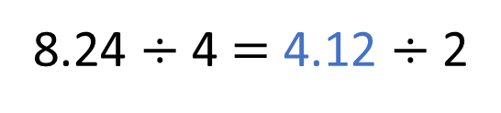
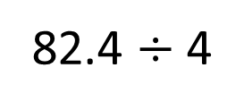
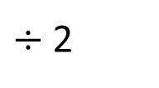
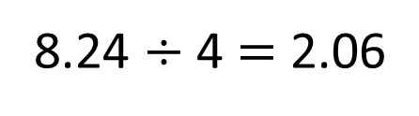
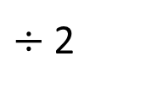
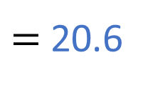
8.24 $÷$ 4 $=$ 2.06
How can I use this to help me solve
$÷$ 2
82.4 $÷$ 4
$=$ 20.6
8.24 $÷$ 4 $=$ 4.12 $÷$ 2
$÷$ 2
Have a think

Slide 17
Have a go at the rest of the questions on the worksheet

