Slide 1


Slide 3



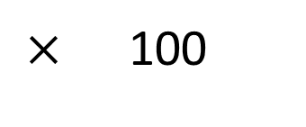
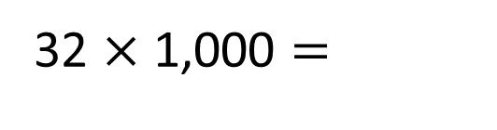
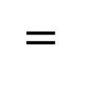
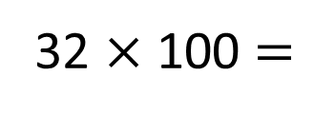
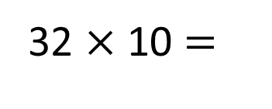
1)
2)
3)
32 $×$ 10 $=$
32 $×$ 100 $=$
32 $×$ 1,000 $=$
$×$ 100
$=$
?
97 | 97 | 97 | 97 | 97 | 97 | 97 | 97 | 97 | 97

Slide 4

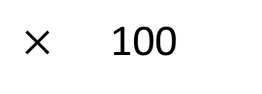
1)
2)
3)
32 $×$ 10 $=$
320
32 $×$ 100 $=$
3,200
32,000
32 $×$ 1,000 $=$
$×$ 100
$=$
12,100
121
$$×$$
100
970
?
97 | 97 | 97 | 97 | 97 | 97 | 97 | 97 | 97 | 97

Slide 6
100 | 200 | 300 | 400 | 500 | 600 | 700 | 800 | 900
10 | 20 | 30 | 40 | 50 | 60 | 70 | 80 | 90
1 | 2 | 3 | 4 | 5 | 6 | 7 | 8 | 9
0.1 | 0.2 | 0.3 | 0.4 | 0.5 | 0.6 | 0.7 | 0.8 | 0.9
0.01 | 0.02 | 0.03 | 0.04 | 0.05 | 0.06 | 0.07 | 0.08 | 0.09
Which counter has the highest value?
How many times greater is the red counter compared to the blue counter?

Slide 7

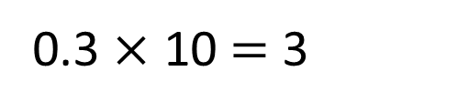
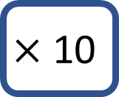
100 | 200 | 300 | 400 | 500 | 600 | 700 | 800 | 900
10 | 20 | 30 | 40 | 50 | 60 | 70 | 80 | 90
1 | 2 | 3 | 4 | 5 | 6 | 7 | 8 | 9
0.1 | 0.2 | 0.3 | 0.4 | 0.5 | 0.6 | 0.7 | 0.8 | 0.9
0.01 | 0.02 | 0.03 | 0.04 | 0.05 | 0.06 | 0.07 | 0.08 | 0.09
$$×\text{10}$$
0.3 $×$ 10 $=$ 3
Have a think

Slide 8
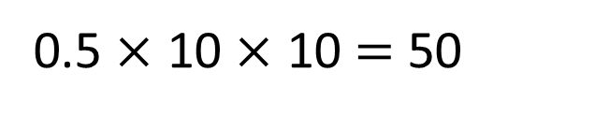
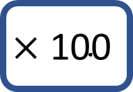
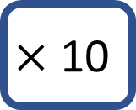

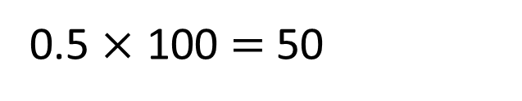
100 | 200 | 300 | 400 | 500 | 600 | 700 | 800 | 900
10 | 20 | 30 | 40 | 50 | 60 | 70 | 80 | 90
1 | 2 | 3 | 4 | 5 | 6 | 7 | 8 | 9
0.1 | 0.2 | 0.3 | 0.4 | 0.5 | 0.6 | 0.7 | 0.8 | 0.9
0.01 | 0.02 | 0.03 | 0.04 | 0.05 | 0.06 | 0.07 | 0.08 | 0.09
$$×\text{10}$$
$$×\text{100}$$
$$×\text{10}$$
0.5 $×$ 10 $×$ 10 $=$ 50
0.5 $×$ 100 $=$ 50

Slide 9
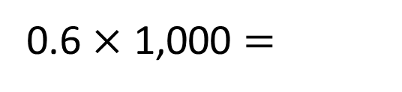
0.6 $×$ 1,000 $=$
600
Have a think
100 | 200 | 300 | 400 | 500 | 600 | 700 | 800 | 900
10 | 20 | 30 | 40 | 50 | 60 | 70 | 80 | 90
1 | 2 | 3 | 4 | 5 | 6 | 7 | 8 | 9
0.1 | 0.2 | 0.3 | 0.4 | 0.5 | 0.6 | 0.7 | 0.8 | 0.9
0.01 | 0.02 | 0.03 | 0.04 | 0.05 | 0.06 | 0.07 | 0.08 | 0.09

Slide 10
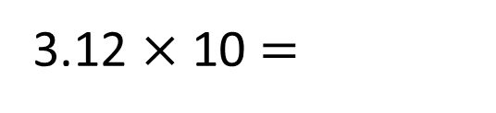
3.12 $×$ 10 $=$
31.2
Th | H | T | O | tth | hth
3
1
2
When the number is multiplied by 10 the counters move _____ place to the _____.
1
left

Slide 11
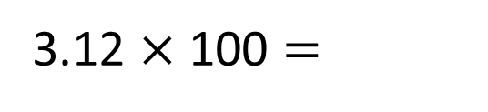
3.12 $×$ 100 $=$
312
Th | H | T | O | tth | hth
3
1
2
When the number is multiplied by 100 the counters move _____ places to the _____.
2
left

Slide 12
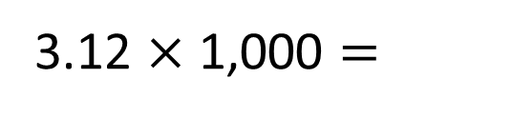
3.12 $×$ 1,000 $=$
Have a think
312
3,120
Th | H | T | O | tth | hth
0
1
2
3
When the number is multiplied by 1,000 the counters move _____ places to the _____.
3
left

Slide 13
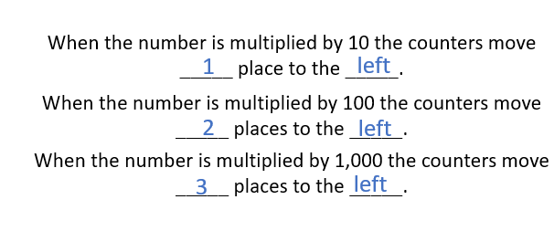
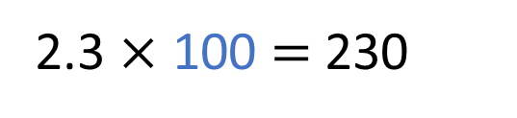
2.3 $×$ 100 $=$ 230
Have a think
Th | H | T | O | tth | hth
0
3
2

Slide 14
Have a go at questions
1 - 4 on the worksheet

Slide 15
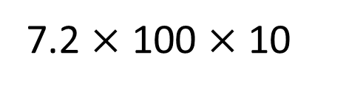
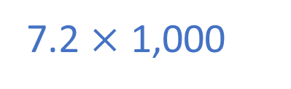
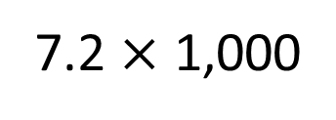

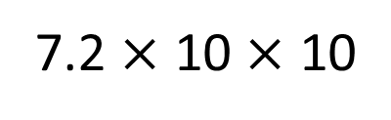



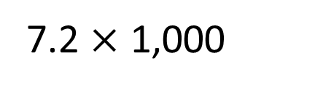
Use $> , <$or $=$ to complete the sentences
7.2 $×$ 10 $×$ 10
$$<$$
7.2 $×$ 1,000
7.2 $×$ 100
7.2 $×$ 100 $×$ 10
$$=$$
7.2 $×$ 1,000
7.2 $×$ 1,000
Have a think

Slide 16






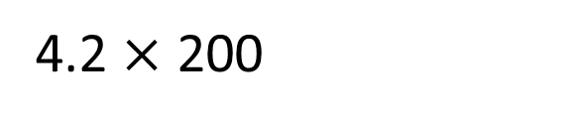
4.2 $×$ 200
Have a think
You could do
4.2 $×$ 100 $×$ 2
Rosie
I disagree, there are two hundreds so it would be
4.2 $×$ 100 $×$ 100
Amir
I think it’d be
4.2 $×$ 2 $×$ 100
Dora

Slide 17
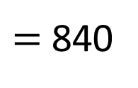
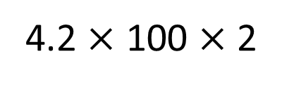
100 | 200 | 300 | 400 | 500 | 600 | 700 | 800 | 900
10 | 20 | 30 | 40 | 50 | 60 | 70 | 80 | 90
1 | 2 | 3 | 4 | 5 | 6 | 7 | 8 | 9
0.1 | 0.2 | 0.3 | 0.4 | 0.5 | 0.6 | 0.7 | 0.8 | 0.9
0.01 | 0.02 | 0.03 | 0.04 | 0.05 | 0.06 | 0.07 | 0.08 | 0.09
4.2 $×$ 100 $×$ 2
$=$ 840

Slide 18
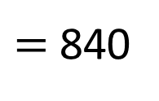
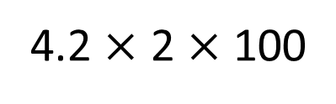
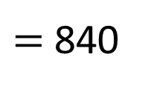
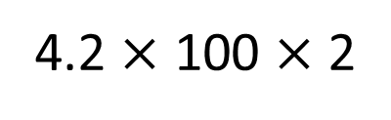
100 | 200 | 300 | 400 | 500 | 600 | 700 | 800 | 900
10 | 20 | 30 | 40 | 50 | 60 | 70 | 80 | 90
1 | 2 | 3 | 4 | 5 | 6 | 7 | 8 | 9
0.1 | 0.2 | 0.3 | 0.4 | 0.5 | 0.6 | 0.7 | 0.8 | 0.9
0.01 | 0.02 | 0.03 | 0.04 | 0.05 | 0.06 | 0.07 | 0.08 | 0.09
4.2 $×$ 100 $×$ 2
$=$ 840
4.2 $×$ 2 $×$ 100
$=$ 840

Slide 19
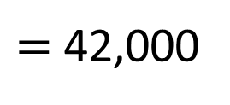
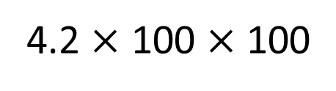
10,000 | 20,000 | 30,000 | 40,000 | 50,000 | 60,000 | 70,000 | 80,000 | 90,000
1,000 | 2,000 | 3,000 | 4,000 | 5,000 | 6,000 | 7,000 | 8,000 | 9,000
100 | 200 | 300 | 400 | 500 | 600 | 700 | 800 | 900
10 | 20 | 30 | 40 | 50 | 60 | 70 | 80 | 90
1 | 2 | 3 | 4 | 5 | 6 | 7 | 8 | 9
0.1 | 0.2 | 0.3 | 0.4 | 0.5 | 0.6 | 0.7 | 0.8 | 0.9
0.01 | 0.02 | 0.03 | 0.04 | 0.05 | 0.06 | 0.07 | 0.08 | 0.09
100 | 200 | 300 | 400 | 500 | 600 | 700 | 800 | 900
10 | 20 | 30 | 40 | 50 | 60 | 70 | 80 | 90
1 | 2 | 3 | 4 | 5 | 6 | 7 | 8 | 9
0.1 | 0.2 | 0.3 | 0.4 | 0.5 | 0.6 | 0.7 | 0.8 | 0.9
0.01 | 0.02 | 0.03 | 0.04 | 0.05 | 0.06 | 0.07 | 0.08 | 0.09
4.2 $×$ 100 $×$ 100
$=$ 42,000

Slide 20
Have a go the rest of the questions on the worksheet

