Slide 1


Slide 3
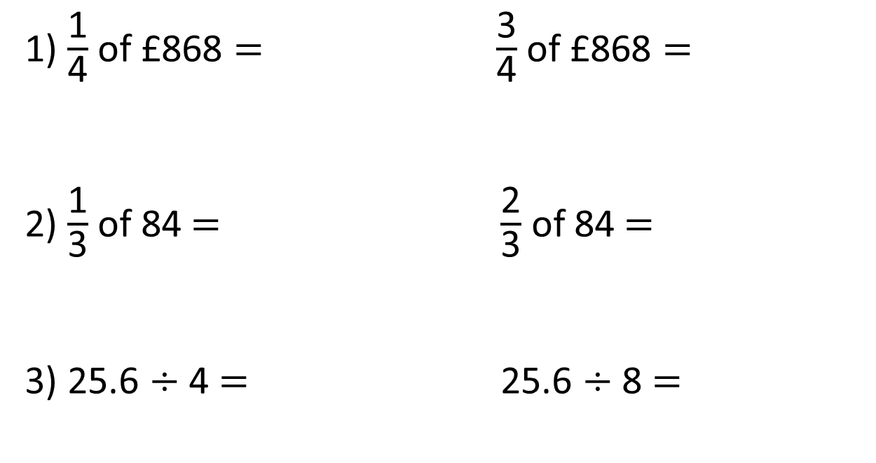
1) $\frac{\text{1}}{\text{4}}$ of £868 $=$ $\frac{\text{3}}{\text{4}}$ of £868 $=$
2) $\frac{\text{1}}{\text{3}}$ of 84$=$ $\frac{\text{2}}{\text{3}}$ of 84$=$
3) 25.6 $÷$ 4 $=$ 25.6 $÷$ 8 $=$

Slide 4
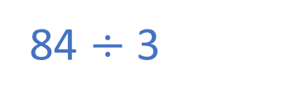
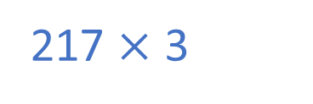
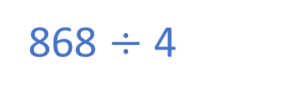
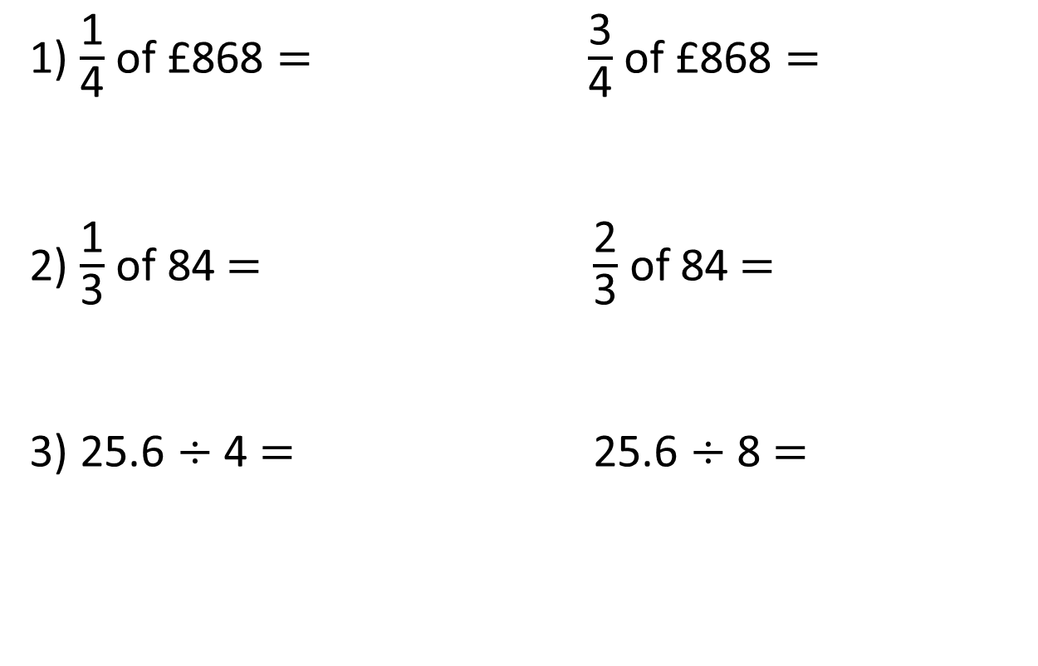
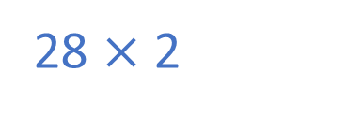
1) $\frac{\text{1}}{\text{4}}$ of £868 $=$ $\frac{\text{3}}{\text{4}}$ of £868 $=$
2) $\frac{\text{1}}{\text{3}}$ of 84$=$ $\frac{\text{2}}{\text{3}}$ of 84$=$
3) 25.6 $÷$ 4 $=$ 25.6 $÷$ 8 $=$
£217
£651
868 $÷$ 4
217 $×$ 3
28
56
84 $÷$ 3
28 $×$ 2
6.4
3.2
 |  |  | .
4 | 2 | 5 | . | 6
 |  |  | .
8 | 2 | 5 | . | 6
0
6
4
0
3
2
Doubled
Halved
1
1

Slide 6



Ron has helped his mum wash the car 7 times.
He gets the same amount of money each time he helps.
Ron has earned £29.40
How much money does he get each time he helps wash the car?
Have a think

Slide 7
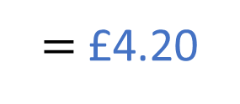
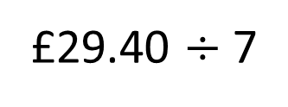
£29.40 $÷$ 7
$=$ £4.20
 |  |  | .
7 | 2 | 9 | . | 4 | 0
0
4
2
0
29.40
1
28
1.4
÷ 7
÷ 7
4
0.2

Slide 8




Eva, Mo and Dexter are having a go at the long jump.
I jumped 4.6 metres.
Eva
I jumped $\frac{\text{3}}{\text{4}}$ of the length Eva jumped.
Mo
Eva jumped twice as far as me.
Dexter
How far did Mo and Dexter jump?
Have a think

Slide 9
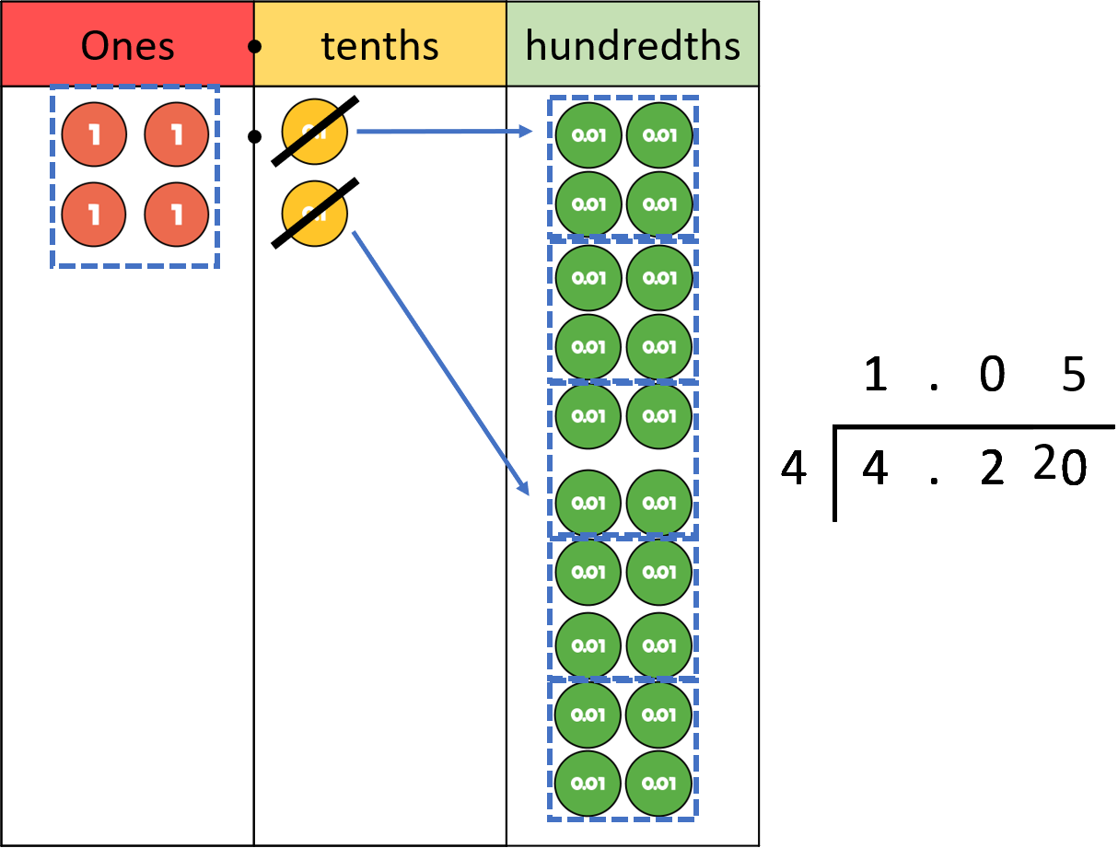
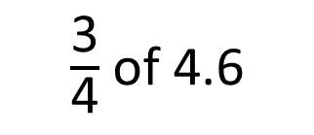

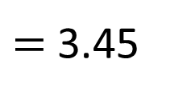
$\frac{\text{3}}{\text{4}}$ of 4.6
$=$ 3.45
I jumped 4.6 metres.
Eva
I jumped $\frac{\text{3}}{\text{4}}$ of the length Eva jumped.
Mo
4.6
1.15
1.15
1.15
?
 |  | .
4 | 4 | . | 6
1
1
5
2
Mo jumped 3.45 metres.
0

Slide 10
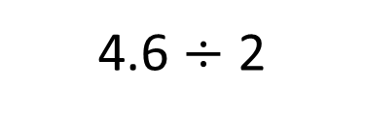
Dexter jumped 2.3 metres.
I jumped 4.6 metres.
Eva
Eva jumped twice as far as me.
Dexter
4.6
2.3
?
4.6 $÷$ 2

Slide 11
Have a go at questions
1 - 5 on the worksheet

Slide 12
There are 478 people at a wedding. They are sitting at tables in groups of 8
How many tables are needed?
What’s the same? What’s different?
What do you notice?
Amir is preparing party bags.
Each party bag has 8 sweets in it.
Amir has 478 sweets altogether.
How many party bags can he fill?
Have a think

Slide 13
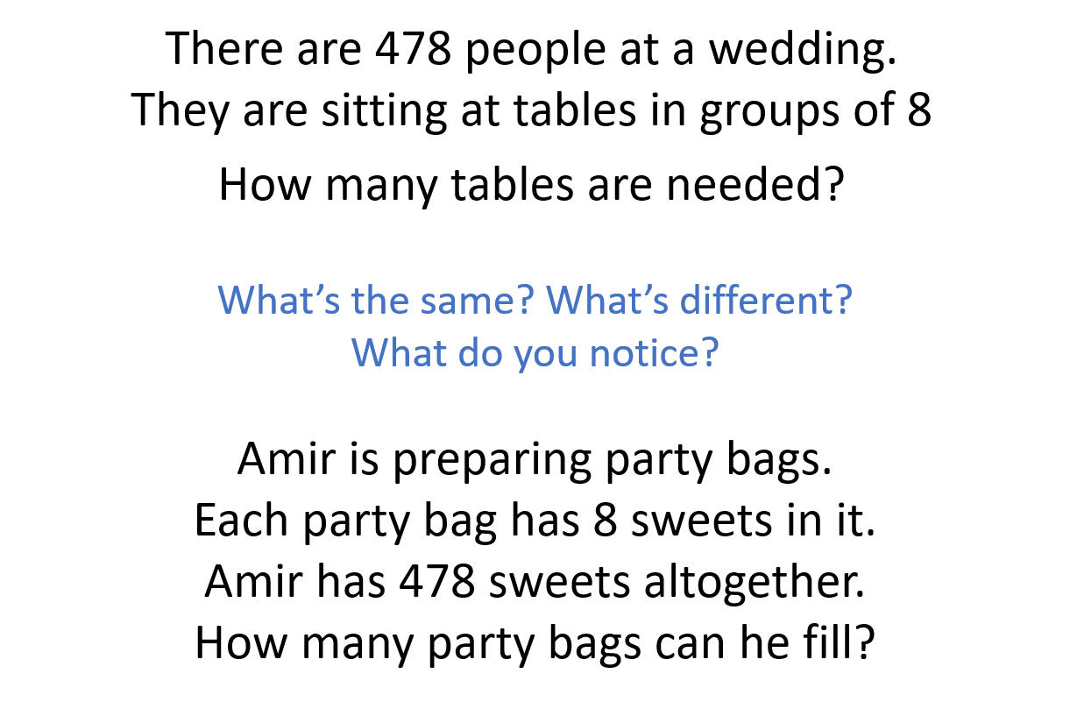
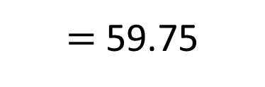
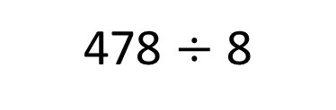
60 tables
59 party bags
8 | 4 | 7 | 8
0
5
r 6
9
478 $÷$ 8
$=$ 59.75
7

Slide 14
Have a go at the rest of the questions on the worksheet

Slide 15
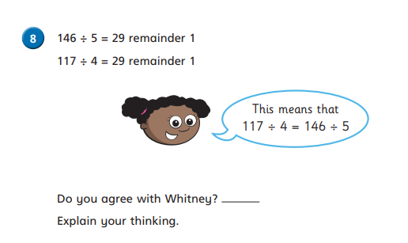

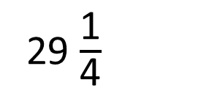
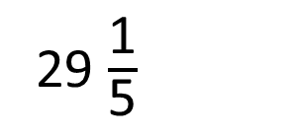
29 $\frac{\text{1}}{\text{5}}$
29 $\frac{\text{1}}{\text{4}}$
$$>$$
5 | 1 | 4 | 6
4 | 1 | 1 | 7
0
2
9
2
.
.
5
0
2
r1
9
2
4
1
3
1
2
.
0
.
0
0

