Slide 1
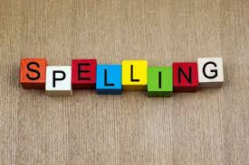
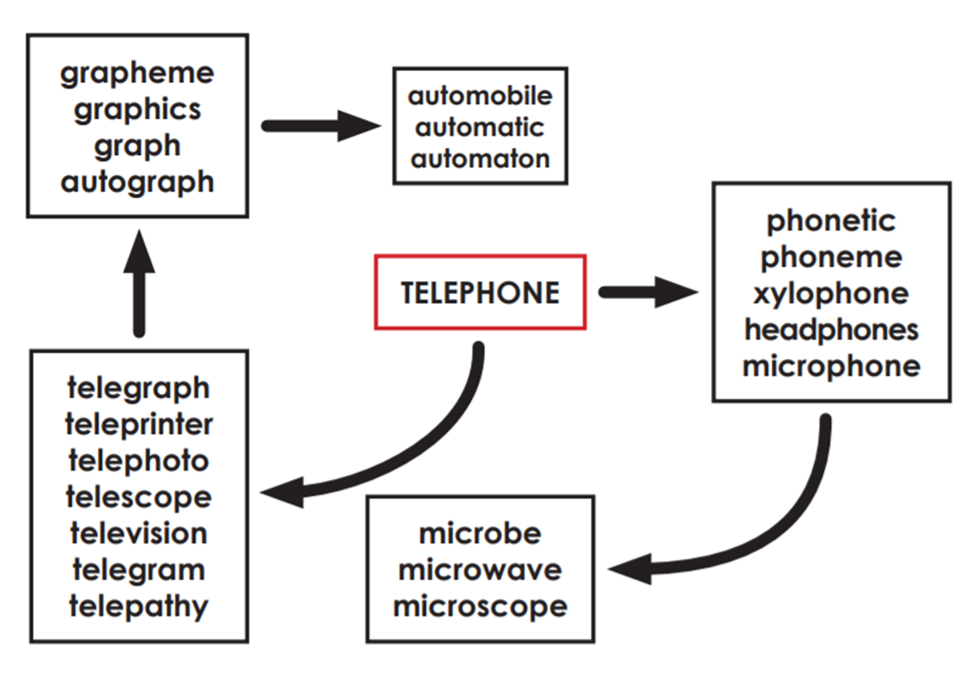
Spellings this week 8.1.21
telegraph
telegram
telephoto
telescope
television
phonetic
phoneme
xylophone
headphones
microchip
microphone
microscope
automobile
automatic

Slide 2
What do you notice about your spelling words?
How are they created?
How can you easily remember them?
Have a look at the next slide to see how they are all connected. What do you notice?

Slide 3
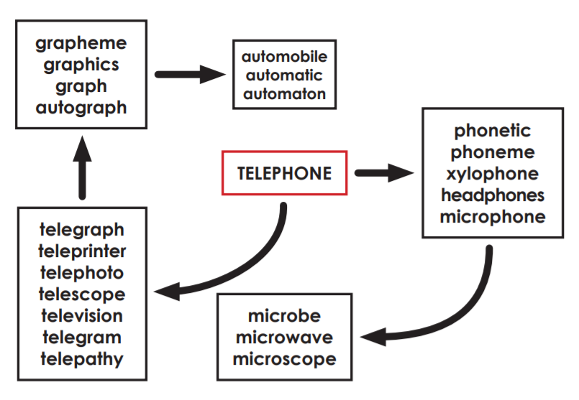

Slide 4
Let’s look at the word television.
Segmenting the word helps us to better understand it:
(at a distance ) tele vision (what you see)
The dictionary definition of the word is:
A system for converting visual images (with sound) into electrical signals, transmitting them by radio or other means, and displaying them electronically on a screen.

Slide 5
Activity
When you are learning your spellings, always use your dictionary to look up the meaning. This way you can better understand the word and how it is formed.
Use your dictionary to write a definition for each of your spellings.

