Slide 1
17 January 2020
LI: To understand the issues around the calling of Peter and Andrew by Jesus
Read Matthew 4: 18 – 20
https://www.bbc.co.uk/bitesize/clips/zbyr87h

Slide 2
Jesus Calls His First Disciples
¹⁸ As Jesus was walking beside the Sea of Galilee, he saw two brothers, Simon called Peter and his brother Andrew. They were casting a net into the lake, for they were fishermen. ¹⁹ “Come, follow me,” Jesus said, “and I will send you out to fish for people.” ²⁰ At once they left their nets and followed him.
Matthew 4 18-20

Slide 3
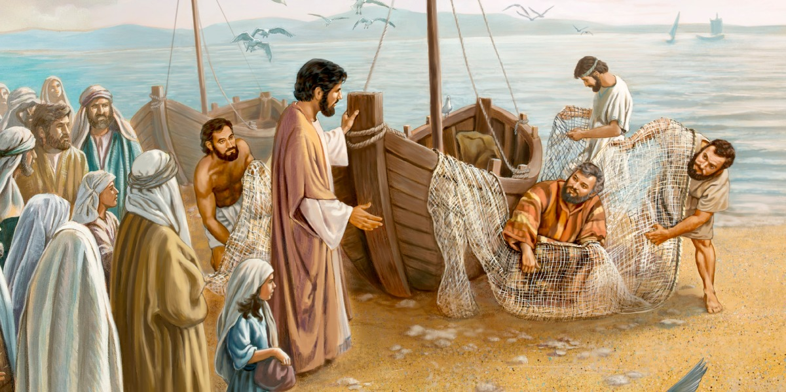
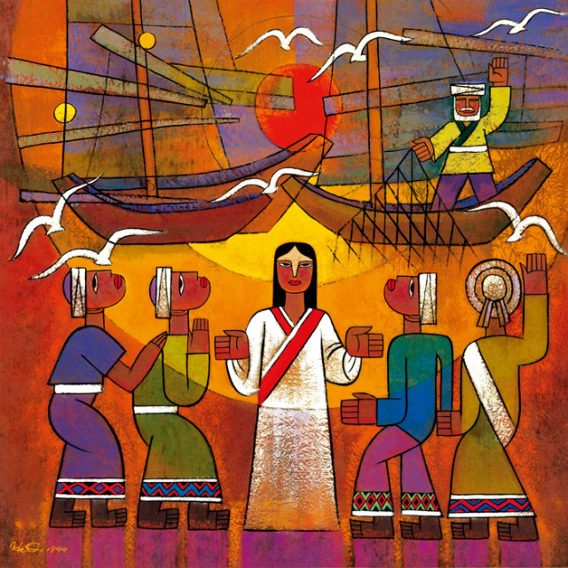
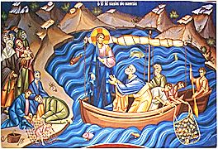
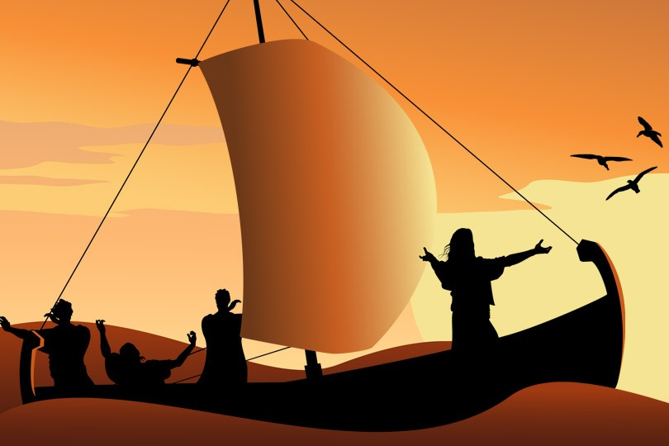

Slide 4
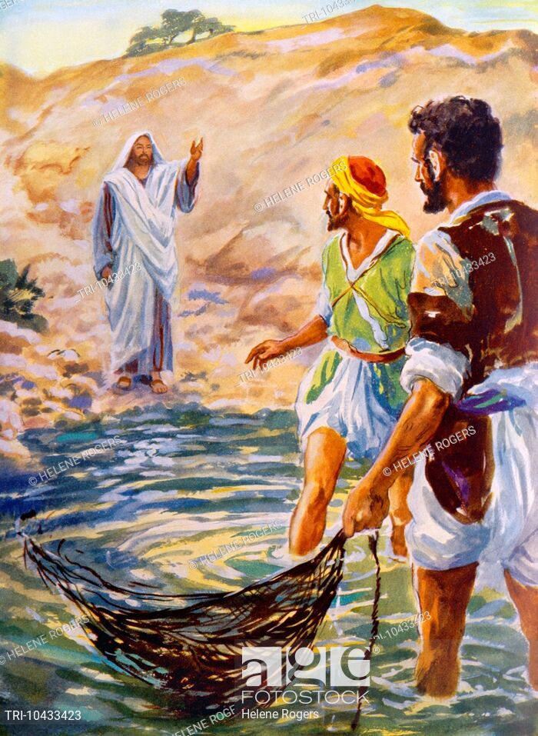
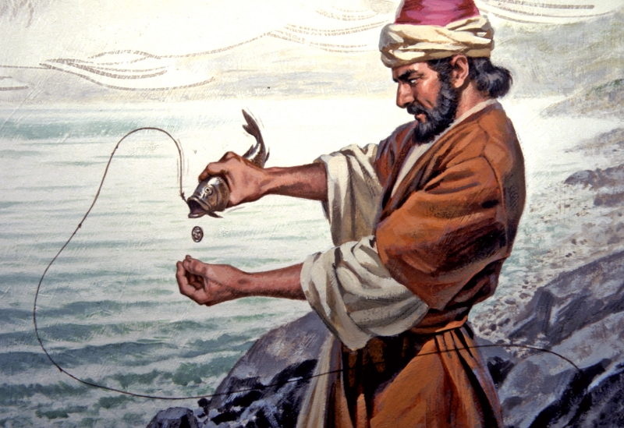
What do you think Peter and Andrew might have thought when Jesus approached them?

Slide 5


Draw and cartoon of the story and include the thoughts of Peter and Andrew using a thought or speech bubble.

