Slide 1
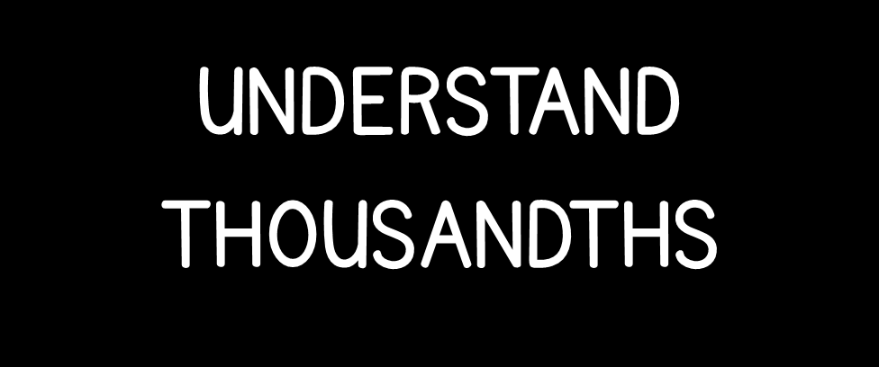

Slide 3



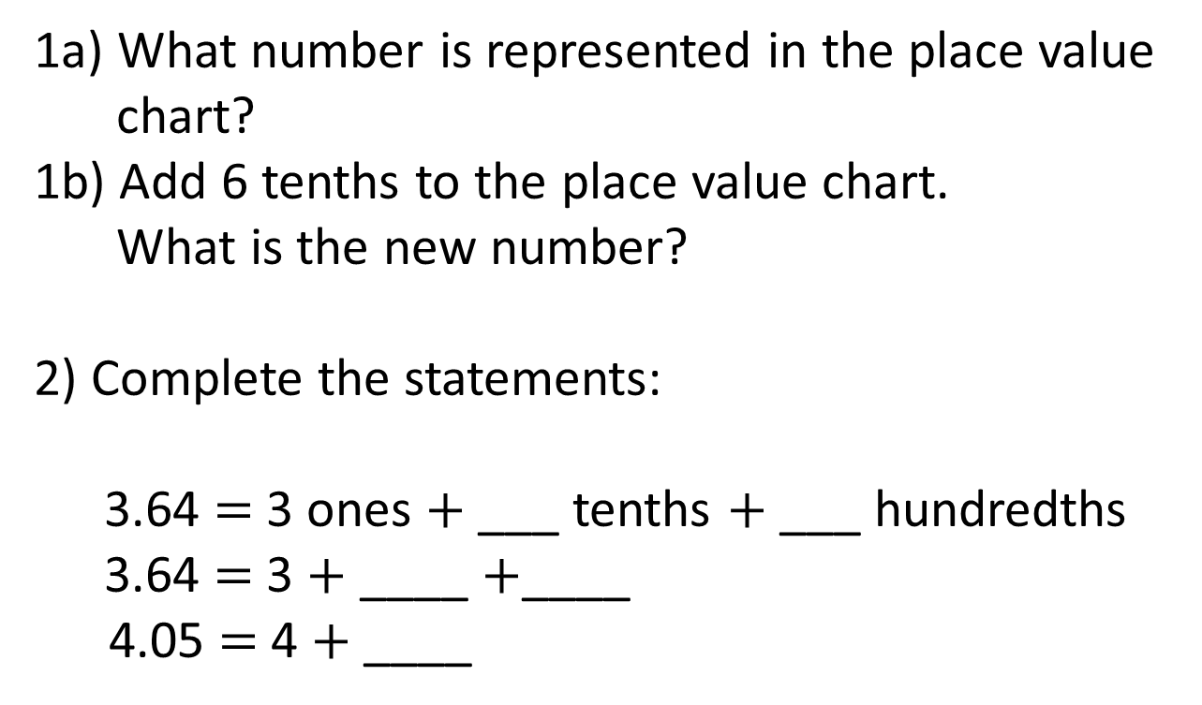
Tens | Ones | Tenths | Hundredths
1a) What number is represented in the place value chart?
1b) Add 6 tenths to the place value chart.
What is the new number?
2) Complete the statements:
3.64 $=$ 3 ones $+$ ___ tenths $+$ ___ hundredths
3.64 $=$ 3 $+$ ____ $+$____
4.05 $=$ 4 $+$ ____

Slide 4
Tens | Ones | Tenths | Hundredths
1a) What number is represented in the place value chart?
1b) Add 6 tenths to the place value chart.
What is the new number?
2) Complete the statements:
3.64 $=$ 3 ones $+$ ___ tenths $+$ ___ hundredths
3.64 $=$ 3 $+$ ____ $+$____
4.05 $=$ 4 $+$ ____
3.13
3.73
6
4
0.6
0.04
0.05

Slide 6




10 tenths $=$ 1 whole
10 hundredths $=$ 1 tenth
10 thousandths $=$ 1 hundredth

Slide 7
represents 1 whole
represents 0.01
represents 0.1
represents 0.001
2
0.6
0.09
0.003
2.693

Slide 8

represents 1 whole
represents 0.01
represents 0.1
represents 0.001
Have a think
1.306
1
0.3
0.006
1.36

Slide 9
Have a go at questions
1 - 2 on the worksheet

Slide 10
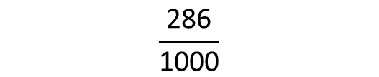
What fraction of the square has been shaded?
Write the fraction as a decimal.
$$\frac{\text{286}}{\text{1000}}$$
0.286

Slide 11
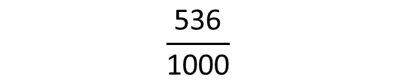
What fraction of the square has been shaded?
Write the fraction as a decimal.
$$\frac{\text{536}}{\text{1000}}$$
0.536
Have a think

Slide 12

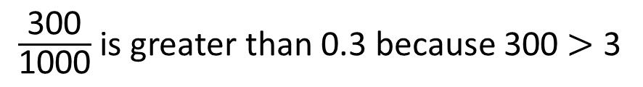
Have a think
$\frac{\text{300}}{\text{1000}}$ is greater than 0.3 because 300 $>$ 3

Slide 13
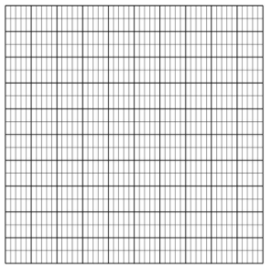
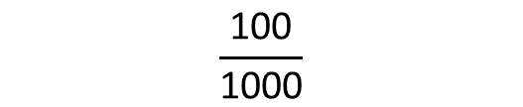
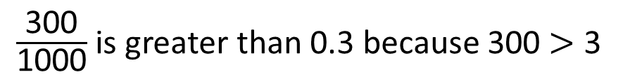
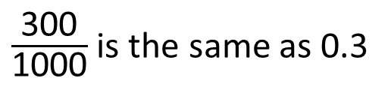

$\frac{\text{300}}{\text{1000}}$ is greater than 0.3 because 300 $>$ 3
$$\frac{\text{100}}{\text{1000}}$$
$=$ $\frac{\text{1}}{\text{10}}$
$\frac{\text{300}}{\text{1000}}$ is the same as 0.3

Slide 14
Have a go at the rest of the questions on the worksheet

