Slide 1


Slide 3

1) What fraction is represented on the bar model?
Can you write it as a decimal?
2) Complete the part whole models:
3) What is the value of the digit 6? 36.48
1
1
0.4
?
?
0.2

Slide 4
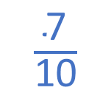
1) What fraction is represented on the bar model?
Can you write it as a decimal?
2) Complete the part whole models:
3) What is the value of the digit 6? 36.48
$\frac{\text{7}}{\text{10}}$
0.7
1
1
0.8
0.4
0.6
?
0.2
?
6 ones

Slide 6



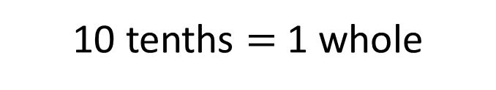

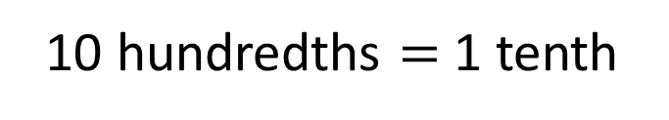
The frame is worth 1 whole
The frame is worth 1 tenth
What would each square be worth?
10 ones $=$ 1 ten
10 tenths $=$ 1 whole
10 hundredths $=$ 1 tenth

Slide 7
Tens | Ones | tenths | hundredths
There are 0 ones, 7 tenths and 2 hundredths.
The number is 0.72

Slide 8
Tens | Ones | tenths | hundredths
There are 3 ones, 1 tenth and 3 hundredths.
The number is 3.13

Slide 9

There are 3 ones, 1 tenths and 3 hundredths.
The number is 0.72
2.05
57.06
0.52
What is the value of the digit 5 in each of these numbers?
Have a think

Slide 10
There are 3 ones, 1 tenths and 3 hundredths.
Tens | Ones | tenths | hundredths
The number is 0.72
2.05
57.06
5 hundredths
5 tens
0.05
50
0.52
5 tenths
0.5
What is the value of the digit 5 in each of these numbers?

Slide 11
Have a go at questions
1 - 4 on the worksheet

Slide 12
0.93
Ones | tenths | hundredths
0.93
0.9
0.03

Slide 13
O | tth | hth
O | tth | hth
What’s the same? What’s different?
What do you notice?
Have a think

Slide 14
O | tth | hth
O | tth | hth
0.93
How many other ways can you partition 0.93?
0.93
0.9
0.03
0.8
0.13

Slide 15
Have a go at questions
5 - 6 on the worksheet

Slide 16

7 ones and 2 hundredths is 7.2 as a decimal.
Tens | Ones | tenths | hundredths
Have a think
7.02

Slide 17

Whitney has 4 digit cards.
1
5
2
3
She needs to place them all in the boxes below.
What’s the largest number Whitney can make?
What’s the smallest number Whitney can make?
How many different numbers can Whitney make?
Have a think

Slide 18
Whitney has 4 digit cards.
1
5
2
3
She needs to place them all in the boxes below.
What’s the largest number Whitney can make?
What’s the smallest number Whitney can make?
How many different numbers can Whitney make?

Slide 19
Whitney has 4 digit cards.
1
5
2
3
She needs to place them all in the boxes below.
What’s the largest number Whitney can make?
What’s the smallest number Whitney can make?
How many different numbers can Whitney make?

Slide 20
Whitney has 4 digit cards.
1
5
2
3
12.35
51.23
12.53
51.32
13.25
52.13
13.52
52.31
15.23
53.12
15.32
53.21
24 numbers can be made.

Slide 21
Have a go at the rest of the questions on the worksheet

