Slide 1

Spring Revision Unit 1
Word Classes (Session 1)
Sentences and their Punctuation (Session 3)
Letters in Harry Potter (Session 5)
Click on links to select topic or use cursor keys to move through PowerPoint in sequence.
Y6: Spring Revision Unit 1

Slide 2
Word Classes
1) Noun
2) Verb
3) Adjective
4) Adverb
5) Preposition
6) Determiner
7) Pronoun
8) Conjunction
What terms do you remember?
Can you tell a partner what they mean?
Can you give examples of any?
Y6: Spring Revision Unit 1

Slide 3
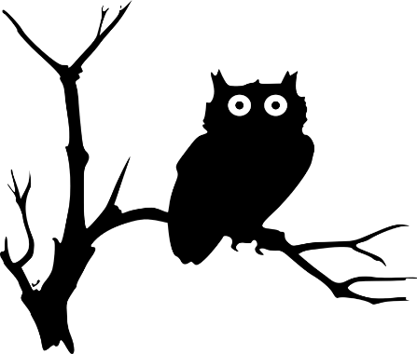
Nouns
A noun names a person, place, idea, thing or feeling.
a boy
the cupboard
an owl
a mystery
In front of a noun, we often have
a an the
determiners
Y6: Spring Revision Unit 1

Slide 4
Nouns
A noun names a person, place, idea, thing or feeling.
Proper nouns are shown using capital letters.
Harry
Privet Drive
Hedwig an owl
My favourite treat is a Chocolate Frog.
When a noun is a particular name it is called a
proper noun.
Y6: Spring Revision Unit 1

Slide 5
Verbs
Verbs indicate that someone or something is
doing, feeling or being.
Dursley blinked.
The cat waited.
They have a secret.
I wish!
Usually verbs have the name of a person or thing or a pronoun in front of them.
Y6: Spring Revision Unit 1

Slide 6
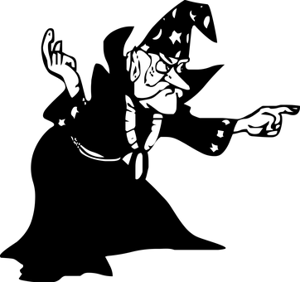
Adjectives
An adjective is a describing word.
It tells you more about a noun.
those funny clothes
some mysterious news
a nice, normal day
her pursed lips
The clothes were funny.
Adjectives sometimes come next to ‘their’ nouns…
but sometimes they do not.
Y6: Spring Revision Unit 1

Slide 7
Adverbs
An adverb tells you more about a verb.
sharply
casually
stiffly
horribly
fast
“No,” she said sharply.
He spoke as casually as he could.
His heart sank fast.
Which verb is being modified by the adverbs?
Y6: Spring Revision Unit 1

Slide 8
Adverbs
An adverb tells you more about a verb.
sharply
casually
stiffly
horribly
fast
“No,” she said sharply.
He spoke as casually as he could.
His heart sank fast.
An adverb can also add to an adjective.
Which verb is being modified by the adverbs?
He had a perfectly normal morning.
It was an obviously silly stunt.
adverb
adjective
noun
adverb
adjective
noun
Can you identify the noun, adjective and adverb?
Y6: Spring Revision Unit 1

Slide 9

Prepositions
Prepositions link a noun or noun phrase to a sentence.
There was a cat reading a map
on the corner.
Owls swooped
in broad daylight.
He yelled
at five different people.
He found it hard to concentrate
after lunch.
Prepositions tell us how words are related.
They can tell us about time, place and cause.
Y6: Spring Revision Unit 1

Slide 10
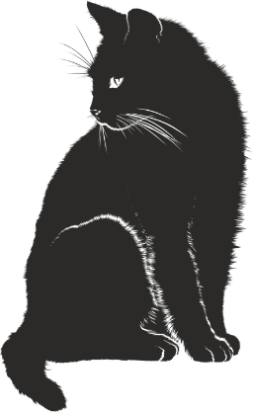
Determiners
Determiners stand in front of nouns.
They specify a noun.
A cat stood on the corner.
any cat
The cat stood on the corner.
a particular cat
That cat stood on the corner.
My cat stood on the corner.
a cat which belongs to…
Your cat stood on the corner.
Every cat stood on the corner.
Some cats stood on the corner.
a specified number of cats
Y6: Spring Revision Unit 1

Slide 11

Pronouns
Pronouns can stand in the place of a noun or noun phrase.
What pronouns could replace these nouns and noun phrases?
Y6: Spring Revision Unit 1

Slide 12
Pronouns
Pronouns can stand in the place of a noun or noun phrase.
He
them
What pronouns could replace these nouns and noun phrases?
Mr Dursley came into the room carrying two cups of tea.
He
her
Mr Dursley would have to say something to Mrs Dursley.
It
They
it
The news could not be ignored. Mr and Mrs Dursley needed to talk about the news.
Y6: Spring Revision Unit 1

Slide 13
Conjunctions
Co-ordinating conjunctions
and
but
or
Co-ordinating conjunctions join two words or clauses.
What conjunctions could be inserted
The cat sat and waited.
The cat might have been reading a map or he may have imagined it.
Subordinating conjunctions
when
while
before
because
so
if
unless
although
Mr Dursley was snoring but the cat was showing no sign of sleepiness.
Subordinating conjunctions introduce subordinate clauses.
It was nearly midnight before the cat moved.
What conjunctions could be inserted
A man appeared while the cat waited.
Because he sensed he was being watched, Dumbledore looked up.
Y6: Spring Revision Unit 1

Slide 14
Word Classes – Check your knowledge
1) Noun
2) Verb
3) Adjective
4) Adverb
5) Preposition
6) Determiner
7) Pronoun
8) Conjunction
verb
motorbike
preposition
landed
noun
on
determiner
Identify the Word Class
a
adverb
steadily
although
conjunction
adjective
huge
they
pronoun
Click to check.
Y6: Spring Revision Unit 1

Slide 15
Sentences and their Punctuation
What is a sentence?
How are sentences punctuated?
Do you know the different parts of a sentence or clause?
Y6: Spring Revision Unit 1

Slide 16

Sentences
Sentences make sense by themselves.
They need at least one main clause.
Each clause has an active verb.
Can you spot the active verb in each sentence?
They went to the zoo.
Harry ate an ice lolly.
It was cool in the reptile house.
Harry looked intently at the snake.
Was it nice there?
Y6: Spring Revision Unit 1

Slide 17


Sentences
Which of these are complete sentences?
ANSWERS
the snake
the snake opened its eyes
Harry glanced around but no one was looking
it winked
until its eyes were level with Harry
A complete sentence needs an active verb and something or someone doing that verb.
This is a subordinate clause. It has a subordinating conjunction at its head and does not contain a complete idea.
Y6: Spring Revision Unit 1

Slide 18
Sentences and their Punctuation
ANSWERS
We punctuate sentences to make our writing clearer.
A capital letter goes at the beginning and the end is indicated by…
a full stop, question mark or exclamation mark.
Punctuation does not make a complete sentence; it makes the beginning and ending clear.
not a complete sentence
Who did the verb?
H
.
he was late
watched them all day
she changed her mind
he wrote a letter
a low rumbling sound
S
.
H
.
How would you punctuate these?
not a complete sentence - a noun phrase.
Y6: Spring Revision Unit 1

Slide 19
Parts of a Clause
A clause is a group of words which contains a verb.
All verbs have a subject.
This clause is about Dudley.
The subject is what the clause is about.
Dudley threw
Harry opened
The cat watched
This clause is about Harry.
This clause is about the cat.
In some clauses there is something the verb acts on.
This is called the object.
Y6: Spring Revision Unit 1

Slide 20
subject verb object
Parts of a Clause
A clause is a group of words which contains a verb.
All verbs have a subject.
The subject is what the clause is about.
Dudley threw
Harry opened
The cat watched
the dinner
the envelope
The object is affected by the verb.
the Dursleys
In some clauses there is something the verb acts on.
This is called the object.
Y6: Spring Revision Unit 1
Notes:
NB: for teachers – This is true for sentences with active voice – with passive voice ‘Dudley threw the dinner’ would become ‘The dinner was thrown by Dudley’. ‘Dinner’ becomes the subject, the verb phrase is ’was chased’ and ‘Dudley’ becomes the ‘agent’. Dudley does not become the object because he is not affected by the verb.

Slide 21
subject verb object
Parts of a Clause
ANSWERS
Dudley opened the door.
He wore orange knickerbockers.
Aunt Petunia dried a tear.
Uncle Vernon nodded his head.
Harry sniggered.
Can you spot the subject, verb and object in each of these clauses?
The whole noun phrase can be counted as the object
‘the living room’, ‘orange knickerbockers’ etc.
some clauses do not have an object
Y6: Spring Revision Unit 1

