Slide 1

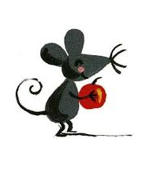
Le secret -
Par Eric Battut

Slide 2

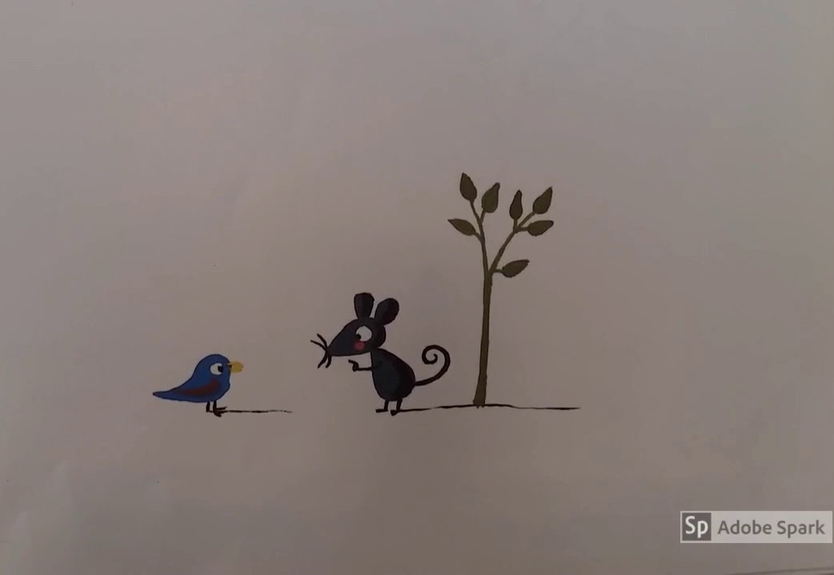
Qu’est-ce que tu as cache?
- What are you hiding?
C’est mon secret, je ne le dirai jamais.
It’s my secret and will never say.

Slide 3
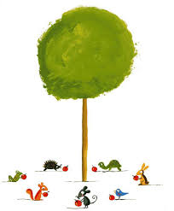
Can you remember any of the names of these animals en francais?

Slide 4

Le francais |  | L’anglais
La pomme |  | squirrel
L’ecureuil |  | hedgehog
La grenouille |  | bird
Le herisson |  | apple
La tortue |  | frog
Le lapin |  | mouse
L’ oiseau |  | tortoise
La souris |  | rabbit
Can you remember why some words begin with LA and others begin with LE ?
If a word begins with a vowel (a,e,i, o,u) it will begin with l’
L’ecureuil
L’oiseau
Match the pairs

Slide 5
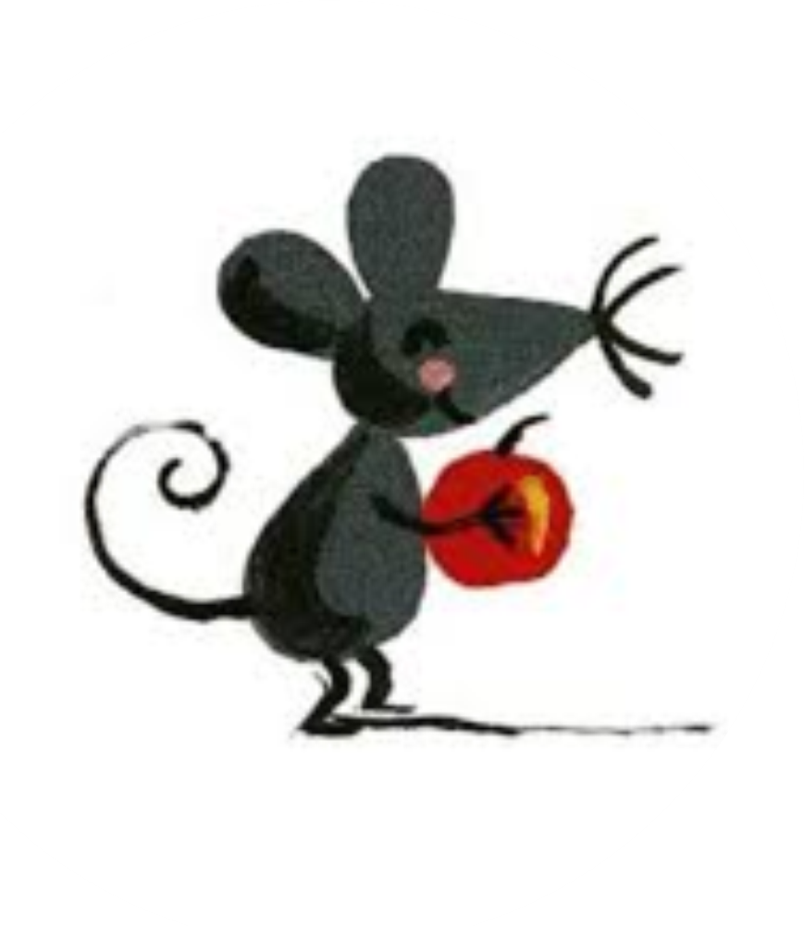
Why did la souris not want to tell the other animals what she was hiding?

Slide 6
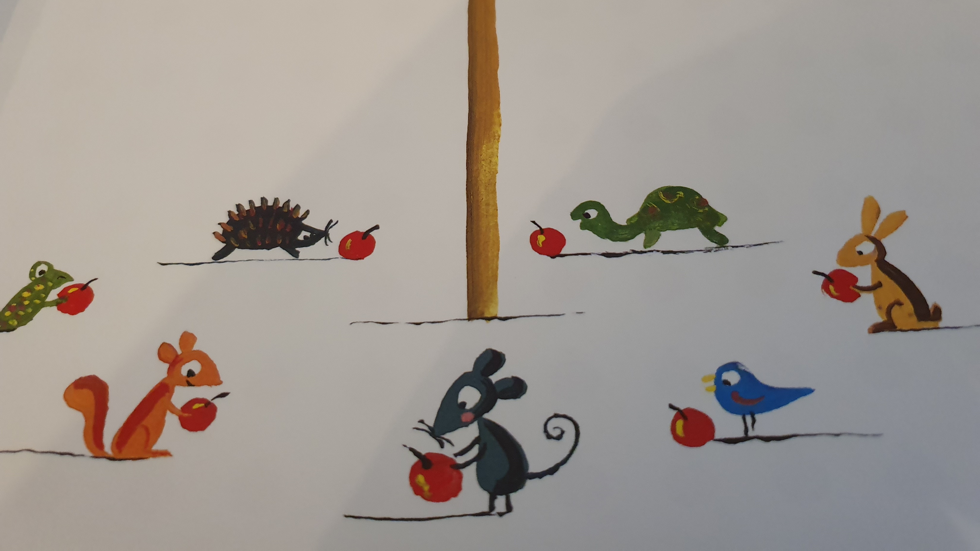
What happened in the end?

