Slide 1
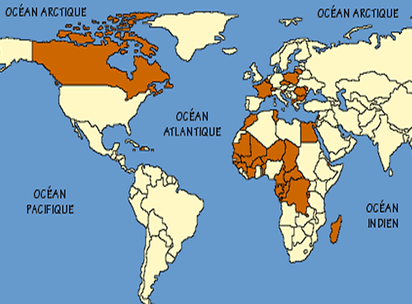
MOI DANS LE MONDE (ME IN THE WORLD)
This unit looks at the different countries around the world where French is spoken.
You will also review some language which you can use to introduce yourself.

Slide 2
Salut!
Je m’appelle Jasmina et j’habite a Dakar au Senegal.
J’ai douze ans.
Salut!
Je m’appelle Edouard et j’habite a Ottawa au Canada.
J’ai dix ans
Salut!
Je m’appelle Merwan et j’habite a Port-au-Prince en Haiti.
J’ai onze ans
Salut!
Je m’appelle Cecile et j’habite a Paris en France.
J’ai treize ans
Task 1: Here you can read about four children from different parts of the world.
Can you write down the translation of what they are saying.

Slide 3
Task 2:
Now practise introducing yourself in the same way (like this example):
Je m’appelle Madame Marshall
J’ai ….. ans
J’habite a Farnham en Angleterre.
L’Angleterre se trouve en Europe.
Je parle l’anglais
Je m’appelle…
J’habite…
Je parle…

Slide 4
Now … .go to the sheet attached on your home learning and link the four children mentioned on slide 2 to the map and complete a sentence for each.

