Slide 1
Expressing our Faith
Thank you for the lovely art work many of you have sent and uploaded illustrating the Apostle’s Creed. Well done for thinking carefully about what it was saying. I hope everyone will send or post their art work.
On the next page you will find the words of the Apostle’s Creed, read it again and imagine you are one of Jesus’ apostles saying it; how would it make you feel?

Slide 2
I believe in God the Father Almighty,
Maker of heaven and earth;
And in Jesus Christ his only Son our Lord:
Who was conceived by the Holy Spirit,
Born of the Virgin Mary,
Suffered under Pontius Pilate,
Was crucified, dead, and buried;
he descended into hell;
the third day he rose from the dead;
he ascended into heaven,
and sits at the right hand of God the Father Almighty;
from there he will come to judge the living and the dead.
I believe in the Holy Spirit,
the holy catholic church,
the communion of saints,
the forgiveness of sins,
the resurrection of the body,
and the life everlasting.
Amen

Slide 3
We have said that a creed is a statement of strong beliefs which significantly influence the way that a person lives their life.
On the next few pages are statements made by some famous people who have held strong beliefs. Read them carefully and see if you can identify what their beliefs are.

Slide 4
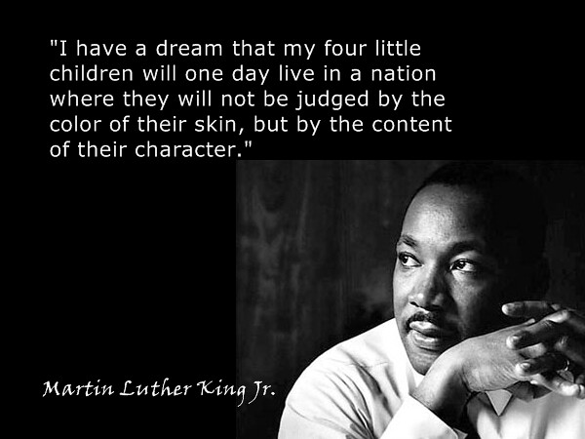

Slide 5
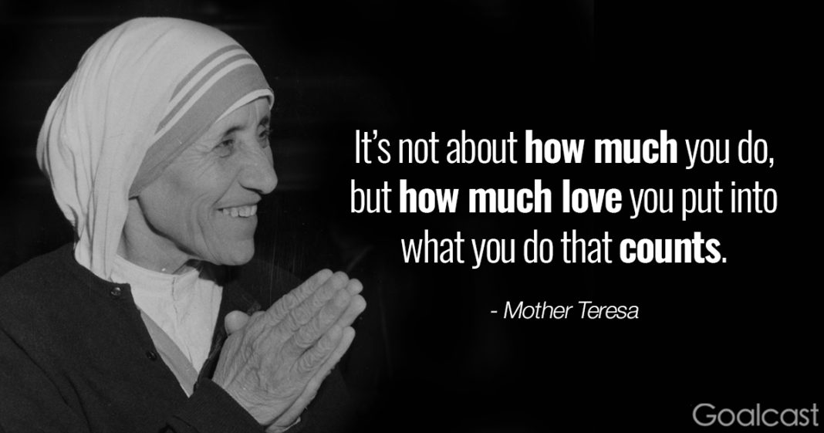
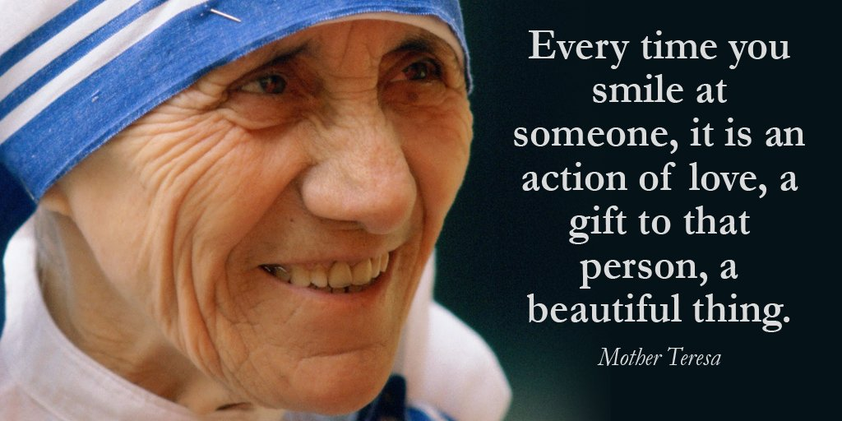

Slide 6
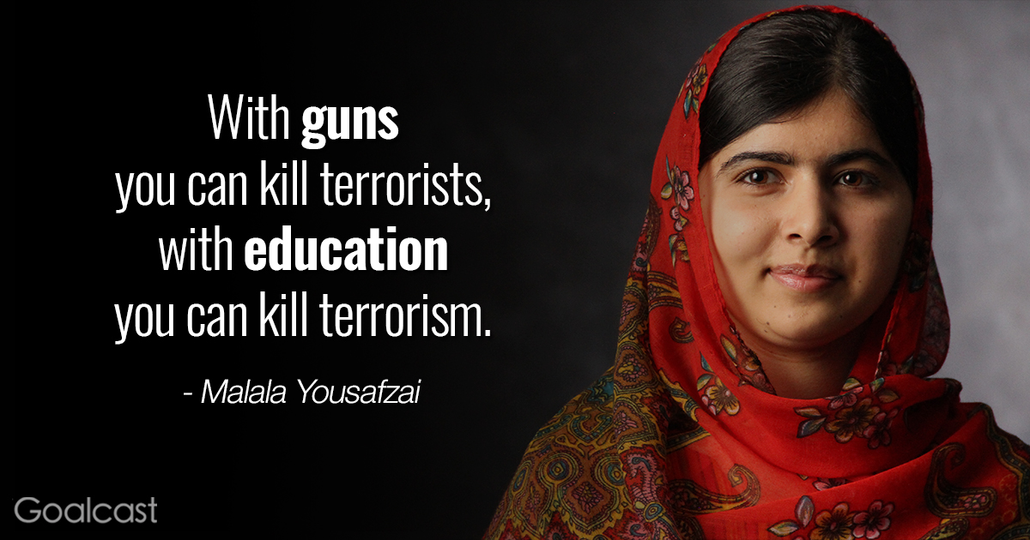


Slide 7
Your Task
Think about our school values, Active Citizen, Inclusiveness, and Courage.
Using the statements you have read to help you, write a short statement that clearly tells the reader what we believe is important at St. Peter’s School.
For example which of our values is this statement about?
“We believe every child should be allowed to take every opportunity they are given to be involved in and learn from new experiences.”
Write your statement, illustrate it using paint, pencils or collage, and send it to me (or better still post it on the Purple Mash RE blog for your class) by the 22nd May.
Enjoy your learning, Mrs. Bolton

