Slide 1
What is…
A herbivore?
A carnivore?
An omnivore?

Slide 2
We can also classify animals as:
predator or prey
A predator is an animal which kills and eats another animal.
Prey is an animal which is killed and eaten by another animal.

Slide 3
Classify animals as predators or prey. Give five examples of each.
Predators
Prey
Can animals be both?

Slide 4
As well as predators and prey, there are producers.
Producer :
Plants which produce nutrients by photosynthesis
Together, producers, prey and predators make up food chains.

Slide 5
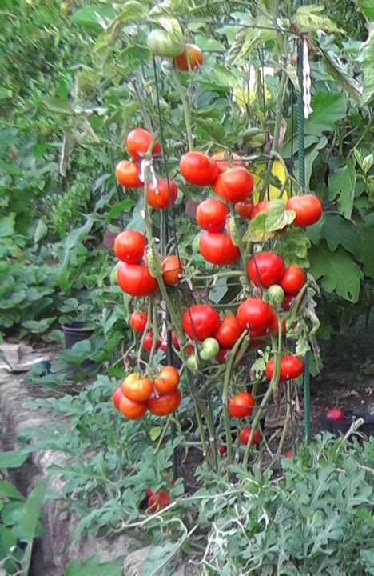
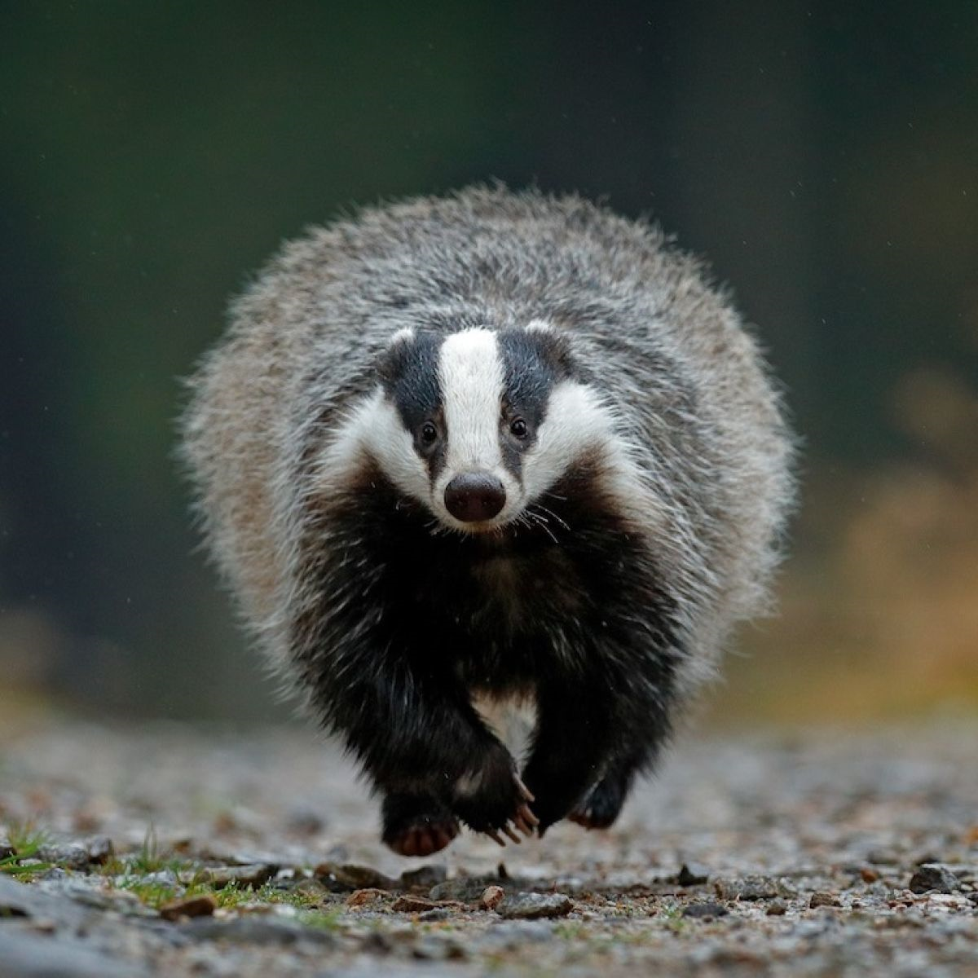
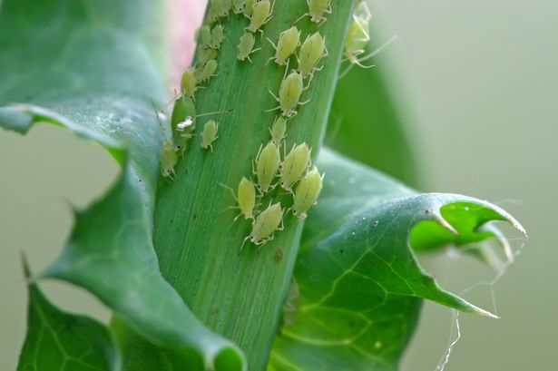
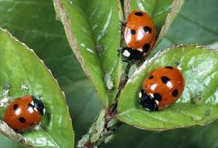
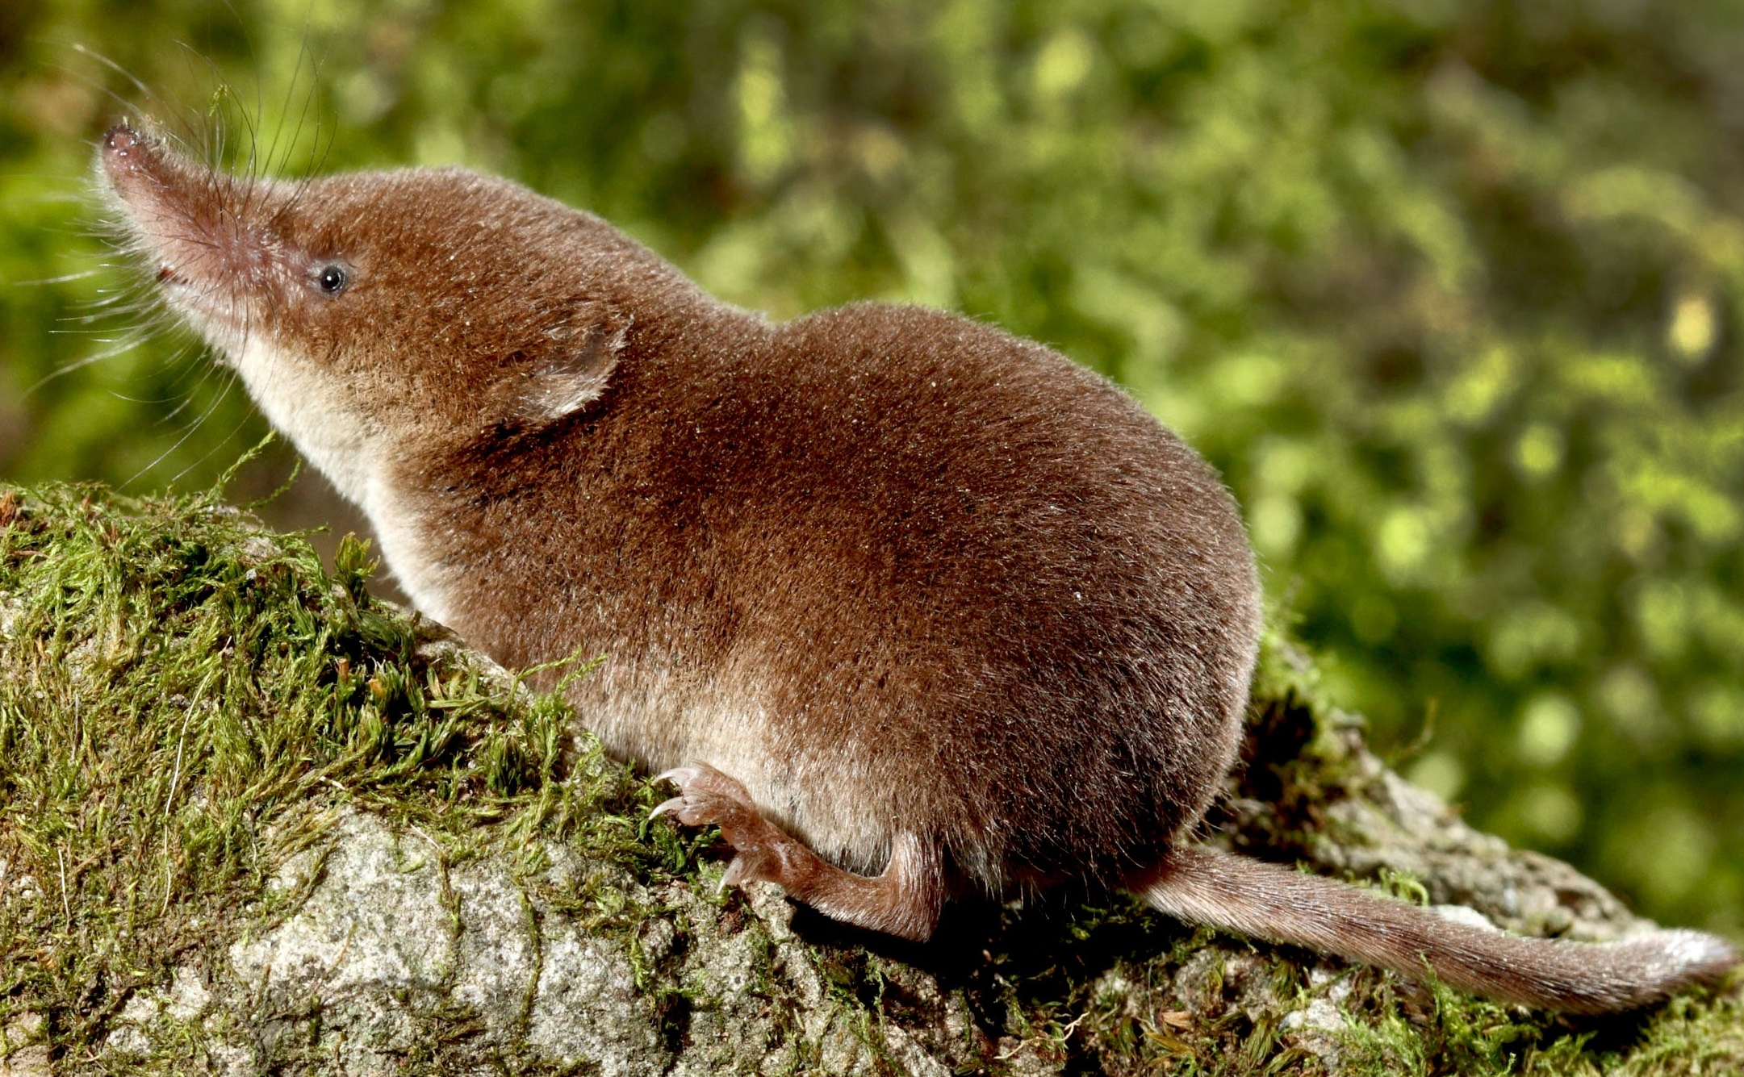
tomato plant greenfly ladybird shrew badger
The arrows point in the direction in which the energy goes up the food chain.
Food chains are linear (they go in a line).

Slide 6
In food chains, there are consumers:
Primary consumers are herbivores which eat the producer.
Secondary consumers are carnivores which eat animals.

Slide 7
Create your own food chains.
Look in your garden or when you go out to exercise, which food chains can you find.
Draw pictures of the producers and consumers with arrows to show the flow of energy.

