Slide 1

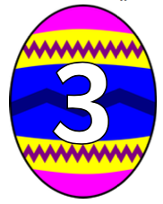
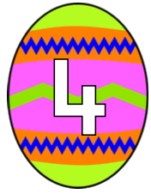
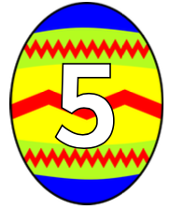
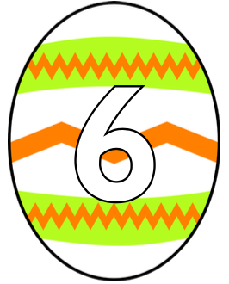

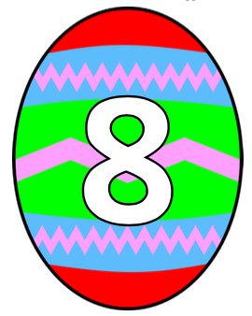
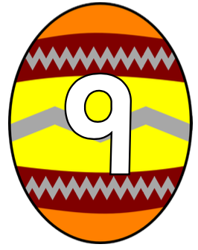

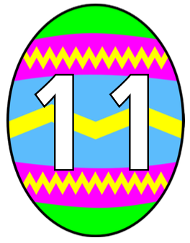
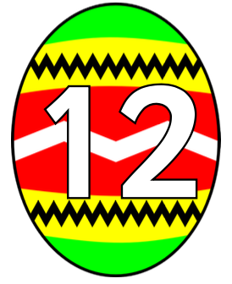

Slide 2
Eggs in the Nest: addition and subtraction
The addition game uses a pair of dice and an egg and nest game board. Two players sit opposite each other and place 10 counters on the numbered eggs on their side of the board. They now take it in turns to roll a pair of dice. The sum of the dots shown on the dice indicate a numbered egg on their board. If they have a counter on that egg, they place it in the nest.
The winner is the first to get all of their egg-counters in the nest.
Throughout the game the children are counting dots on the dice, determining the sum and also identifying the numeral that represents this value. If you want to introduce a little more strategic thinking into the game, then let the children placed their ten counters on any combination of the numbers at the beginning. At this point (if children are familiar with using dice) they may choose to place more counters on the middle numbers; 5, 6, 7, 8, 9 and avoid the ones that are more difficult to roll such as 2, 3 or 11.
The subtraction, or difference game uses a similar egg and nest game board and a set of 0 – 10 number cards. As before, the players place 10 counters on the eggs on their side of the board. This time, however instead of rolling dice they draw two number cards at random, turn them over and calculate the difference. It is this value which indicates an egg. If the player has a counter on that egg, he or she can place it in the nest. The winner is the first to get all of their egg-counters in the nest.

