Slide 1
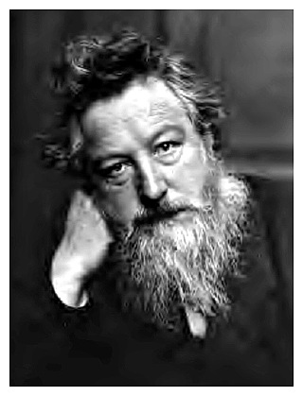
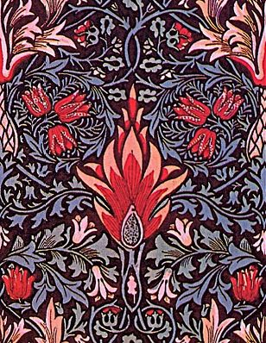
William Morris

Slide 2
William Morris was a leading member of the Arts and Crafts Movement. He is best known for his pattern designs, particularly on fabrics and wallpapers.
William Morris was an artist, designer, printer, typographer, bookbinder, craftsman, poet, writer and champion of socialist ideals.
Morris encouraged artists to look to the past for their inspiration believing that the art of his own age was inferior. Morris' solution was for a return to the values of the Gothic art of the middle Ages, where artists and craftsmen had worked together with a common purpose: to glorify God through the practice of their skills.

Slide 3
Morris was one of the great pattern designers. His classic designs are still commercially available as wallpapers and textiles. His patterns are inspired by his intimate knowledge of natural forms discovered through drawing.
Morris took the natural forms that he found outside in the woods and meadows and used them to decorate the inside of our homes.
His wallpaper designs were echoed in his textile, tapestry and carpet designs.

Slide 4
William Morris was a leading member of the Arts and Crafts Movement.
Morris is mostly known as a designer of patterns for wallpaper and textiles.
Morris was also an artist, designer, printer, typographer, bookbinder, craftsman, poet, writer and champion of socialist ideals.
Morris believed that the art and design of his own time was inferior and unworthy. He felt that this was due to the poor quality of life during the Industrial Revolution.
Morris believed that nature was the perfect example of God's design.
Morris believed that all design should be based on nature which he saw as the spiritual remedy to the inferior standards of art and design during the Industrial Revolution.
Morris said, "Have nothing in your house that you do not know to be useful, or believe to be beautiful."
Morris encouraged artists and designers to look back to medieval art for their inspiration as this was a time when artists and craftsmen worked together with equal status.
Morris founded the Kelmscott Press to create beautiful handmade books which would elevate the craft of printing to an art form.

Slide 5
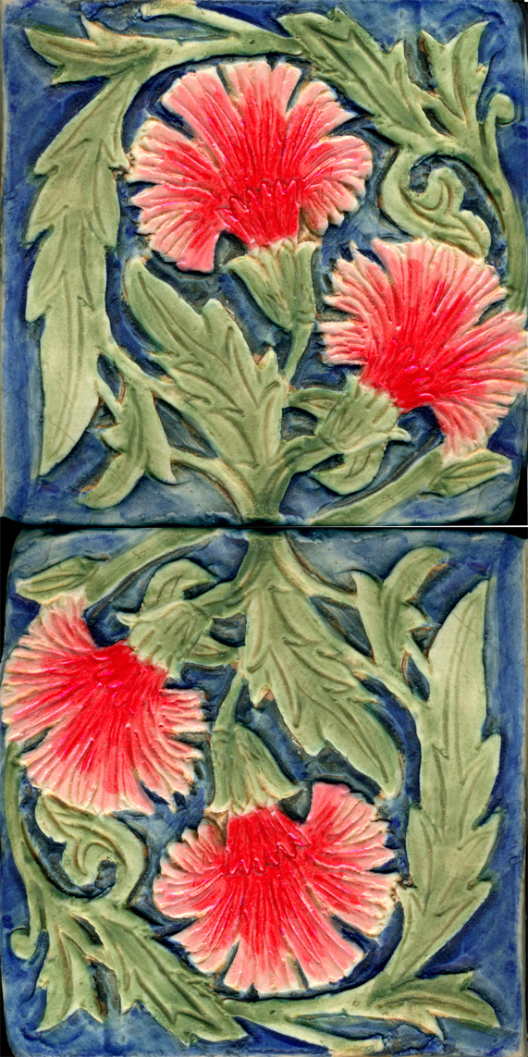
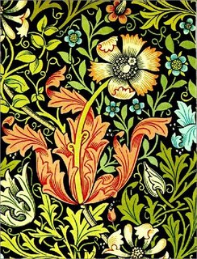
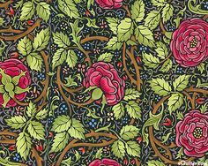
Where is the inspiration from for these designs?

Slide 6
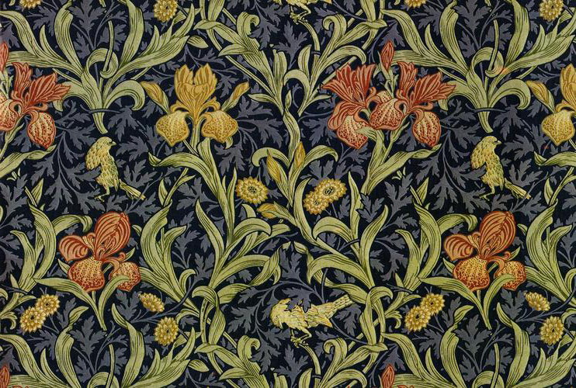
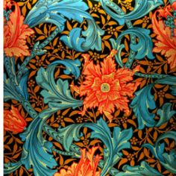
What colours, shapes can you see?

Slide 7
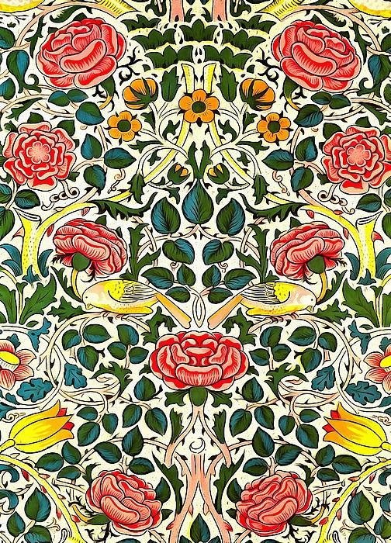
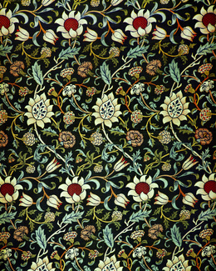
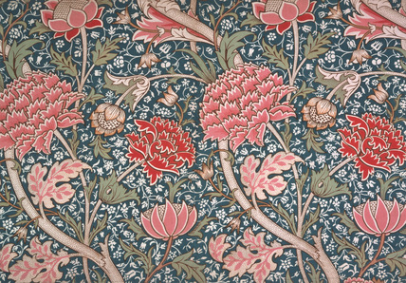
Can you spot a pattern in these designs?

Slide 8
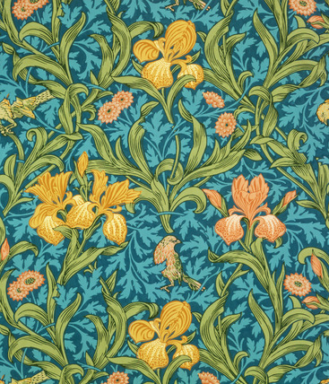
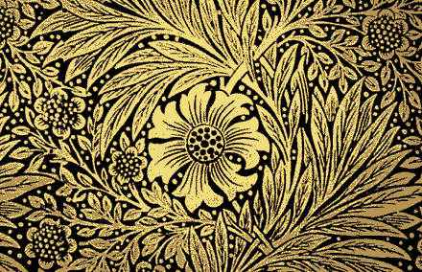

Slide 9
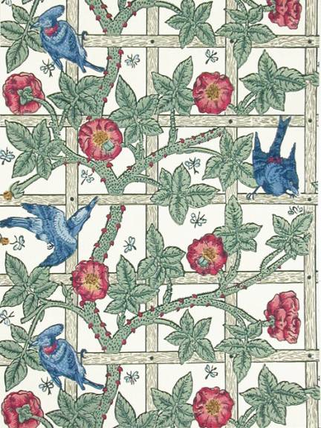
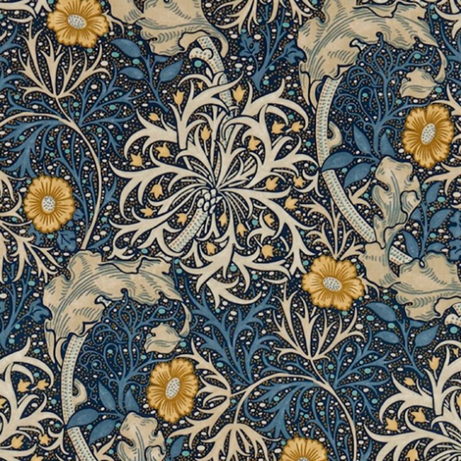

Slide 10
Create your own textile pattern inspired by nature, in the style of William Morris.
Colour it in using the types of colour palettes used by William Morris. Remember he only used natural dyes.

