Slide 1
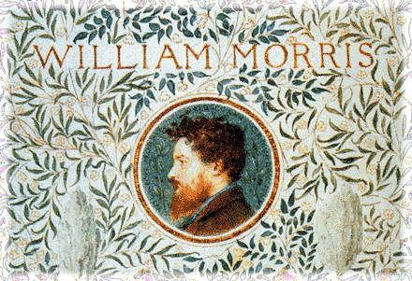
William Morris

Slide 2



Slide 3

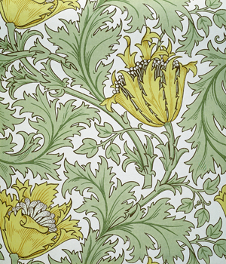

Slide 4



Slide 5



Slide 6
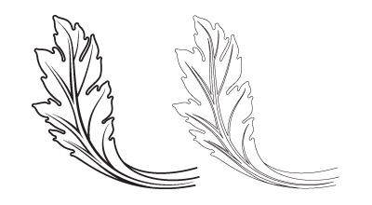



Slide 7



